Slide 1


The role of consumers in the uptake of decentralised energy storage technologies
Catherine S. E. Bale¹, Pepa Ambrosio-Albala¹, Andrew Burlinson², Monica Guilietti², Daniel Murrant³, Jonathan Radcliffe³,
Paul Upham⁴ and Peter G. Taylor¹
^{1 University of Leeds; 2} ­Loughborough University; 3 University of Birmingham; 4 Leuphana University

Slide 2
Overview
Background
Research aims
Methods
Results
Conclusions

Slide 3
Background
Decentralised energy storage (DES) could play an important role in addressing the twin challenges of meeting increased energy demand and integrating new forms of low carbon energy supply.
DES can deliver services including: matching supply and demand over periods from seconds to days; maximising the utilisation of existing and new infrastructure; providing links between heat and electricity systems and ensuring secure energy supplies.
To date, the technical development of DES has received a lot of attention - with new technologies (e.g. Tesla Powerwall) and aggregation platforms (e.g. Moixa’s GridShare) now available.
However, we have a limited understanding of the role that households and communities could play in owning or using DES.
The EPSRC funded C-MADEnS project has been undertaking interdisciplinary research on DES for the last three years.

Slide 4
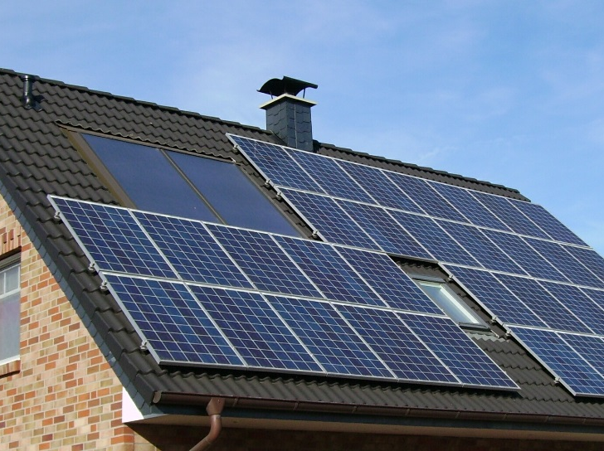
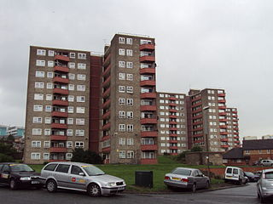
Aims of the research
To explore the role of consumers in the potential uptake of household and community-scale storage.
Focus on three distinct but interlinked aspects:
  1) public perceptions of decentralised energy storage;
  2) the likely non-traditional business models that will be appropriate for household ownership or use of storage; and
  3) the policy and regulatory barriers that these business models may face.

Slide 5
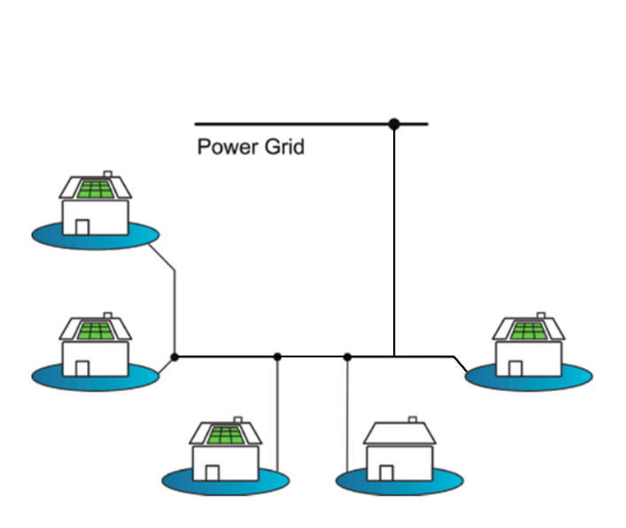
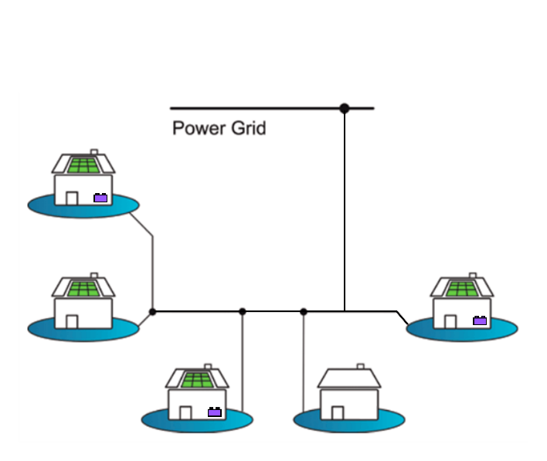
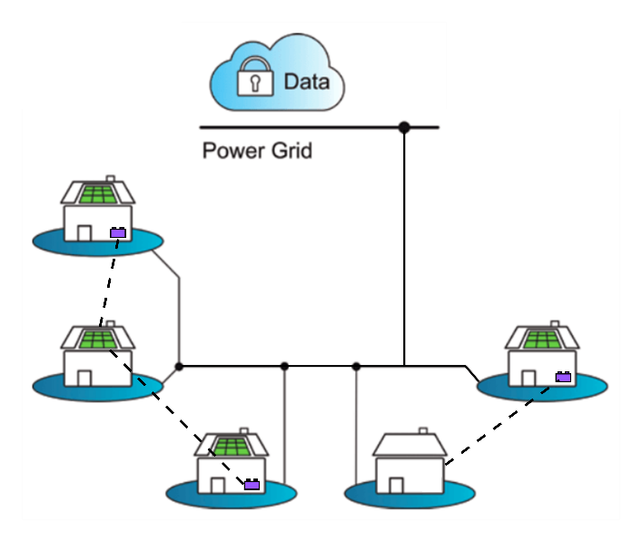
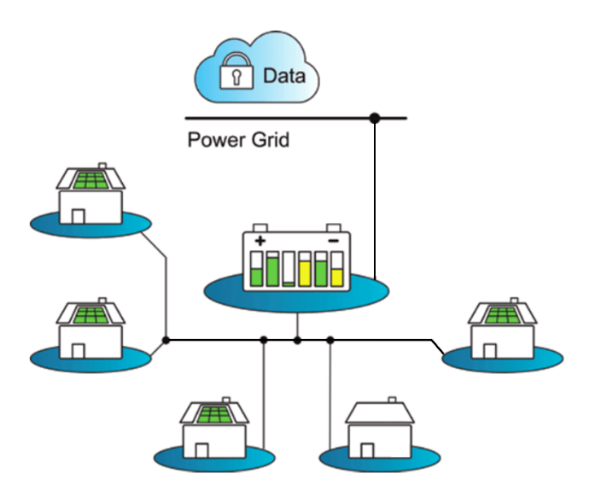
Household & community batteries
PV but no battery
PV with individual battery
PV with linked batteries
PV with community battery
Source: Andrew Pimm

Slide 6
Methods
Mixed methods approach combining:
Four focus groups with the public;
Nationwide survey of 949 households;
Reviews of business model case studies and international energy storage policy;
Semi-structured interviews with storage technology developers.
To understand public perceptions we applied an approach based on the Energy Cultures Framework (ECF) (Stephenson et al, 2010).

Slide 7
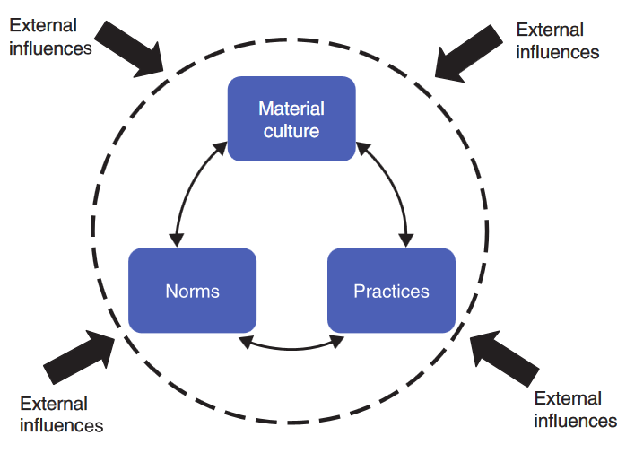
Understanding public perceptions
Available objects, technologies and individuals
HAVE
Expectations of a particular service
Everyday actions
THINK
DO
Energy Cultures Framework (Stephenson et al, 2010)

Slide 8
Results: public perceptions (1)
The general public is not currently well informed about either household or community-level DES.
  Only 19% of people were “familiar” or “very familiar” with energy storage in the home or community
Both local and central government are seen as playing an important role in delivering credible information and practical support to help householders adopt the technology or in delivering community-level schemes.
  Female 4: “Yeah, for your needs, the needs of your house, you know; this is how much electricity your solar panels have created; this is how much you’ve used. (…) to kind of assess how you live for a week, to see the peaks and troughs, when you use your electricity, to be able to work out that way what would benefit you better, using the electricity.”
  Male 5: “It would be about trust so I’d want somebody I could trust and I would like to think I could trust the information the government provided me rather than 1 of 50 companies that would be telling me I needed this when this company said I needed this.”

Slide 9
Results: public perceptions (2)
Yet, at the same time, a lack of trust in both public and private institutions may present a significant barrier and consumers’ experience (good or bad) with previous schemes, such as the installation of PV, can also be an important factor.
  Female 1: “(…) basically, both the council and the energy suppliers are going to be out for themselves, so somebody independent to both, who’s just there to tell you exactly what it is that you’re using, what you’re burning, what you’re saving..”
Under current market arrangements and with traditional business models, there is little financial benefit to householders from installing DES, even if they have PV installed and this presents a major barrier.
  Male 2: “I suppose at the end of the day it comes down to the fact what are the benefits for me and how long is it going to take me to get those benefits and to get back what I’m putting in. Ultimately I think that’s the way that most people are going to look at it.”

Slide 10
Results: Business models (1)
Stacking revenue schemes
Connected demand
Backup power
RE self consumption
Retail market arbitrage
System & network operators
ST operating service
Capacity mechanism
Black start
Fast reserve
FFR
EFR
Triads
Red zone avoidance
“…one of the things that has been revealed is that behind-the-meter storage has much greater access to stacking revenues …” -- (Chris Wright, Moixa)
Connected generation
Wholesale market arbitrage
Correct forecasting inaccuracy
Capture spilt energy
Source: based on Everose (2016)

Slide 11
Results: Business models (2)
Non-traditional business models for distributed energy storage
LAYER 1 | Off Grid Consumers | On-Grid Consumers | Private wire Consumers
LAYER 2 | Prosumer | Aggregators (+) |  | Community Groups | Municipal Suppliers |  | DNO 3rd Parties
LAYER 3 | Licence Lite Providers | Multiple Service Providers |  | Peer-to-Peer Specialists |  | Software Specialists |  | White Label Providers
Source: based on Burlinson and Giulietti (2018)

Slide 12
Results: Business models (3)
Interviews with technology developers found that their key priority was maximising benefits to consumers.
  “Our model works on the basis that we give the house everything it needs from the battery. So, saving all of its self-generating electricity and time-shifting off-peak electricity for the balance. Over and above that any extra battery capacity we can use for ancillary services.” -- (Peter Sermol, North Star Solar)
  “Obviously our first priority is ensuring that customers get maximum possible benefits from solar-storage because that is where a lot of the value lies and at the same time we are developing other models around services of one kind or another that will enable to offer extra benefits, extra revenues to the customer.”
  -- (Chris Wright, Moixa)

Slide 13
Results: Regulation (1)
Most consumers are on a flat tariff and therefore the value of using DES, even combined with PV, to engage in arbitrage is small.
The value of providing ancillary services may be greater but, at the moment, few consumers have direct access to this market.
However, the overall value of DES to the energy system is likely to increase as renewable technology deployment continues, and there may be wider societal benefits (i.e. positive externalities).
Policy and regulatory frameworks therefore need to evolve to prepare markets for these future developments and remove unnecessary barriers so that the economic value of DES can be realised in the future.
The UK has recently made some regulatory changes aimed at promoting storage, but still lags behind other countries.

Slide 14
Results: Regulation (2)
A review of experience in the United States (California, New York and Hawaii), Germany and Japan, identified a number of lessons:
Apart from Hawaii (which has very high energy prices) all the regions have subsidies to promote ES. The UK could consider some form of subsidised intervention; e.g. a direct energy storage subsidy, or competitive auctions.
The value of rooftop PV can be enhanced with the introduction of ES and so promoting batteries alongside solar PV can provide a route to market, as has happened in Germany.
California and New York have used load shifting programmes to promote electrical and thermal energy storage. A load shifting programme in the UK could promote battery storage, helping to reduce congestion on the network at times of peak demand.

Slide 15
Conclusions
The general public is not currently well informed about DES.
A lack of trust in both public and private institutions is a key issue.
But both local and central government seen as a source of credible information and practical help.
A key barrier is cost; there is little financial benefit of DES to the householder under current market arrangements and traditional business models.
Profitable business models may arise if they are able to successfully ‘stack’ several revenue streams and/or have the option to trade energy with their peers.
Changes to the regulatory system, combined with a range of innovative business models that access new sources of revenue, would provide greater incentives for the uptake of DES.

Slide 16
Further information
Email: p.g.taylor@leeds.ac.uk
Project website: www.c-madens.org

