Slide 1



Energy Cooperatives: A Missing Piece of the Peer-to-Peer Energy Regulation Puzzle?
Alexandra Schneiders, David Shipworth
UCL Energy Institute
BIEE 2018, Oxford

Slide 2
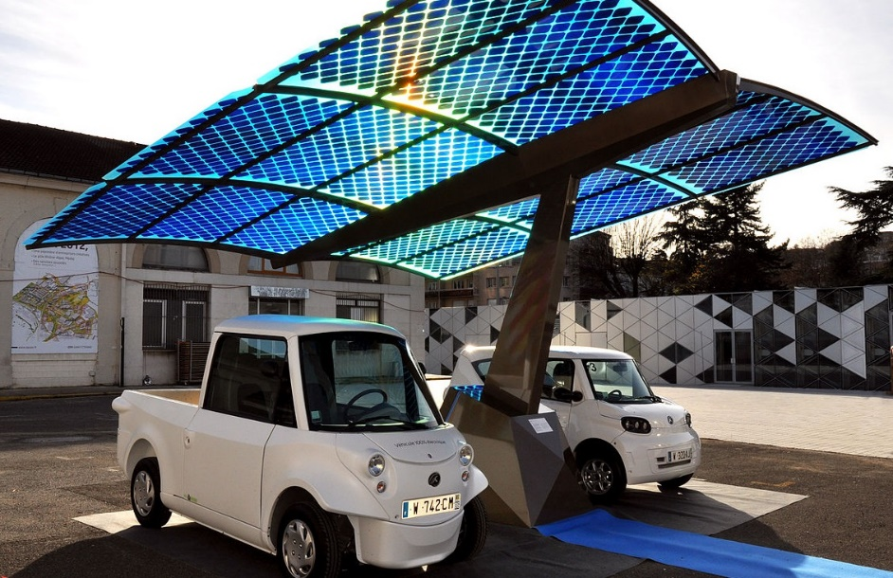
Outline
I. INTRODUCTION
Blockchain and energy
II. ENERGY COMMUNITIES IN THE UK
The importance of incorporation
Co-operative Societies
Limited Liability Partnerships
III. METHOD
IV. LEGAL CHALLENGES
Data privacy
Smart contracts
Prosumer rights
V. CONCLUSION

Slide 3
I. INTRODUCTION
Context:
Decentralising energy grid.
Distributed ledger technology (e.g. blockchain) to balance supply and demand.
Lack of legal clarity on application of data privacy, contract and consumer law to individual use of blockchain technology.
Paper:
Would grouping consumers into one legal entity remedy these legal challenges?
Research question: How can UK energy communities, as they are currently legally recognised, shield consumers from the main challenges presented by individual use of blockchain for peer-to-peer energy trading?

Slide 4
Blockchain and energy
Cheaper RES technologies: rise in domestic consumers generating, storing and selling renewable energy.
Challenging for grid to manage the injection of intermittent energy, when it is designed for unidirectional flow.
Consequence: higher grid management costs.
Potential solution for balancing of demand and supply at local level: ‘peer-to-peer’ energy trading using distributed ledger technologies (e.g. blockchain).
Permissioned vs public blockchain (e.g. Bitcoin).

Slide 5
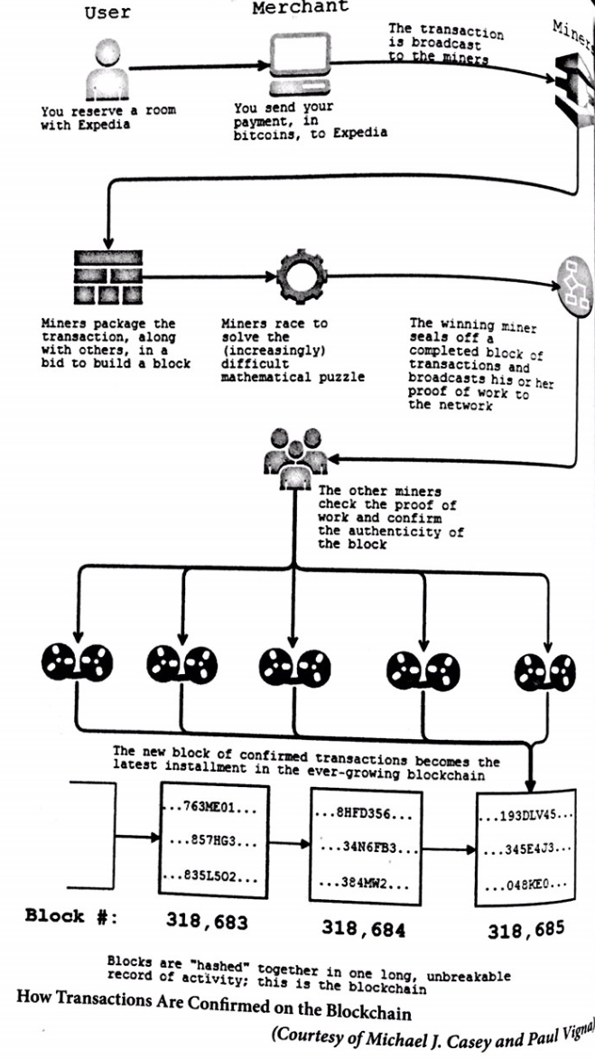
Blockchain:
Cryptographic proof of ownership.
Transactions recorded and stored sequentially in an unalterable chain of data blocks.
All network participants (‘nodes’) hold a constantly updated copy of the blockchain.
Computational power provided by ‘nodes’ to verify new transactions and update the ledger.
Added functionality (Ethereum blockchain): ‘smart contract’.
Source: The Age of Cryptocurrency (2015), P. Vigna & M. Casey

Slide 6
Blockchain and energy (cont’d)
April 2016: first peer-to-peer energy trade (Brooklyn Microgrid).
Since then, significant increase in peer-to-peer energy trading pilots within communities.
In Europe, Goiener (energy cooperative in Spain) and Repowering London (see next slide).
How does it work?
Connected smart meter: imported and exported electricity is measured and recorded by the blockchain system.
Based on data, system matches buyers and sellers of self-generated renewable energy and then settles financial transactions between them.

Slide 7
Repowering London (UK)
Not-for-profit organisation facilitating community energy projects.
Part of consortium trialling a local peer-to-peer blockchain-enabled energy trading platform in London (Brixton).
Urban residents living in apartment block with solar PV on the roof.
Sell or donate energy to neighbours through a blockchain network.
Within framework of Ofgem regulatory sandbox.

Slide 8
II. ENERGY COMMUNITIES IN THE UK
Several legal forms available.
Most popular in England, Wales and NI in 2017: Community Benefit Societies (47%), Co-operative Societies (19%) and Community Interest Companies (13%).
Not applicable: Community Benefit Societies (BenComs) and Community Interest Companies (CICs) → required by law to invest their profits into the wider community.
Applicable: Co-operative Societies and Limited Liability Partnerships (LLPs) → primarily set up to benefit their own members.

Slide 9
The importance of incorporation
Legal identity is created for an organisation that is distinct from its members.
Separate person in the eyes of the law, with different rights and duties to members (i.e. can own land, sign contracts).
Limited liability of members: share risk more evenly between themselves.

Slide 10
Co-operative Societies
Co-operative and Community Benefit Societies Act 2014.
“An autonomous association of persons united voluntarily to meet their common economic, social and cultural needs and aspirations through a jointly owned enterprise” (International Co-operative Alliance).
Not meant to carry on business with the object of “making profits mainly for the payment of interest, dividends or bonuses”.
‘Rules’ (governing document) are binding on members, and contravention thereof punishable.
Members may include corporate bodies.
FCA has allegedly stopped registering these since 03/2014.

Slide 11
Limited Liability Partnerships (LLP)
Main legislative Act → Limited Liability Partnerships Act 2000.
Formed by two or more natural/legal persons carrying on a “lawful business with a view to profit”.
‘Agreement’ (governing document) is not compulsory and can be kept confidential.
Members are taxed separately.

Slide 12
III. METHOD
Aim of paper:
To assess and advise on current legal challenges presented by blockchain to individual consumers, as well as how the legal recognition of energy communities may shield them from such risks.
Sources: secondary literature, legislation and stakeholder interviews.
Process:
Extensive literature review to scope out main legal challenges.
Review UK and EU consumer, energy, contract and data privacy law to shape analysis.
In parallel: stakeholder interviews (REScoop, Repowering London, Goiener) to guide direction of paper.

Slide 13
IV. LEGAL CHALLENGES
Data privacy
Smart contracts
Prosumer rights

Slide 14
A) Data privacy
Challenge: Blockchain is not recognised in UK data privacy law.
Context:
GDPR is applicable in the UK since 25 May 2018 and will remain so post-Brexit.
Scope → personal data: “any information relating to an identified or identifiable natural person”. Pseudonymous but not anonymous data.
Issues:
Article 29 Working Party: encryption and hashing are pseudonymisation techniques.
Right to be forgotten (Article 17), for data to be corrected (Article 16) etc. → clash with blockchain’s immutability.
Obligations on controllers and processors of data- who are these in a blockchain?

Slide 15
Role of legal entities
Private blockchain run by legal entity (controller). Processor is blockchain platform provider.
Members are mostly natural persons → GDPR to be enforced by legal entity.
Storing data off chain is solution.
What about public keys? Impossible to store them off chain since they are indispensable for transaction validation. Options available (‘ring signatures’).
No legal certainty on whether these techniques constitute ‘anonymisation’. No legal certainty on rights and obligations (e.g. ‘erasure’), nor roles of blockchain actors.
Conclusion:
All parties would willingly take risks. Governing document could try to limit damage. Legal entity is ultimately responsible.
Legal entities such as Co-operative Societies and LLPs would not remove the risk of data privacy infringement for individual consumers.

Slide 16
B) Smart contracts
Challenge: Smart contracts are not recognised in English contract law.
Context:
Transaction that self-executes when parties’ (pre-programmed) terms are met.
Once executed, all network parties see transaction and it cannot be tampered with.
P2P energy trading: smart contracts are programmed by members of energy community to trade/donate when X terms are met (e.g. price to be paid for energy). When terms match, financial transaction automatically takes place.
Issues:
A smart contract can be considered a ‘contract’ under UK law → agreement reached; consideration; intention to create legal relations; certainty/completeness of terms.
Once executed, they are immutable and cannot be undone → Cannot keep up with changing circumstances (something which is foreseen in contract law).
Increased role of third party intervention and mediation/arbitration.

Slide 17
Role of legal entities
Members will be personally liable for smart contracts.
They will need to mention contract terms in a separate (reviewed) document, kept off the blockchain and referred to in the smart contract.
Governing document of Co-op or LLP should include a ‘participating agreement’, making off-chain document compulsory and specifying third party intermediary.
Conclusion:
Avoid conflicts and misunderstandings between community members by binding them to governing document (particularly Co-op Society → fines).
Legal entities such as Co-operative Societies and LLPs would help shield consumers from the risks posed by a lack of legal clarity on smart contracts.

Slide 18
C) Prosumer rights
Challenge: Domestic energy consumers producing their own energy (‘prosumers’) are not recognised in UK consumer law.
Context:
Distinction between ‘traders’ and ‘consumers’ in (B2C-centric) consumer law becomes blurred in the case of prosumers.
Little clarity in UK/EU consumer law (this will change w/ revision of EU energy legislation).
Issues:
UK gvt: no plans to extend consumer law to C2C transactions, since “both parties…have equal status and should therefore have the freedom to contract as they wish”.
Online C2C transactions → is the position of parties really ‘equitable’?

Slide 19
Role of legal entities
Members will be individually responsible for transactions.
To maintain members’ trust and ensure their well-being, the legal entity should formulate rules around platform use together with community members. Include these in governing document.
Shared burden between the legal entity and its members → ‘self regulation’ approach; more suitable than B2C-centric consumer law.
Conclusion:
Legal entity’s governing document ensures the protection of prosumer rights (particularly Co-op Society → fines).
Legal entities such as Co-operative Societies and LLPs would help shield consumers from the risks posed by the lack of legal recognition of prosumer rights in consumer law.

Slide 20
V. CONCLUSION
Co-ops and LLPs unable to resolve data privacy issues around individual blockchain use.
Smart contracts and prosumer rights: Co-ops and LLPs can play a significant role in shielding consumers from risks, particularly in light of a lack of legal clarity.
Co-operative is best option, since its governing document is binding on its members and infringements are punishable.
Limited liability aspect: only plays a minimal role, in the case of data privacy.
Recommendations:
Recognise that an increasing number of energy communities will start P2P trading with DLTs such as blockchain (enhances the uptake of RES by e.g. urban residents with little space).
Anticipate this by amending recognition process of Co-ops/LLPs, as well as the applicable law. Roll back funding cuts.
Legal entities will play a key intermediary role in the ‘bottom up’ regulatory approach observed in P2P markets.

Slide 21
VI. ACKNOWLEDGEMENTS
This work has been supported by the EPSRC grant PETRAS Internet of Things (IoT) Research Hub under the project The Internet of Energy Things (‘P2P-IoET’). The authors would like to thank the interviewees (Repowering London, REScoop and Goiener), as well as Professor Iris Chiu (UCL Faculty of Laws) and Dr Michael Fell (UCL Energy Institute) for their valuable input.

Slide 22
Thank you for your attention!
Any questions?

