Slide 1
BIEE European Conference 2018
Prosumage of solar electricity: batteries, heating and mobility
Wolf-Peter Schill, Alexander Zerrahn, Michael Pahle
Oxford, September 18, 2018

Slide 2
Overview
Introduction
The model
Input data
Results
(Preliminary) Conclusions and future research

Slide 3
Introduction
1
Background: Our article in IAEE’s EEEP (2017)
  Qualitative discussion of prosumage from an
  economic perspective
  Quantitative illustration of selected system effects
  Focusing on battery storage and
  different operational strategies
  https://doi.org/10.5547/2160-5890.6.1.wsch
  Updated version forthcoming as a book chapter in „Energy Transition – Financing consumer (co-)ownership in renewables“, Lowitzsch, J. (Edt.), Palgrave Macmillan
  Extension: prosumage and sector coupling [work in progress]
  People may increase self-consumption also by electric heating or electric mobility
  We look at electric storage heaters and battery-electric vehicles
  Evaluation of system effects compared to batteries

Slide 4
PRO-SUM-AGE und prosumagers
1
How we define PRO-SUM-AGE
  PROduction of renewable electricity (PV)
  ConSUMption of self-generated electricity
  StorAGE to temporally align supply and demand
Prosumagers
  produce their own renewable (PV) electricity at times,
  draw electricity from the grid at other times,
  feed electricity to the grid at other times,
  and make use of storage (stationary batteries, vehicle batteries, heat storage)
  Self-consumption vs self-generation
Source: own illustration

Slide 5
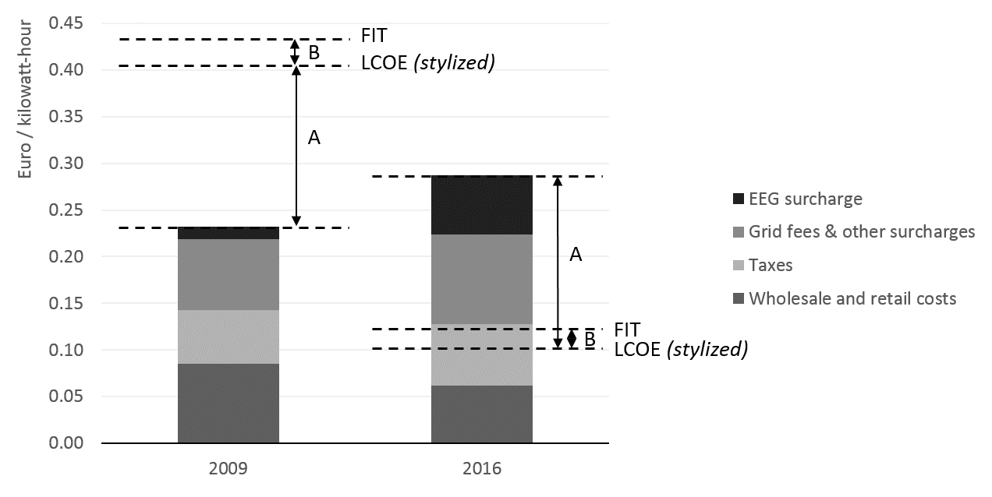
Incentives for prosumage in Germany
1
Incentives for prosumage through FITs, LCOEs, and household tariffs
  Volumetric grid charges and EEG surcharge – but not on self-generation
  Strong decline of FIT compared to household tariff (“Socket parity“)
  → We do not explicitly model this kind of incentive
Source: own illustration

Slide 6
Pros and cons of prosumage from an economic perspective
1
Pros and cons depend on the perspective
  Prosumagers and other consumers
  Incumbent industry, new industry, service providers
  Electricity system / system operators
→ Further reading: EEEP article
+ book chapter
Arguments in favor of prosumage
Consumer preferences Lower/more stable electricity costs Participation/acceptance of energy transformation Activation of private capital Distribution grid relief
Arguments against prosumage
Increasing system costs Distributional impacts
Arguments with ambiguous conclusions
Transmission grid relief Flexibility Driver for sector coupling Energy efficiency vs. rebound effect Local and macroeconomics benefits, increased competition Political economy, path dependency, and policy coordination Data protection and security

Slide 7
A model-based analysis
2
Analysis with an extended version of the DIETER model
  Open-source electricity system model: www.diw.de/dieter
  Minimization of yearly system costs for dispatch and investment, hourly resolution
  Linear program, implemented in GAMS
  Exogenous inputs: cost and capacity data, time series on load and renewables
  Endogenous variables: costs, dispatch and investments
Representation of prosumage
  Some fraction of electric load and PV is assumed to engage in prosumage
  Varying (exogenous) minimum self-consumption restrictions
Options for increasing self-consumption
  Stationary Li-ion batteries
  Smart electric thermal storage (SETS)
  Battery-electric vehicles (BEV)

Slide 8

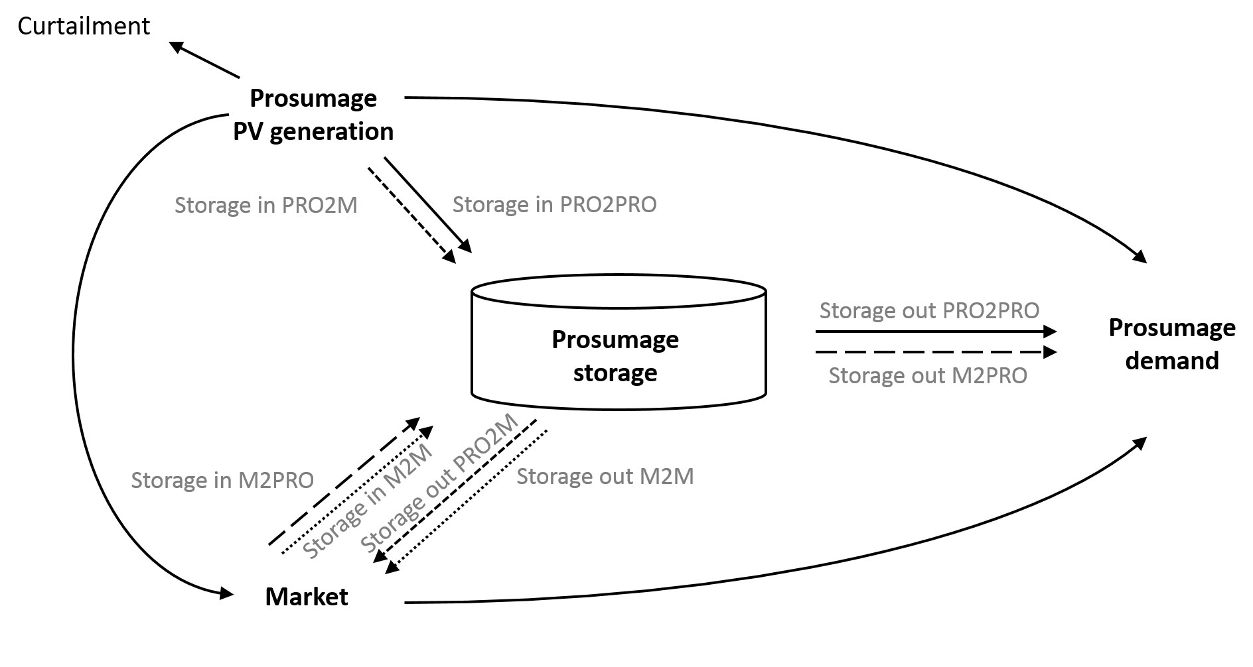
Model extension: electric heating and electric mobility
2
Battery-electric vehicle
Smart electric thermal storage (SETS)

Slide 9
Assumptions on different prosumage options
2
 | Electricity supply | Additional electricity demand | Investment cost | Other assumptions
Stationary li-ion batteries | Only self-generated | No (only losses) | 65 €/kW 300/kWh | E/P free No connection to grid
Smart electric thermal storage | Only self-generated | Yes | 350 €/kW (=44 €/kWh) | E/P 8 hours No connection to grid Natural gas back-up assumed Fluctuating heat demand profile (Horizon 2020 project)
Battery-electric vehicles | Self-generated and from grid | Yes | - (one BEV per household) | 3.7 kW / 30 kWh „Free lunch“ No V2G Time-varying charging availability profile (based on empirical German data) → available in 90% of hours

Slide 10
Input data
3
Scenario for 2030 leaning on EU Reference Scenario
  ~53% renewables in electricity consumption
  25% of PV capacity attributed
  to prosumage segment, such that
  yearly PV generation = yearly load
  (w/o sector coupling)
  ~3.5 million prosumage systems
  with 4.6 kWp each
  Baseline self-consumption ~40-50%
  Endogenous investments in prosumage storage or SETS
  Further parameter assumptions
  System-average PV and load profiles also for prosumers
  No changes in generation portfolio
  No change in size of PV systems
Installed capacity
in GW

Slide 11
Results:
System costs, related to prosumager households
4
→ Battery only: system costs increase strongly beyond 70% (log scale)
→ Much lower costs if SETS are used, even more so if BEV are available
→ What are the drivers?

Slide 12
Results:
Investments into storage (power) per prosumager household
4
→ Moderate investments in storage power (4 kWp PV) …

Slide 13
Results:
Investments into storage (energy) per prosumager household
4
→ …but extreme investments into battery energy beyond 70%, “long-term storage”
→ 80-100%: much lower investments required if SETS (and BEV) are available
→ Drivers: differences in investment costs, flexibility, and electricity demand
Notes:
Extreme E/P ratio up to 700

Slide 14
Results:
Hourly storage charging level of stationary batteries (100% cases)
4
→ Batteries only: seasonal smoothing of variable PV and load profiles
→ If BEV are available: much more plausible short-term balancing

Slide 15
Results:
Shares of prosumagers‘ PV generation used for different options
4
→ Hardly any battery use if other options are available (except 100%)
→ BEV crowd out SETS

Slide 16
Sensitivity: 50% smaller PV installations
System costs, related to prosumager households
4
→ Higher “natural” self-consumption, much lower cost increases
→ Smaller benefits of SETS and BEV

Slide 17
Sensitivity: 50% smaller PV installations
Investments into storage (energy) per prosumager household
4
→ Much lower energy storage capacity required
Notes:
Extreme E/P ratioup to 700

Slide 18
Sensitivity: 50% smaller PV installations
Shares of prosumagers‘ PV generation used for different options
4
→ Larger role for direct use of PV electricity
→ Less use of batteries and SETS

Slide 19
Conclusions
5
Prosumage: a growing niche
  Growth depends on consumer attitudes, technology cost and regulatory framework
  Here: no assessment if prosumage is desirable or not
  Potential role of electric heating and electric mobility
  Batteries can increase self-consumption shares only to some extent
  SETS and BEV facilitate higher (cheaper) self-consumption shares
  Despite restrictions related to time profiles of heating and mobility demand
  (Preliminary) conclusions
  If households aim to achive higher self-consumption, increased sector coupling is likely (and desirable)
  Policy / regulation: avoid distortions at sector borders

Slide 20
Future research
5
  Future research
  Exploration of different BEV profiles
  Other sector coupling options: hybrid / direct electric heating
  Further investigation of alternative PV sizing
  Impacts on overall generation portfolio, RES shares, and CO₂ emissions
  Explicit consideration of regulatory environment
  Prosumage may help to unlock demand-side flexibility potentials
  → only „own“ electricity and no aggregator involved
  Complementary research: desirable amount of various sector coupling strategies in long-term decarbonization scenarios

Slide 21
Wolf-Peter Schill
wschill@diw.de

Slide 22
Backup: distribution grid relief
Source: own illustration

Slide 23
Backup: hourly heat demand profiles
Taken from European Horizon 2020 research project RealValue
Derived from dynamic simulations with RWTH building model
12 building archetypes; here we pick one-family houses with medium energy demand

