Slide 1
Unlocking the benefits to end consumers
Public
19 September 2018
Nicholas Rubin

Slide 2
“The energy system is undergoing fundamental change.”
Ofgem, 2016
2

Slide 3

What is ELEXON?
It’s an exciting time…
… and a challenging time
How we unlock benefits for end consumers
  Practical and timely whole-system solutions
  Coordination
  Collaboration
  Simplification and consolidation
3

Slide 4
What ELEXON does?
ELEXON provides essential energy market infrastructure
We administer the Balancing and Settlement Code – we calculate Balancing Mechanism cashflows and imbalance settlement every half hour, which involves taking 1.25 million meter readings every day and handling £1.5 billion of our customers’ funds each year.
Code Administration
Code
Operation
Policy
Delivery Support
Industry rules management
Trusted critical friend
Dedicated customer support /training
24/7 settlement
Design/change implementation
Assurance services
Dedicated customer support/ training
Impartial, expert advice/guidance
Market scanning
Providing support to deliver policy outcomes
We are trusted, reliable independent market experts
447
We serve
27 Distributors, NG & Ix Administrators
115 Traders & Ix Users
market participants including:
122 Generators
178 Suppliers
4

Slide 5












Significant industry change
Rate of Change
Regulatory Changes
Coordinating Change
Electric Vehicles
New participants
Decarbonisation
Decentralisation
BSC SYSTEMS
Disruptive Technologies
Processing Capacity
Block chain, Peer to Peer
More granular data
Smart meters
Increasing Complexity
More frequent processing
Democratisation
Digitisation
Operational Cost
Data silos
Maintenance
5

Slide 6
Half Hourly Settlement
BSC Sandbox
Code simplification
Multiple Providers
Access to Energy Markets
Behind the Meter
Consumer Opportunities
EV/V2G
Bundled Services
Smart devices
Aggregation
Smart Tariffs
Storage
Community Energy
Energy Markets
P2P
Enabling Initiatives
6

Slide 7




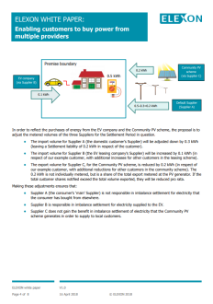



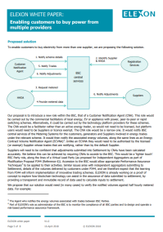
Greater choice: Multiple Providers Model
Problem – Supplier Hub is an established market design principle
  Customers can only have one Supplier at a time
Consumer Opportunity
  Bundled Services
  P2P
  Community Energy
  Aggregators
  Rapid switching
Solution
  Customer Notification Agent provides details of participating meters
  Use metered data to adjust suppliers/providers imbalance positions
White Paper: Enabling customers to buy power from multiple providers
7

Slide 8








Enabling innovation: BSC Sandbox
Problem – no BSC provision to enable trial of innovative products/business models.
  Barrier to innovation
Consumer Opportunity
  New products/Services
Solution
  Innovators can apply for a derogation from BSC requirements
    Time limited
    Scope limited
    Party/consortium specific
  Coordination with Ofgem’s Innovation Link
  Successful trials converted to BAU quicker
8

Slide 9








Simplify: GB Energy industry governance
GB Energy Industry Codes and Agreements
Problem – Regulatory inertia
  Complexity = barrier to entry
  Coordination and delivery of change
  Outdated design principles
Opportunity –
  Simpler, more transparent
    Improved market entry
    Improved change coordination and delivery
  Cost effective
Solution – simplification, collaboration and consolidation
  Retail Energy Code (REC)
  Refresh design principles
Electricity Licence
Both Licences
Gas Licence
Code
Managed by:
Code
Managed by:
Code
Managed by:
BSC
SEC
UNC
MRA
REC
?
SPAA
CUSC
iGT UNC
Grid Code
STC
DCUSA
DCode
Market Design Principles – c.1998
Centralised Generation
Single SO
Supplier Hub
NHH
9

Slide 10






Digitising our technology platform – Foundation Programme
Industry’s fragmented systems with data in silos, using old technology, slow to change.
ELEXON’s Foundation Programme to re-architect our central systems, to deliver a scalable, flexible and efficient platform to provide settlement and other value-added services to the market, with accessible data.
1
Data available for analysis (open data principle)
Benefits to existing and new market participants
2
Scalable and flexible solution for future changes
Improved customer experience
1
Faster, automated processes
3
Faster, digital registration
2
Secure by design
4
Unified customer portal
3
5
Opportunity to use emerging technologies (Blockchain, AI, IoT)
Real-time analytics and insight
4
5
Easy integration with other data sources through APIs
Benefits to central services utilised by all market participants
10

Slide 11
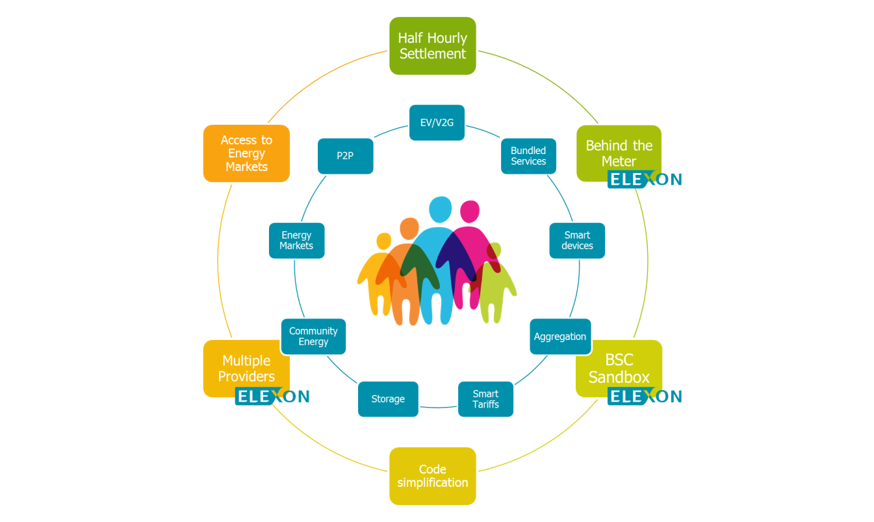
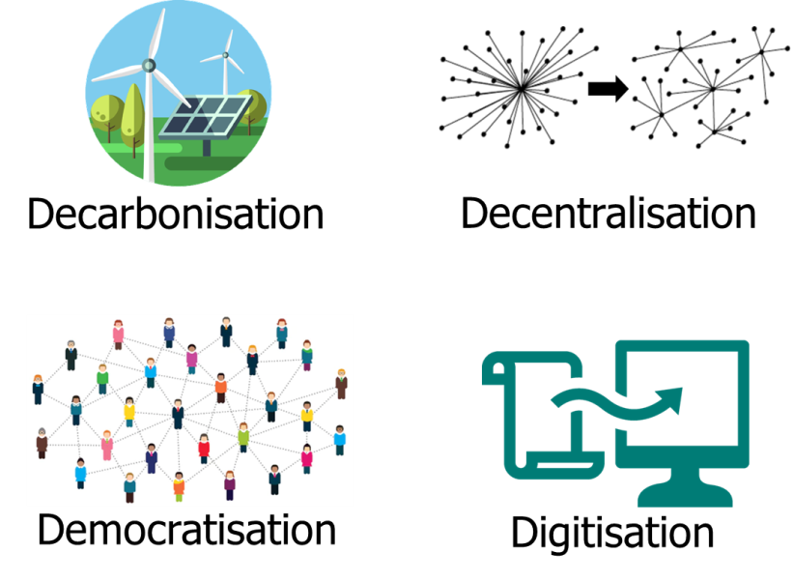
Unlocking benefits - conclusion
Collaboration
Coordination
Simplification & Consolidation
Innovation
Market Participation
11

Slide 12
Want to know more?
nicholas.rubin@elexon.co.uk
020 7380 4007

