Slide 1
Causal Tree Estimation of Heterogeneous Household Response to Time-of-Use Electricity Pricing Schemes
Dr. Melvyn Weeks & Eoghan O’Neill
University of Cambridge

Slide 2
Outline
Introduction
Description of Machine Learning methods
Heterogeneity of Demand Response to TOU Pricing
Data
Results

Slide 3
Introduction
We consider the problem of both understanding and predicting demand response following a policy intervention.
Application: demand response and time-of-use electricity prices.
We anticipate that the extent of the response will vary in an unknown way across households.
We apply a machine learning (ML) method, known as causal trees.

Slide 4
Introduction
A regulator would like to know what variables can be used to predict household demand response to energy policies.
This is a difficult problem to address:
Additive versus Multiplicative effects
  Many of these variables should be considered in a multiplicative fashion.
  The Customer-Led Network Revolution project noted
    .. a surprisingly consistent average demand profile across the different demographic groups, with much higher variability within groups than between them. This high variability is seen both in total consumption and in peak demand.
Multiplicity
  Post hoc analysis, looking for patterns in the data that were not specified a priori, leads to the well known multiple testing problem.

Slide 5
Literature Review
The Lower Carbon London trial, and a literature review by Frontier Economics and Sustainability First, have noted the lack of evidence relating to differing responses of low-income and vulnerable customers.
Few studies explore heterogeneity of demand response across aspects of past usage.
The CSE produced a report for Ofgem on the “hardest hit”. The report uses estimates from the DIMPSA model of whether consumers are better off, worse off, or have a marginal impact as a result of energy policies. A tree-based method finds covariates that characterise groups predicted to be worse off.
Prest (2017), Balandat (2016), Zhou et al. (2017) use machine learning methods to estimate household demand response.

Slide 6
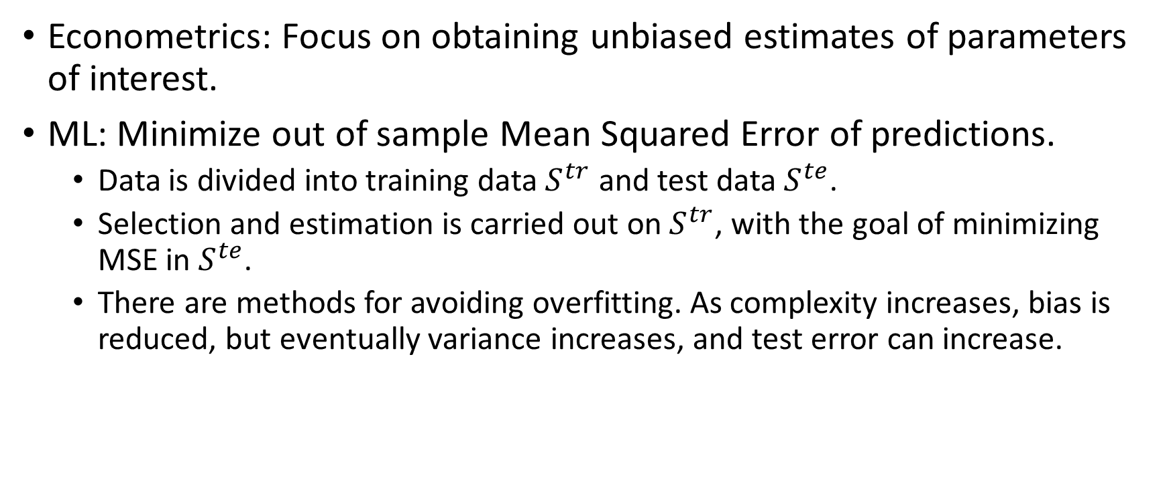
ML Overview
Econometrics: Focus on obtaining unbiased estimates of parameters of interest.
ML: Minimize out of sample Mean Squared Error of predictions.
  Data is divided into training data $S^{tr}$ and test data $S^{te}$.
  Selection and estimation is carried out on $S^{tr}$, with the goal of minimizing MSE in $S^{te}$.
  There are methods for avoiding overfitting. As complexity increases, bias is reduced, but eventually variance increases, and test error can increase.

Slide 7
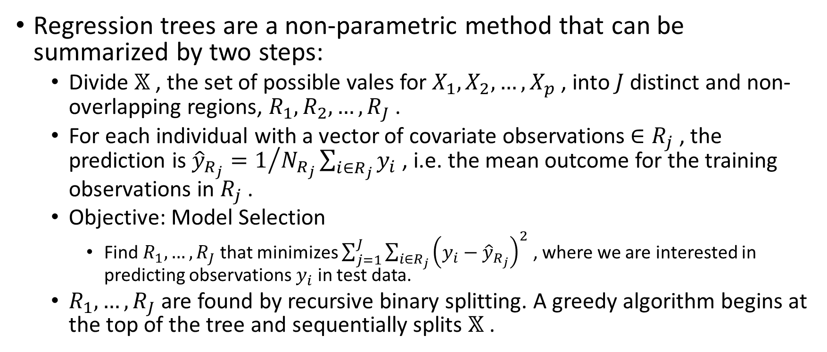
Regression Trees
Regression trees are a non-parametric method that can be summarized by two steps:
  Divide $𝕏$ , the set of possible vales for $X_{1}, X_{2},…, X_{p}$ , into $J$ distinct and non-overlapping regions, $R_{1}, R_{2}, …, R_{J}$ .
  For each individual with a vector of covariate observations $∈R_{j}$ , the prediction is ${\hat{y}}_{R_{j}}=1/{N_{R_{j}}\sum_{i∈R_{j}}{y_{i}}}$ , i.e. the mean outcome for the training observations in $R_{j}$ .
  Objective: Model Selection
    Find $R_{1}, …, R_{J}$ that minimizes $\sum_{j=1}^{J}{\sum_{i∈R_{j}}{{\left(y_{i}−{\hat{y}}_{R_{j}}\right)}^{2}}}$ , where we are interested in predicting observations $y_{i}$ in test data.
  $R_{1},…,R_{J}$ are found by recursive binary splitting. A greedy algorithm begins at the top of the tree and sequentially splits $𝕏$ .

Slide 9
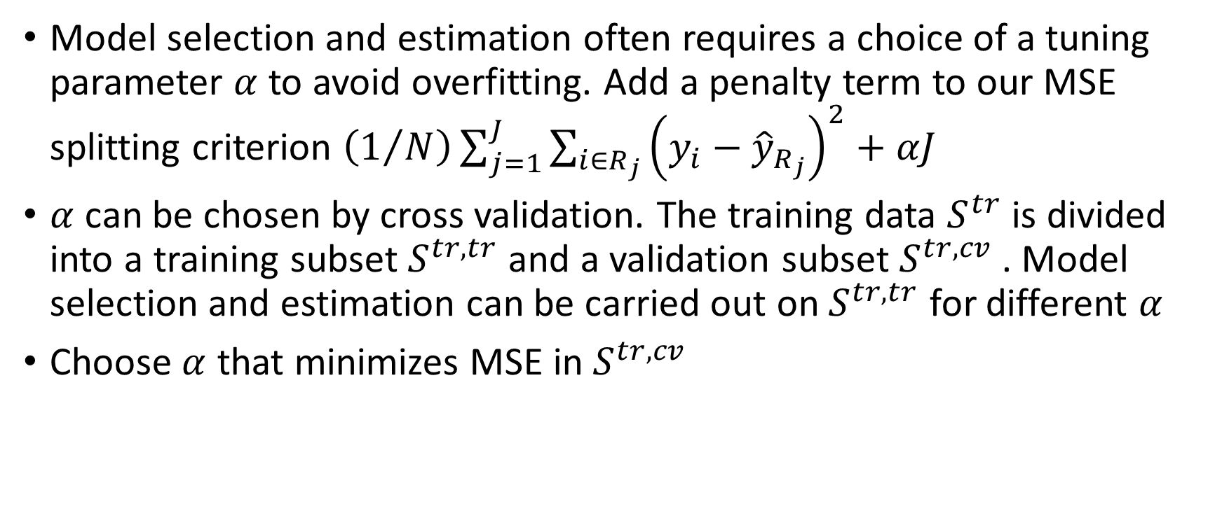
Cross-validation
Model selection and estimation often requires a choice of a tuning parameter $α$ to avoid overfitting. Add a penalty term to our MSE splitting criterion $\left(1/N\right)\sum_{j=1}^{J}{\sum_{i∈R_{j}}{{\left(y_{i}−{\hat{y}}_{R_{j}}\right)}^{2}+αJ }}$
$α$ can be chosen by cross validation. The training data $S^{tr}$ is divided into a training subset $S^{tr,tr}$ and a validation subset $S^{tr,cv}$ . Model selection and estimation can be carried out on $S^{tr,tr}$ for different $α$
Choose $α$ that minimizes MSE in $S^{tr,cv}$

Slide 10
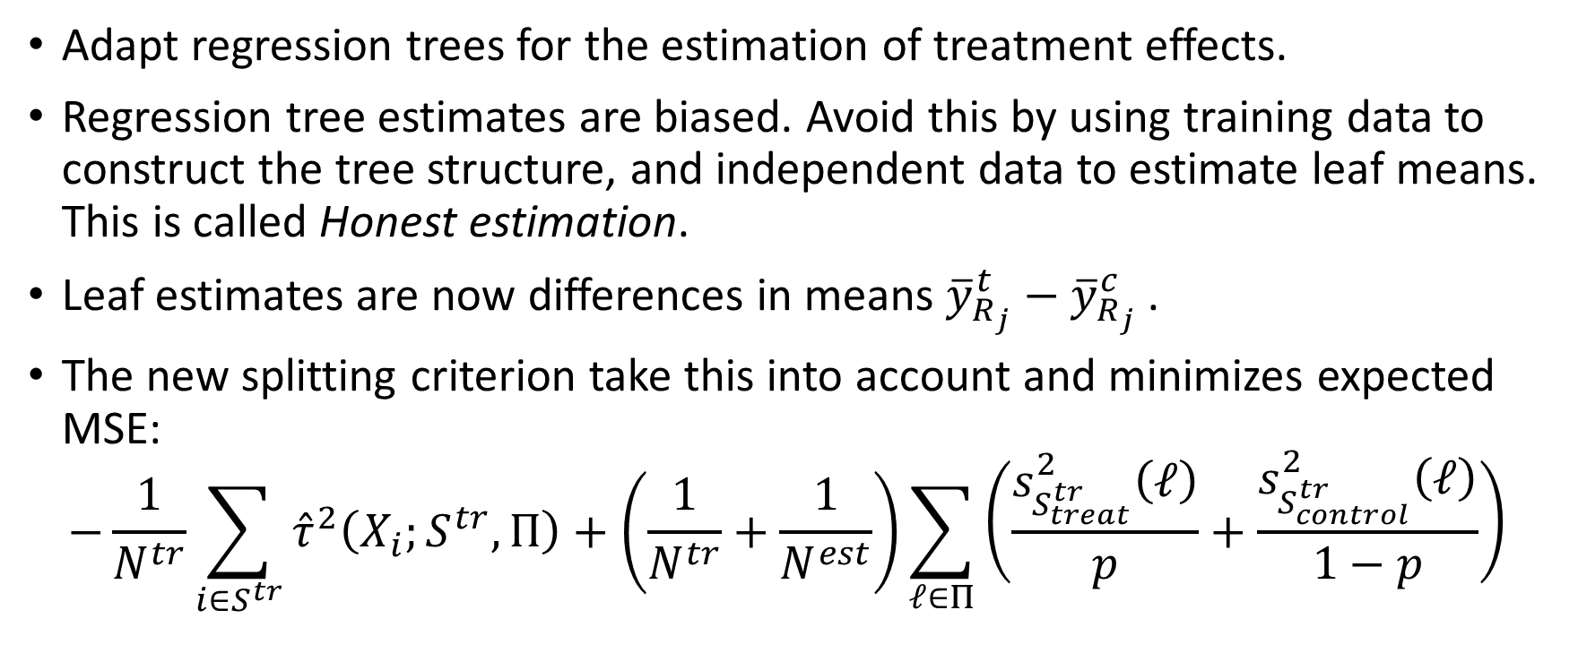
Causal Trees – Athey and Imbens (2016)
Adapt regression trees for the estimation of treatment effects.
Regression tree estimates are biased. Avoid this by using training data to construct the tree structure, and independent data to estimate leaf means. This is called Honest estimation.
Leaf estimates are now differences in means ${\overline{y}}_{R_{j}}^{t}−{\overline{y}}_{R_{j}}^{c}$ .
The new splitting criterion take this into account and minimizes expected MSE:
$$−\frac{1}{N^{tr}}\sum_{i∈S^{tr}}{{\hat{τ}}^{2}\left(X_{i};S^{tr},Π\right)}+\left(\frac{1}{N^{tr}}+\frac{1}{N^{est}}\right)\sum_{ℓ∈Π}{\left(\frac{s_{S_{treat}^{tr}}^{2}\left(ℓ\right)}{p}+\frac{s_{S_{control}^{tr}}^{2}\left(ℓ\right)}{1−p}\right)}$$

Slide 11
Random Forests and Causal Forests
The partitions generated by trees can be sensitive to input data.
If we randomly partition the data and then fit two trees, then the results can be quite different.
As a result single trees suffer from high variance and can have relatively poor predictive accuracy.
In contrast, low variance methods (e.g. linear regression) will yield similar results if applied repeatedly to distinct datasets.
Predictive performance can be substantially improved by methods such as Bagging, Random Forests, and Boosting.
Causal forests (Wager and Athey 2018) average over causal tree estimates. This gives Individual Treatment Effect Estimates.

Slide 12
Context and Motivation
TOU tariffs charge different prices for usage at different times of day. Heterogeneity of household response is of interest to:
  Retailers: Target consumers.
  Network operators: Constraint management.
  Regulators: Evidence and reasons for differing responses for different groups, particularly vulnerable and low-income customers.
Regulators may be interested in:
  Heterogeneity of reduction in consumption or bills.
  Describing the households with the largest and smallest estimated demand response.
  Which variables are most useful for predicting demand response?
Practical applications:
  Using trial data to predict heterogeneous demand response in a larger population.
  Targeting and approval of new pricing schemes or demand stimuli.

Slide 13
Consumer Vulnerability
Characterizing consumers impacted the most by a new pricing scheme:
  Consider most responsive leaves in a tree.
  Describe association between predicted effects and variables indicating vulnerability
If we have a vulnerability variable:
  Consider the predicted responses for vulnerable households, and for other households.
  Consider the proportion of vulnerable households in different groups. e.g. leaves of a tree.
  Consider proportion of vulnerable households in the quartiles of households predicted to be most and least responsive.

Slide 14
Data
The Electricity Smart Metering Customer Behavioural Trial was conducted by the Irish Commission for Energy Regulation (CER). The CER note that this is “one of the largest and most statistically robust smart metering behavioural trials conducted internationally to date”.
The dataset consists of half hourly residential electricity demand observations for 4225 households over 536 days.
Benchmark period: 14th July 2009 to 31st December 2009.
Trial period: 1st January 2010 to 31st December 2010.
We focus on the TOU group C (below), combined with an In-Home Display (IHD). This group and the control group contain 1001 households in total.

Slide 15
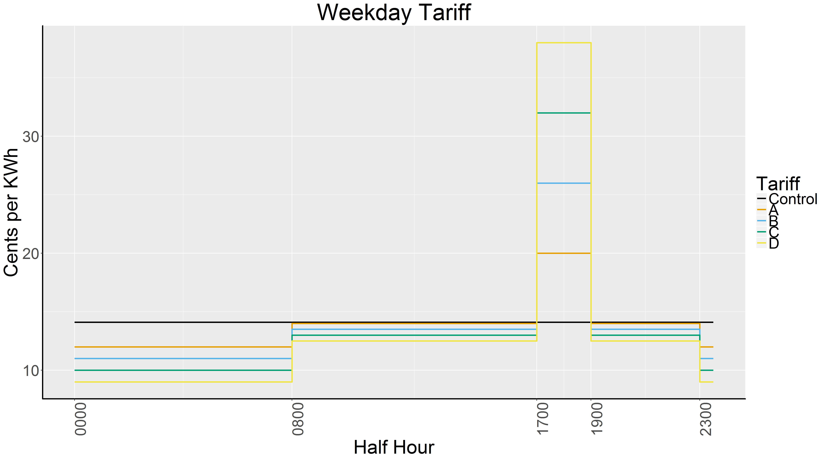
Treatments

Slide 16
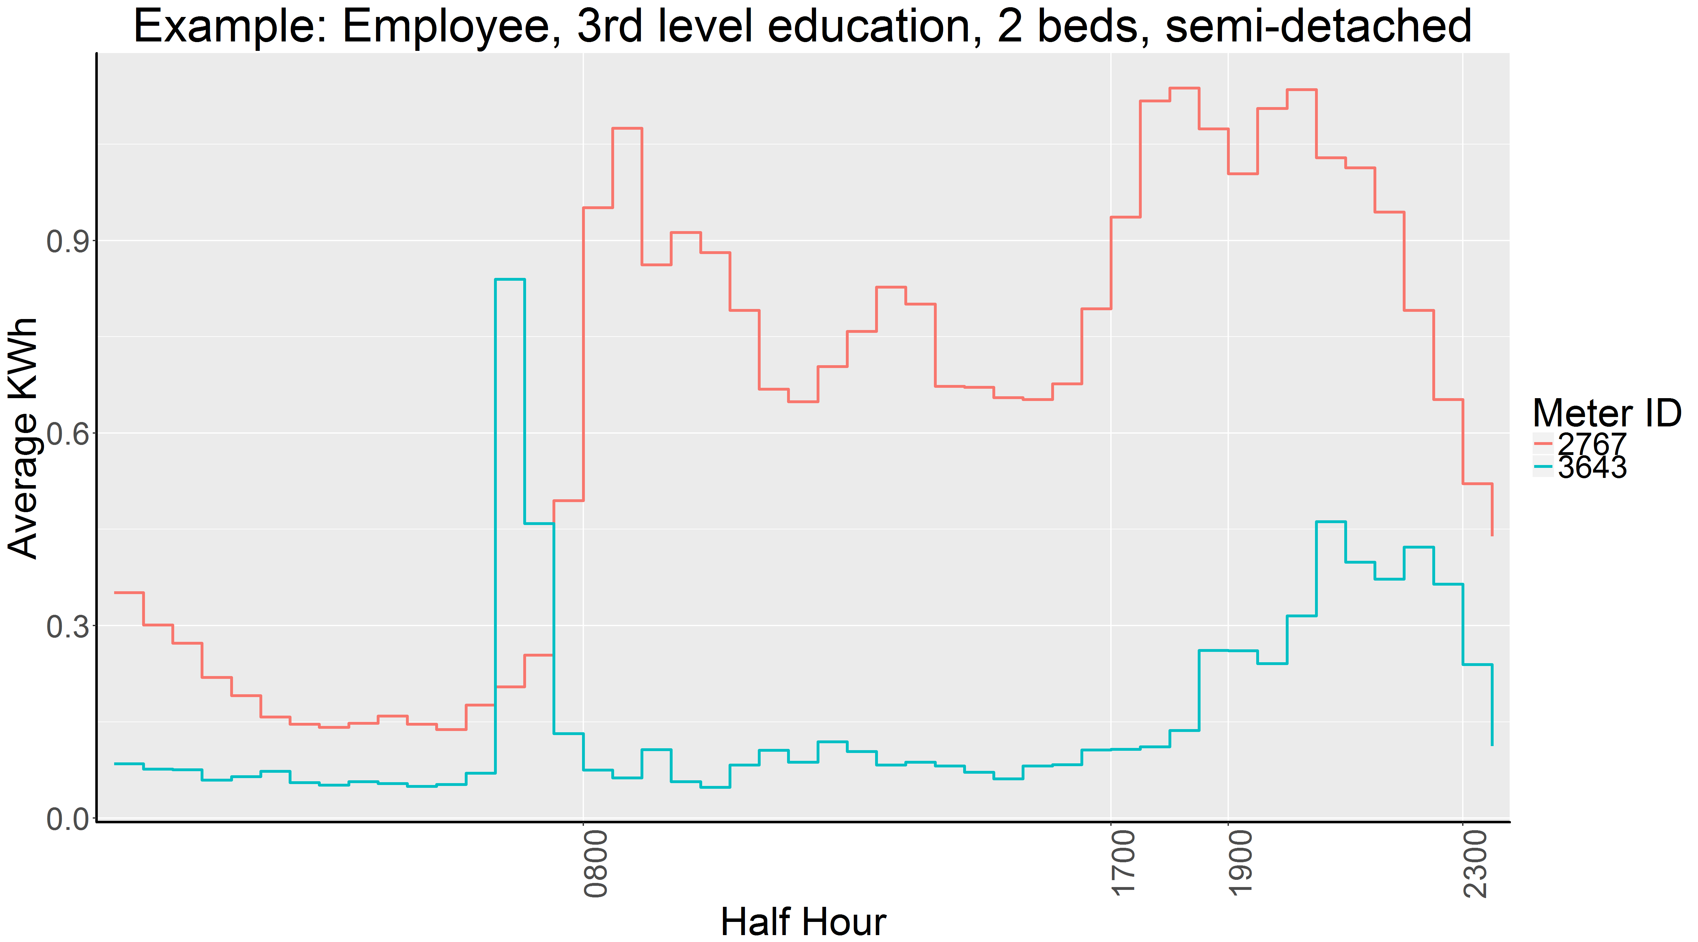

Slide 17
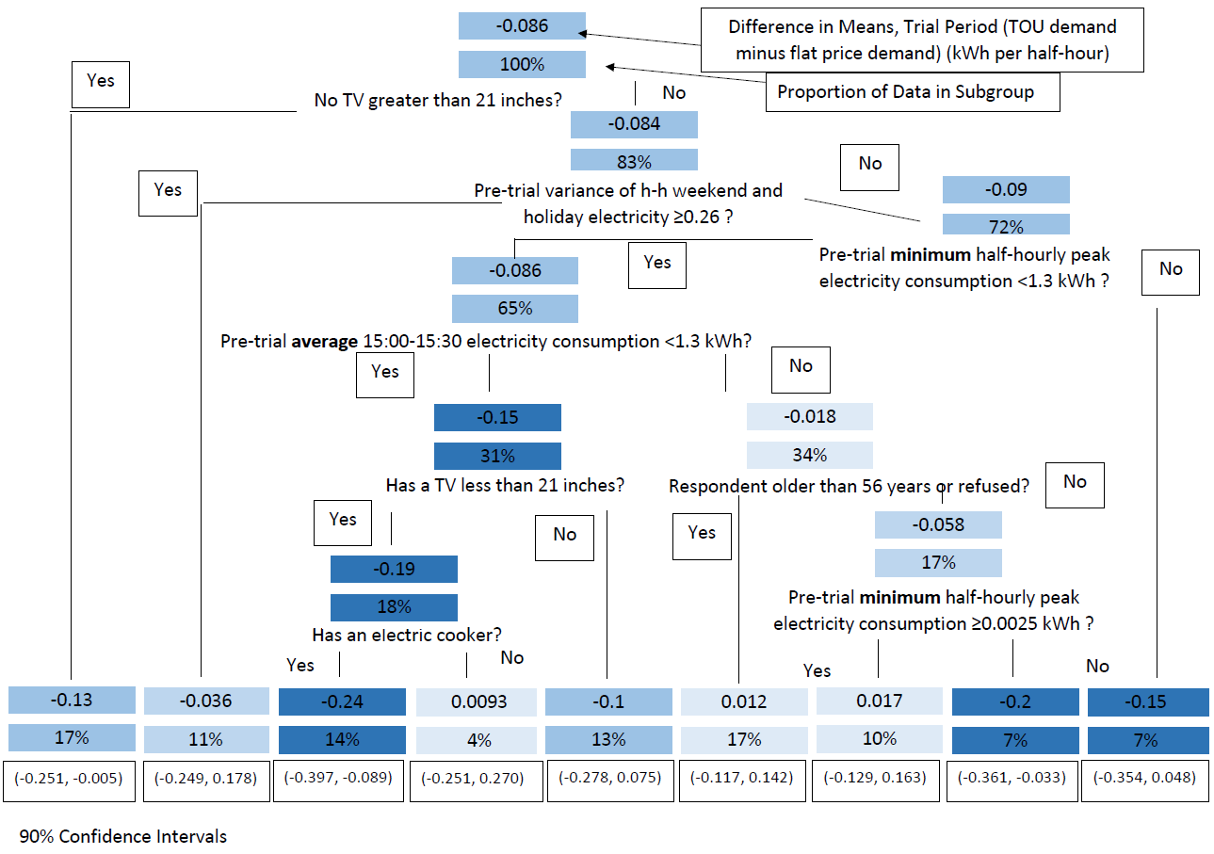

Slide 18
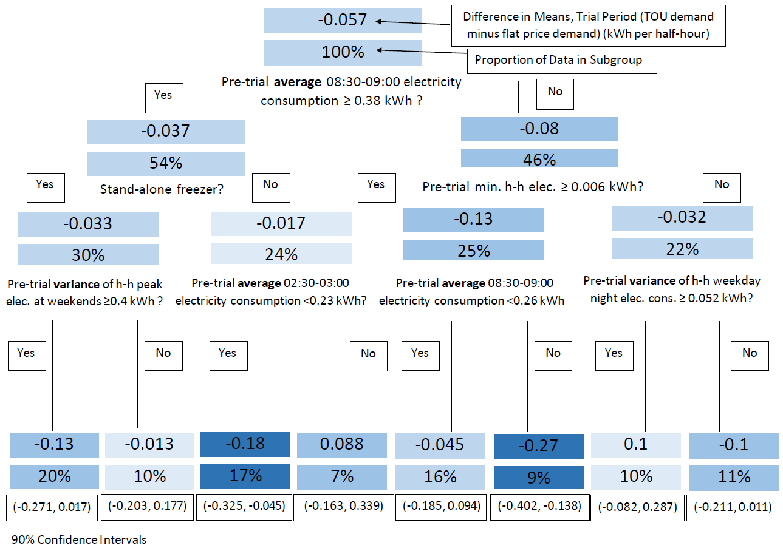

Slide 19
Presenting Forest Output
A Random Forest uses the averages of the predictions from a large number of trees.
This gives individual-specific predictions.
We arrange the data into quartiles of predicted effects, then present pre-trial averages of covariates by quartile.

Slide 20
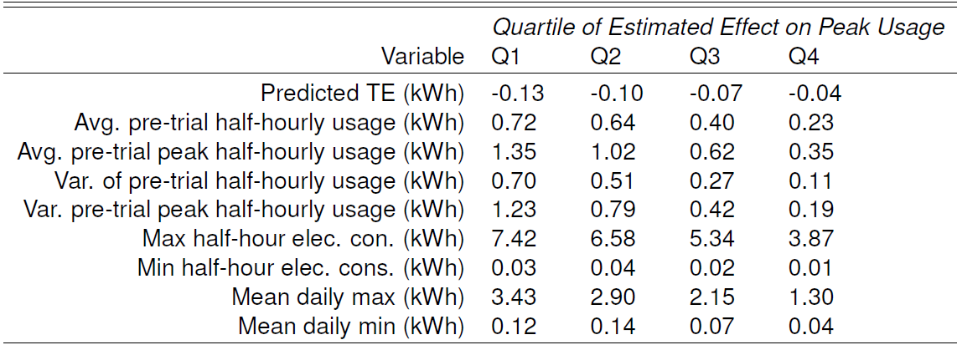
Pre-trial electricity consumption by quartiles of estimated Treatment Effects

Slide 21
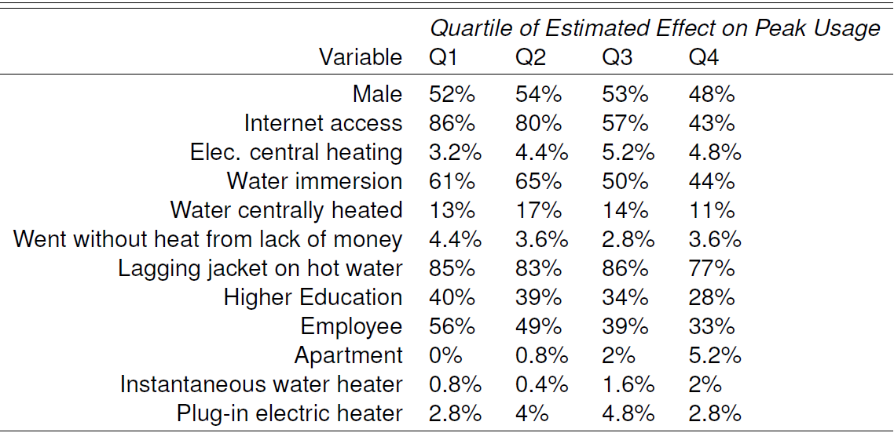
Survey variables by quartiles of estimated TEs

Slide 22
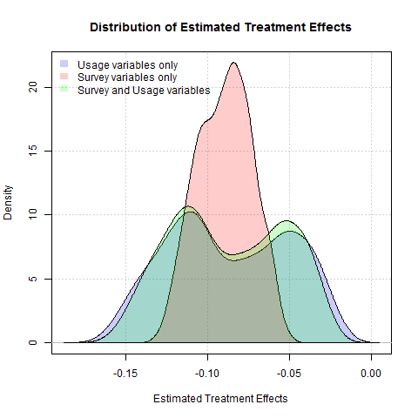

Slide 23
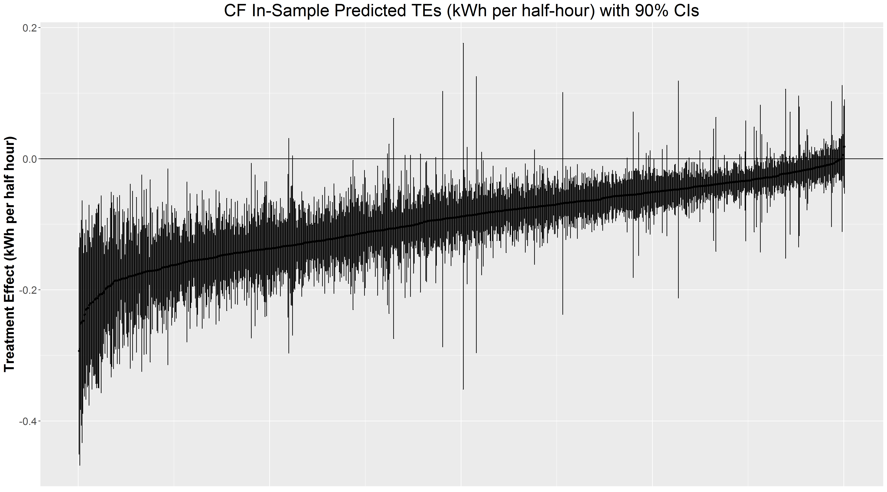

Slide 24
Variable Importance Results
We can find which variables have splits that lead to the greatest improvement in the splitting criterion, or we can count the number of splits on different variables.
There is a bias towards continuous variables and variables with more categories, which we address with a permutation-based test.
The causal forest prefers peak hour consumption information to survey information or other consumption information.

Slide 25
Future Work
Applications to energy demand
  Vulnerable customers
  Usefulness of survey information and past consumption information
  Prediction and targeting
Methodological Contributions
  Interested in interactions between covariates, which are clear for a single tree, but more difficult to describe for a forest. There is a limited literature on interaction importance.
  Describe jointness of variables using Bayesian Model Averaging.
  Combine Bayesian Causal Forests and Bayesian Model Averaging.

Slide 26
Thank you
epo21@cam.ac.uk

Slide 27
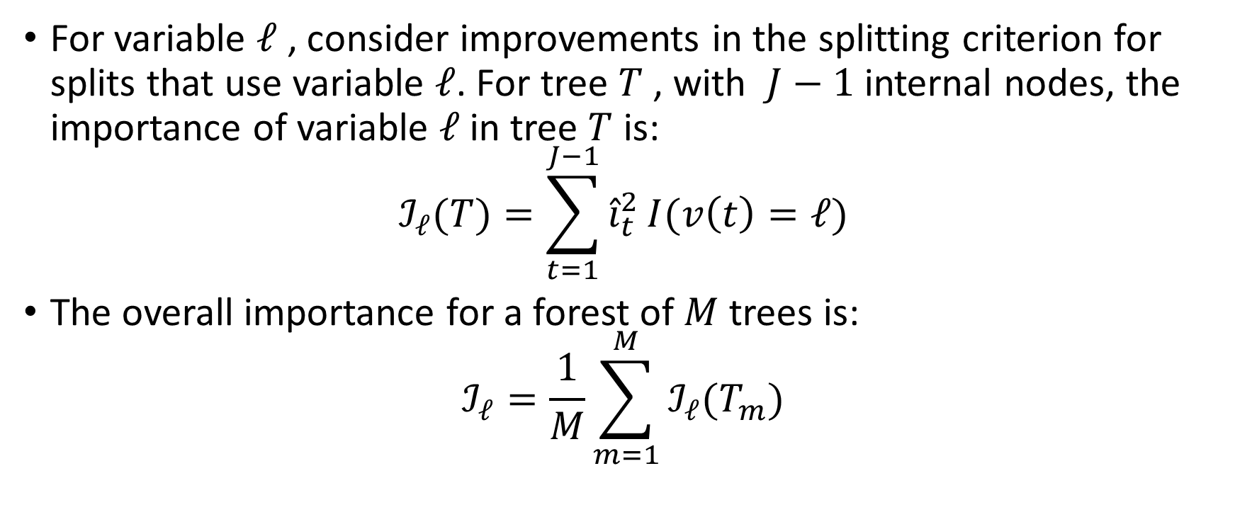
Variable Importance
For variable $ℓ$ , consider improvements in the splitting criterion for splits that use variable $ℓ$. For tree $T$ , with $J−1$ internal nodes, the importance of variable $ℓ$ in tree $T$ is:
$$ℐ_{ℓ}(T)=\sum_{t=1}^{J−1}{{\hat{i}}_{t}^{2}}I(v\left(t\right)=ℓ)$$
The overall importance for a forest of $M$ trees is:
$$ℐ_{ℓ}=\frac{1}{M}\sum_{m=1}^{M}{ℐ_{ℓ}(T_{m})}$$

Slide 28
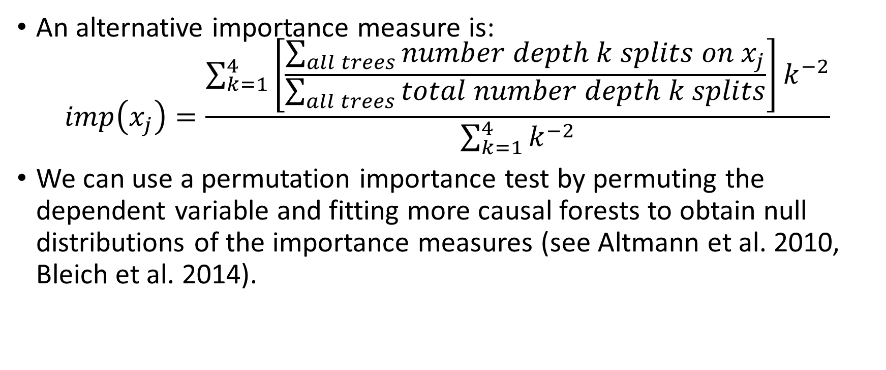
Variable Importance
An alternative importance measure is:
$$imp\left(x_{j}\right)=\frac{\sum_{k=1}^{4}{\left[\frac{\sum_{all trees}{number depth k splits on x_{j}}}{\sum_{all trees}{total number depth k splits}}\right]k^{−2}}}{\sum_{k=1}^{4}{k^{−2}}}$$
We can use a permutation importance test by permuting the dependent variable and fitting more causal forests to obtain null distributions of the importance measures (see Altmann et al. 2010, Bleich et al. 2014).

Slide 29
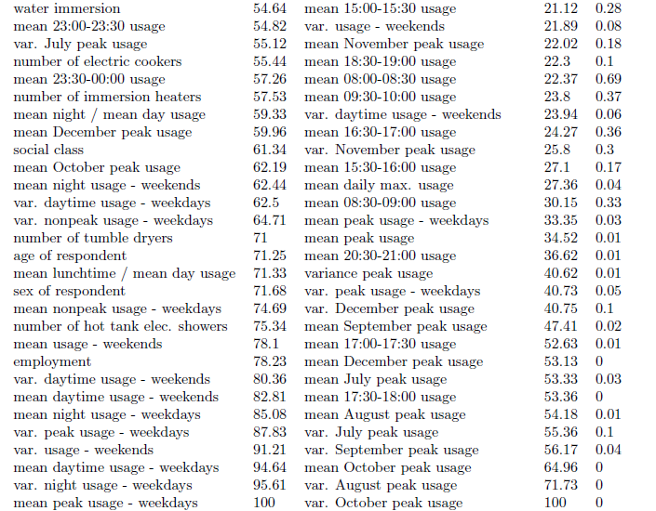

Slide 30
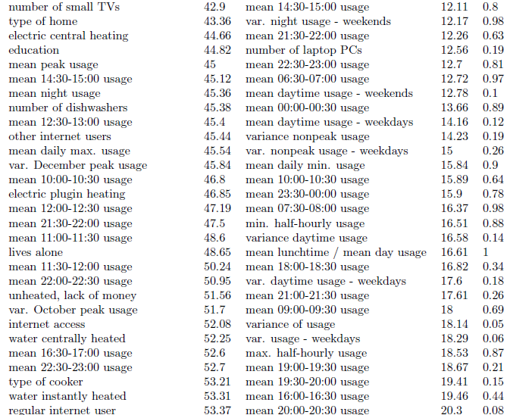

Slide 31
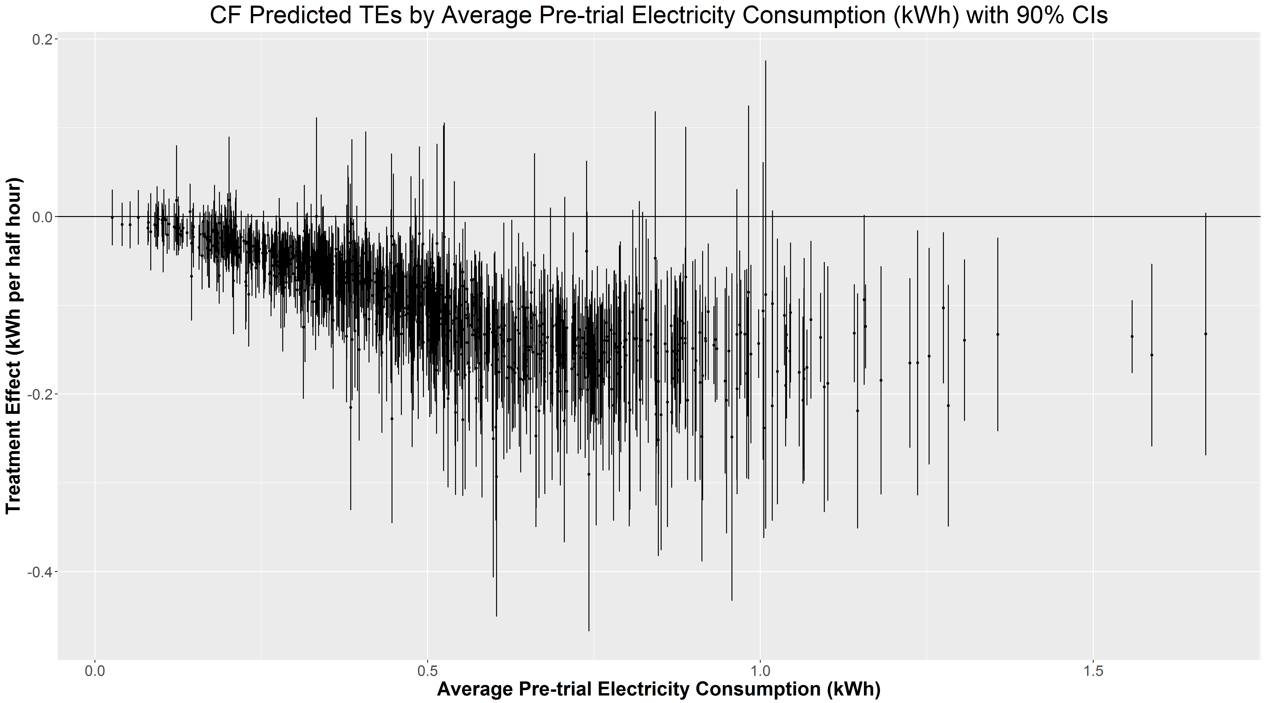

Slide 32
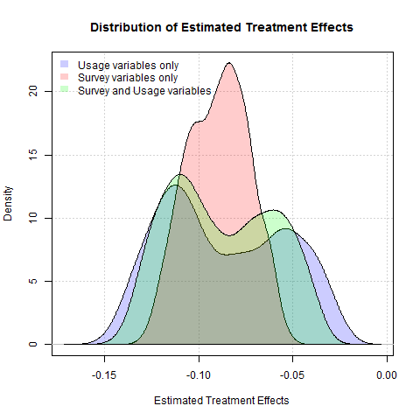

Slide 33
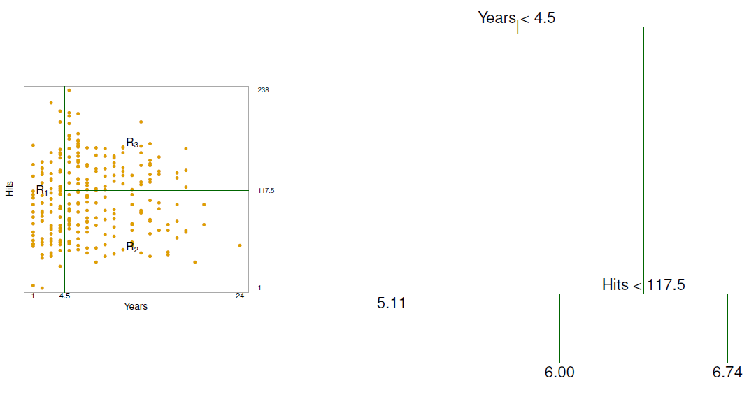
Predicting baseball player (log) salary data.

Slide 34
