Slide 1

Why the energy efficiency gap is smaller than we think: quantifying heterogeneity and persistence in the returns to energy efficiency measures
Presentation at BIEE Research Conference: Consumers at the Heart of the Energy System? Oxford, Sept 2018
Daire McCoy (LSE, ESRI), Raphaela Kotsch (LSE)

Slide 2
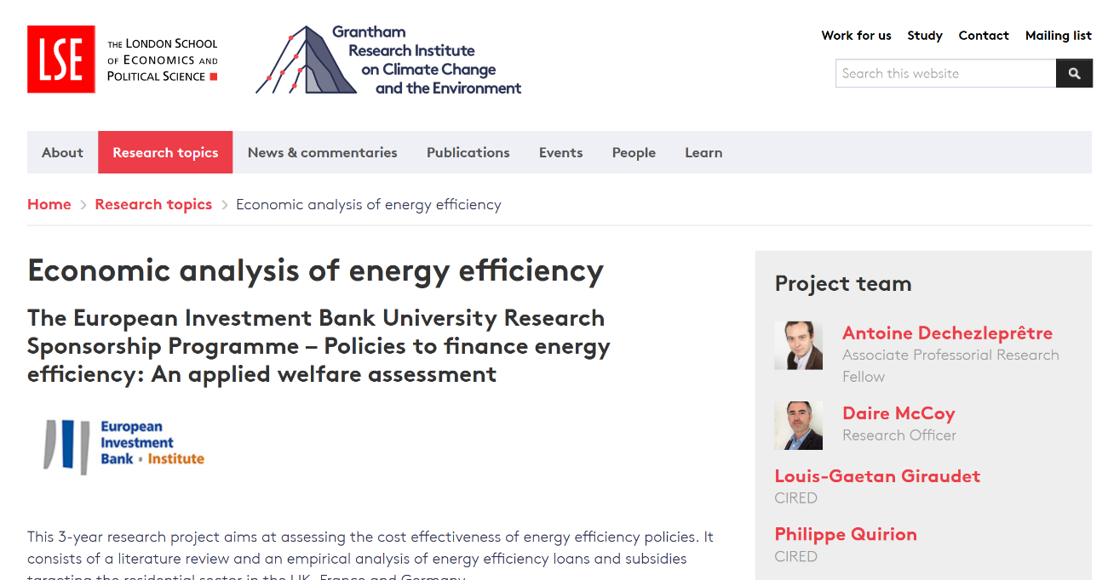
EIB funded project examining energy efficiency financing

Slide 3
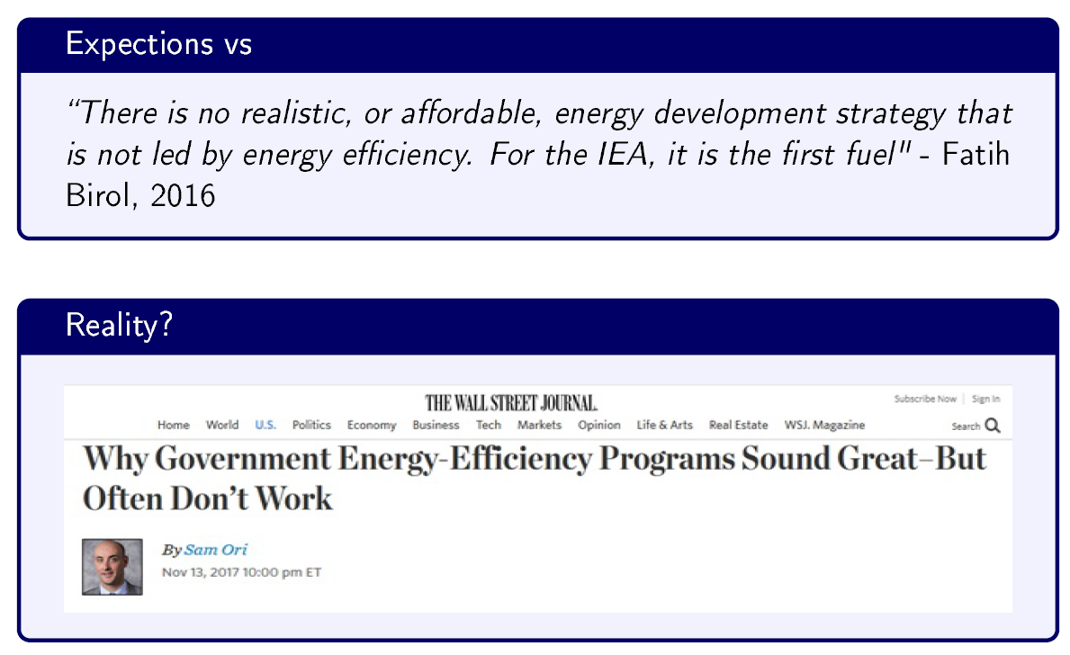
Introduction and Motivation

Slide 4
Introduction and Motivation
Fowlie at al. (2018), Allcott and Greenstone (2017)
  Actual energy savings 40-60 percent of predicted
Gerarden at al. (2015) energy efficiency gap
  Market failures, behavioural failures, model/measurement error
  Unobserved costs, overstated savings from adoption, consumer heterogeneity, inappropriate discount rates and uncertainty contribute to low adoption rate not being as “paradoxical as it first appears”
Kotchen (2017) long-run effects of building regulations
  Effects of code change on electricity consumption diminish over time
  Effects on gas consumption increase over time

Slide 5
Introduction and Motivation
Very little work on the longer term effects of energy efficiency measures
  Despite the long-term savings that they are supposed to deliver
  Most research estimates short-term savings and makes assumptions about stable returns over longer periods
  If savings are not stable this could have implications for incentives faced by households; cost-effectiveness of policies; distributional effects of measures

Slide 6
Contribution
What we do:
  Examine how well measures perform
  Variation in savings by measure and household type
  Persistence over time
  Assess how this impacts the cost-effectiveness of measures and incentives faced by households
  Examine distributional effects
How we do it:
  Analyse a database of four million households over an eight year period
  Statistical matching and panel econometric estimations to control for unobserved heterogeneity and selection into schemes
  Population of supplier TWC schemes - mitigate against “site selection bias” (Allcott, 2015)

Slide 7
Presentation overview
Introduction
Background
Data
Methods
Results

Slide 8
Background
UK Supplier Obligations (Tradeable White Certificates)
  Principal policy instrument in UK
  Also widely used in Europe (Italy, France)
  Hybrid subsidy-tax instrument (Giraudet, 2012)
Main features
  An obligation is placed on energy companies to achieve a quantified target of energy savings
  Savings are based on standardised ex-ante calculations
  The obligations can be traded with other obligated parties
  Market-based flexibility aims to encourage cost-effectiveness
  Suppliers bear the cost and then pass through to their customers
  Widely considered to have been cost-effective

Slide 9
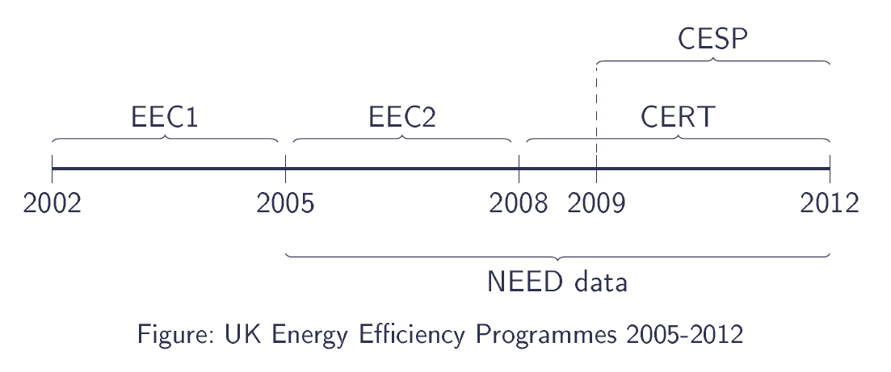
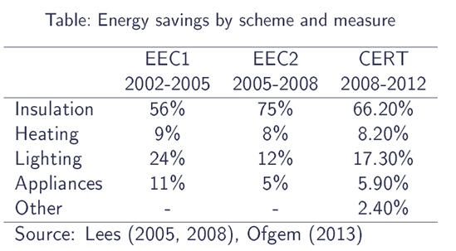
Background

Slide 10
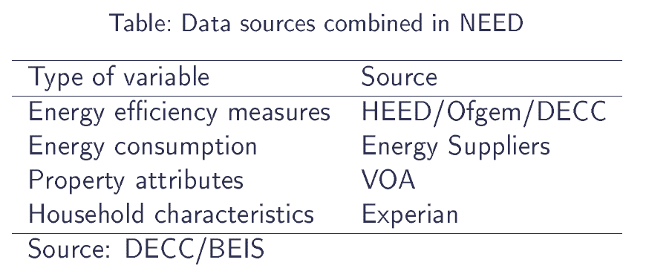
Data: National Energy Efficiency Data framework (NEED)
NEED Database
  Annual panel of four million households (2005-2012)
  Metered gas and electricity consumption
  Detailed dwelling characteristics
  Some socioeconomic information

Slide 11
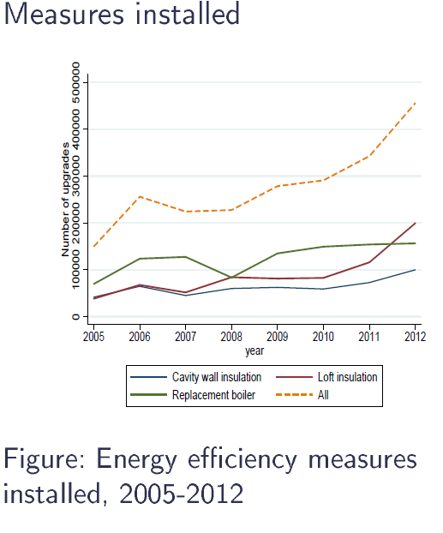
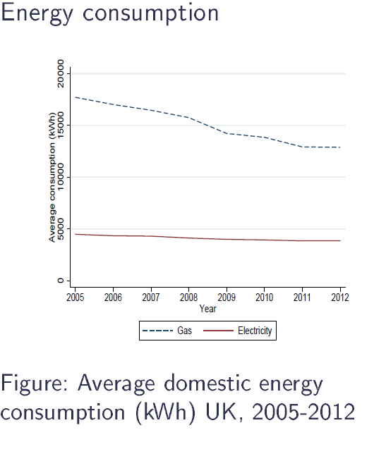
Have installed measures delivered?

Slide 12
Non-random assignment
Selection effects and unobserved heterogeneity
  FE estimator assumes treatment (upgrade) is strictly exogenous and randomly assigned
  Selection into scheme is likely correlated with energy consumption, income, location, dwelling quality and other factors...
  Not taking this into account would bias results
  Pre-process data using coarsened-exact matching (CEM) to reduce imbalance in observed variables (Iacus, King, and Porro, 2008; Alberini and Towe, 2015)
  Match on variables most likely to:
      predict selection into scheme and determinants of energy consumption
      level and trend of prior year's energy consumption

Slide 13
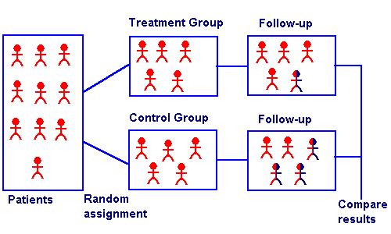
Overview of Matching
  Matching estimator mimics random assignment by reducing imbalance in observed variables
  We match each “treatment” household with an identical “control” household

Slide 14
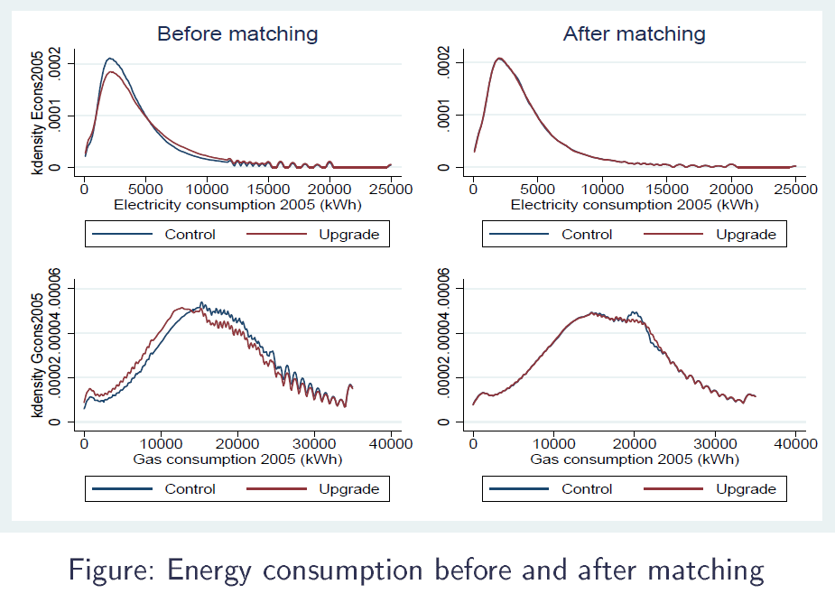
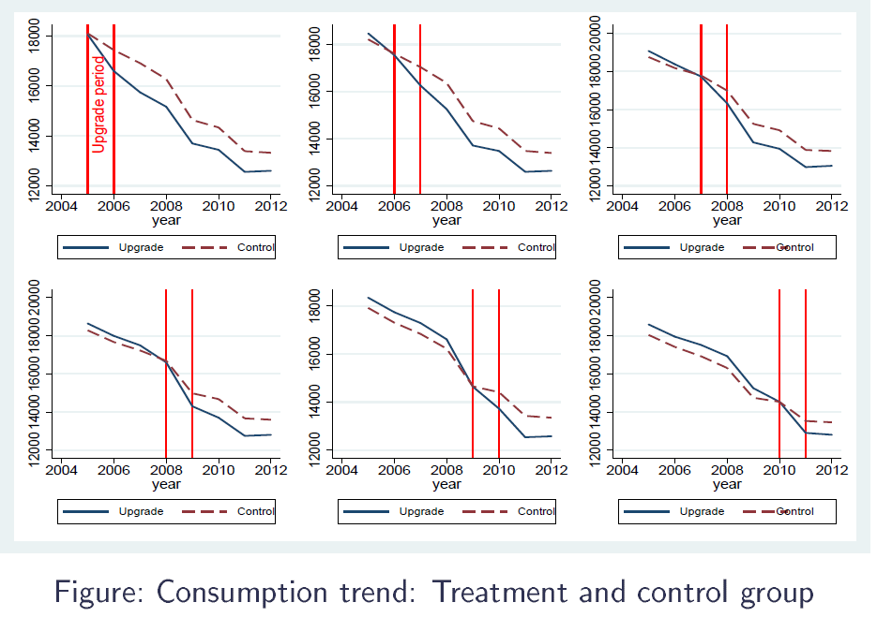
Matching results
Level
Trend

Slide 15
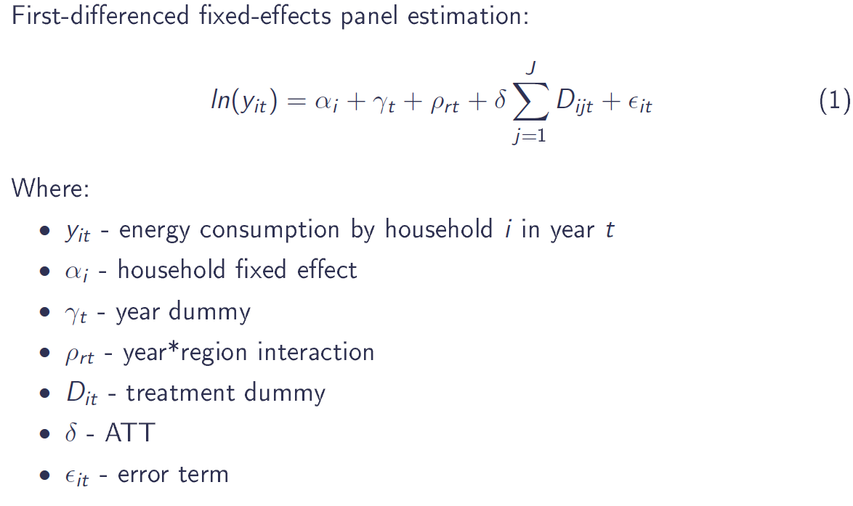
Econometric approach

Slide 16
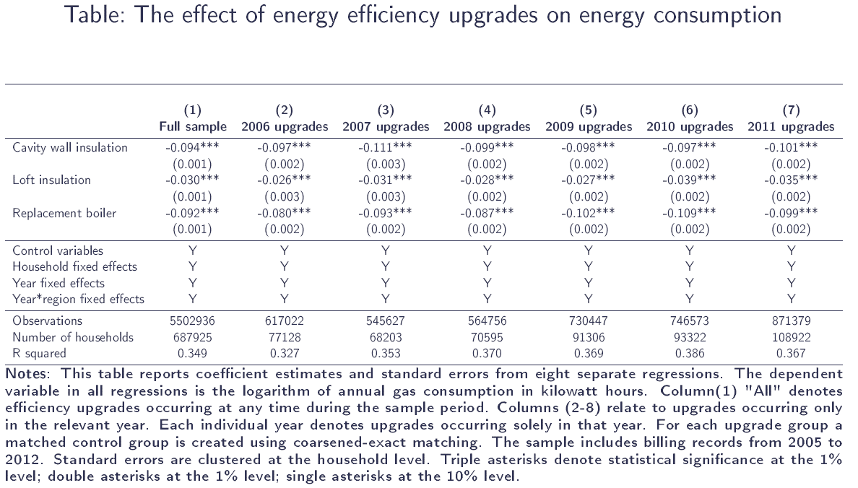
R1: Main results

Slide 17
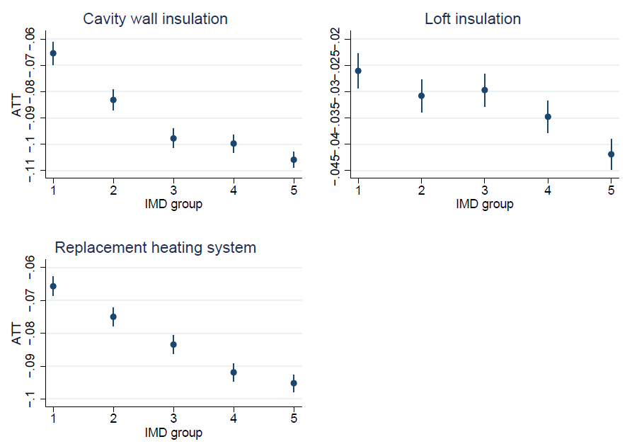
R2: Heterogeneity in energy savings
ATT by measure and IMD group
  Savings much lower in more deprived areas.
  Particularly for cavity wall insulation and replacement heating systems

Slide 18
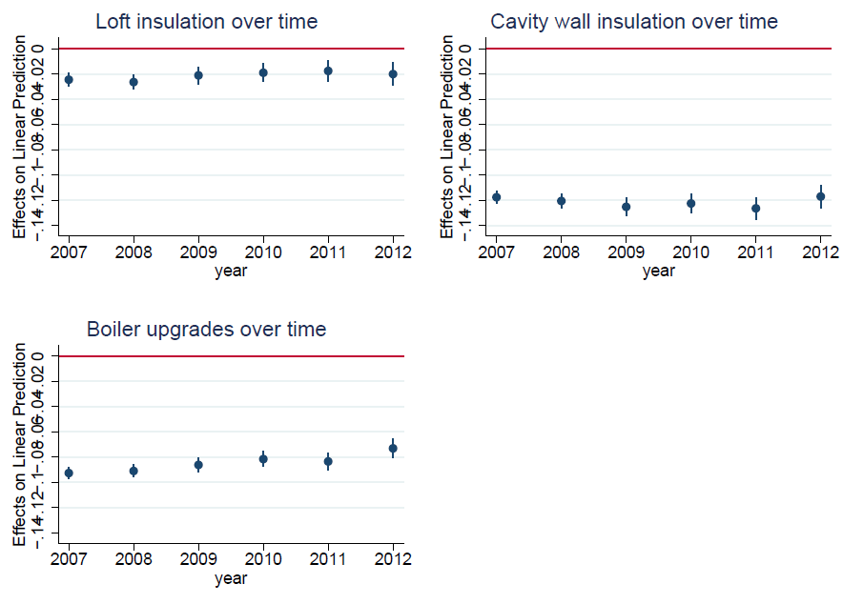
R3: Persistence in energy savings
ATT by measure over time
  Savings relatively stable for cavity wall and loft insulation…
  For replacement heating systems?

Slide 19
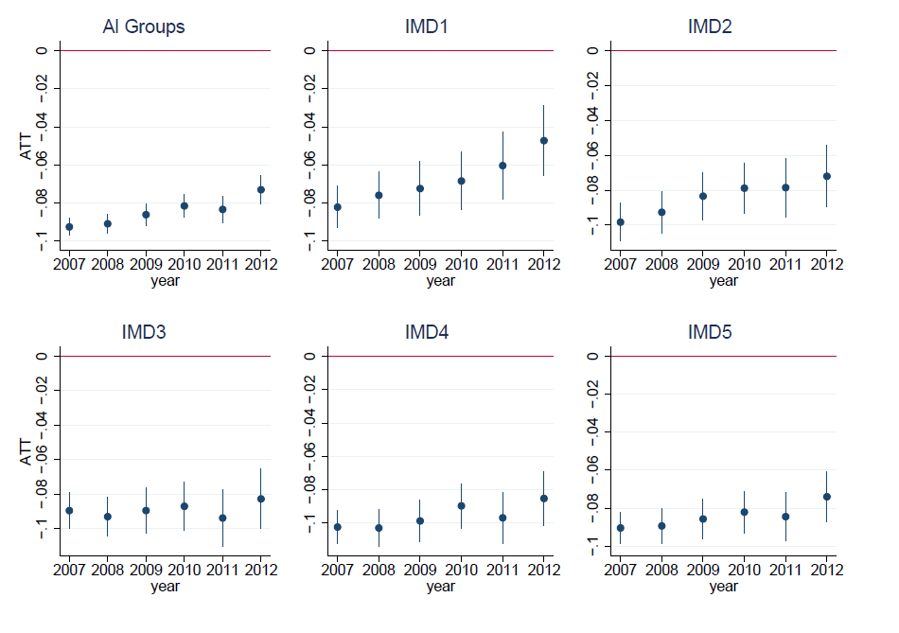
R3: Persistence in energy savings
ATT for heating systems by IMD group
Erosion of savings concentrated in more deprived households (IMD1 and maybe IMD2)
Stable for others

Slide 20
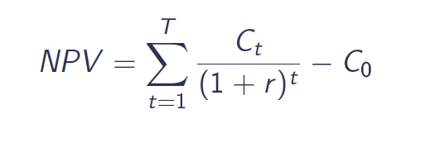
How does this impact cost-effectiveness?
Internal rate of return (IRR)
Cost estimates
Measure | Cost assumptions (£)
Cavity wall insulation | 350
Loft insulation | 285
Replacement boiler Lower (policy cost) | 200
Replacement boiler Upper (private cost) | 2000
Source: Based on Lees (2005, 2008), Shorrock (2005)
Where:
NPV: net present value
T: estimated lifetime of measures
Ct: avoided energy costs in year t
C0: upfront investment cost
r: IRR we solve for

Slide 21
Internal rate of return (IRR)
IRR for all measures
IRR taking erosion of energy savings into account
 | Cavity wall | Loft | BoilerL | BoilerU
IRR 10 | 7% | -8% | 17% | -24%
IRR 20 | 15% | 4% | 23% | -7%
IRR 30 | 16% | 6% | 23% | -2%
 | IMD1 | IMD2 | IMD3 | IMD4 | IMD5
BoilerL | 6% | 12% | 16% | 20% | 19%
BoilerU | -29% | -26% | -23% | -21% | -22%
IRR for all measures by IMD group
 | Sample Average | IMD1 | IMD2 | IMD3 | IMD4 | IMD5
Cavity wall | 16% | 11% | 14% | 16% | 17% | 18%
Loft | 6% | 5% | 5% | 5% | 7% | 9%
BoilerL | 17% | 12% | 14% | 17% | 20% | 22%
BoilerU | -24% | -26% | -25% | -24% | -23% | -22%

Slide 22
Overall cost-effectiveness
Policies still quite cost-effective
 | £ per tonne of CO2 | £ per kWh
Cavity wall insulation | 36 | 0.0072
Loft insulation | 90 | 0.0171
Replacement heating (200) | 60 | 0.0141
Replacement heating (2000) | 600 | 0.1412
Calculated using Carbon Trust estimates of CO2 per kWh of electricity and gas

Slide 23
Overall cost-effectiveness
And compare well internationally
Intervention type | Reference | Evaluation type | Relevant subset | Percent reduction in energy usage | Engineering estimates of percent reduction in energy usage | Cost effectiveness (cents per kWh saved, 2015 USD)
Behavioral programs | Allcott (2011) | RCT | NA | 2 |  | 3.6
 | Allcott & Rogers (2014) | RCT | One-shot intervention |  |  | 4.4
 |  |  | Two-year intervention |  |  | 1.1 to 1.8
 |  |  | Four-year intervention |  |  | 1.2 to 1.8
 | Ayres et al. (2012) | RCT | Sacramento, California | 2 |  | 5.5
 |  |  | Puget Sound, Washington | 1.2 |  | 2
Building codes | Novan et al. (2017)c | RD analysis | NA | 1.3 | 20 | 24.4
Efficient equipment or energy savings subsidy | Alberini & Towe (2015) | Matching | NA | 5.3 |  | 3.9
 | Alberini et al. (2016) | DID | Rebate of $1,000 or more | 0
 |  |  | Rebate of $450 | 5.5 |  | 47.9
 |  |  | Rebate of $300 | 6.2 |  | 28.2
 | Burlig et al. (2017) | Machine learning | NA | 2.9 to 4.5 | 11.6 to 18
 | Davis et al. (2014) | DID regression | Refrigerators | 8 |  | 27.2
 |  |  | Air conditioners | plus 1.7 |  | 4.5
Information provision | Alberini & Towe (2015) | Matching |  | 5.5
Supplier Obligation (TWC) | McCoy & Kotsch (2018) | Matching, FE regression | Cavity wall insulation | 9.4 | 20.0 | 1.54 to 2.31
 |  |  | Loft insulation | 3 | 5.2 | 3.65 to 5.47
 |  |  | Replacement heating system | 9.2 | 24.9 | 3.02 to 30.19
Previous estimate of UK Supplier obligation Lees, 2008) |  |  |  |  |  | 1.92
Adapted from Gillingham et al (2018)

Slide 24
Conclusions
Key findings
  Standardised assumptions about returns to energy efficiency need to be revised
  Considerable variation by measure, household type and over time. Savings much less than engineering models predict
  Savings lower and less persistent for more deprived households
  Distributional concerns despite explicit targets for deprived households
  Raises questions about incentive to invest and size of “EE gap”
Policy implications
  Evaluations need to use actual rather than estimated savings
  Evaluations need to better quantify non-financial savings. Particularly comfort and health benefits of EESavings lower and less persistent for more deprived households
  Variation in returns has implications for policy prescription

Slide 25

d.m.mccoy@lse.ac.uk

Slide 26
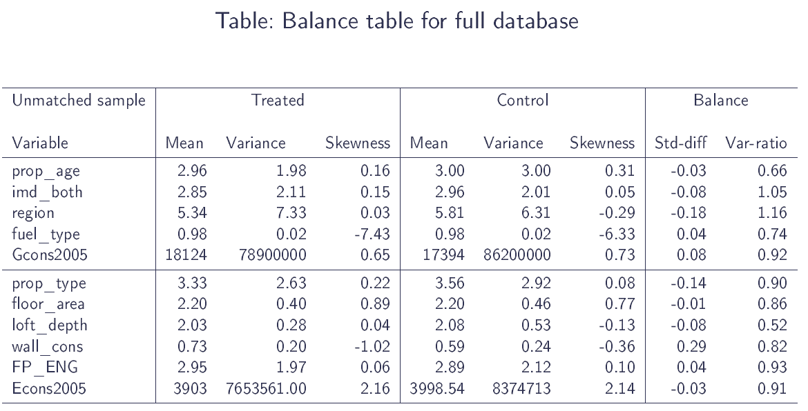
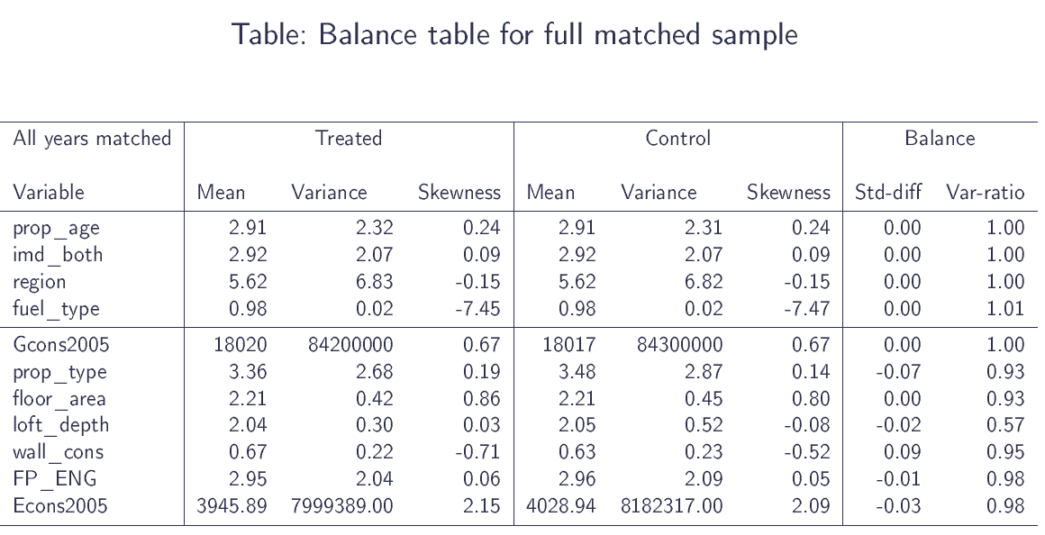
Matching results

Slide 27
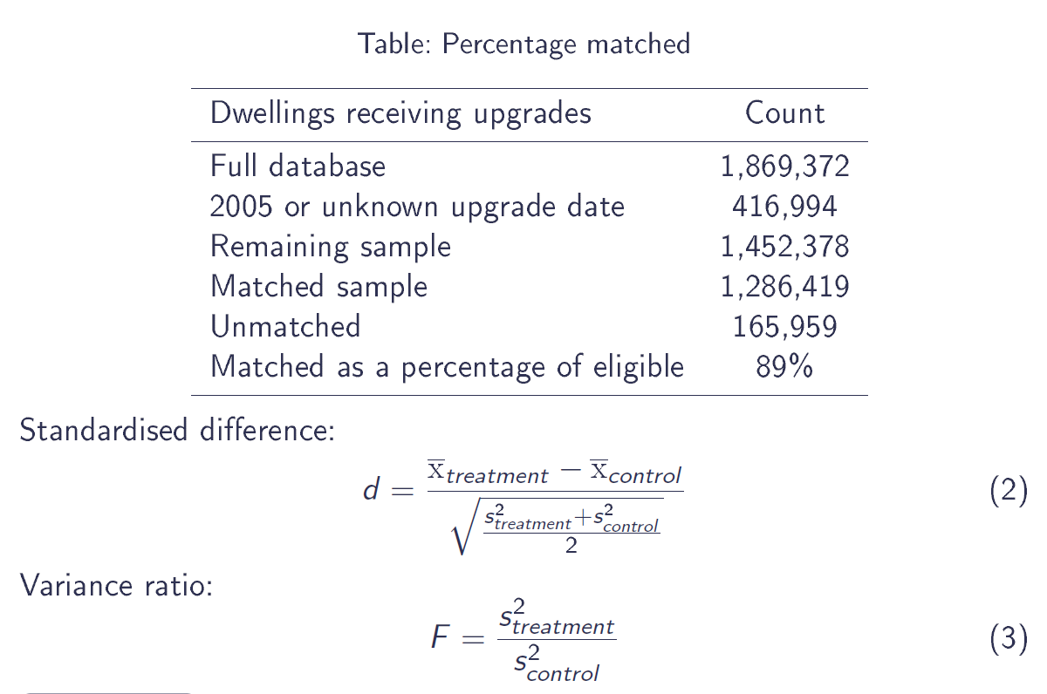
Matching results

Slide 28
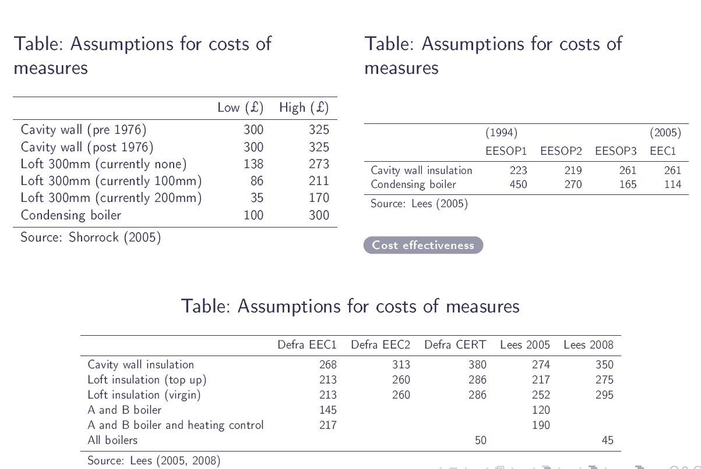
Cost assumptions

Slide 29
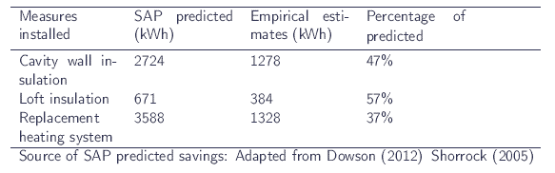
Comparison with ex-ante SAP predictions

