Slide 1
Experimenting with Heat Plans
Matthew Lipson
Head of Consumer Insight

Slide 2
Overview
How can energy services deliver low carbon heat?
What have we focused on and why?
What have we found?
Where next?

Slide 3
Part 1: How can energy services deliver low carbon heat?

Slide 4
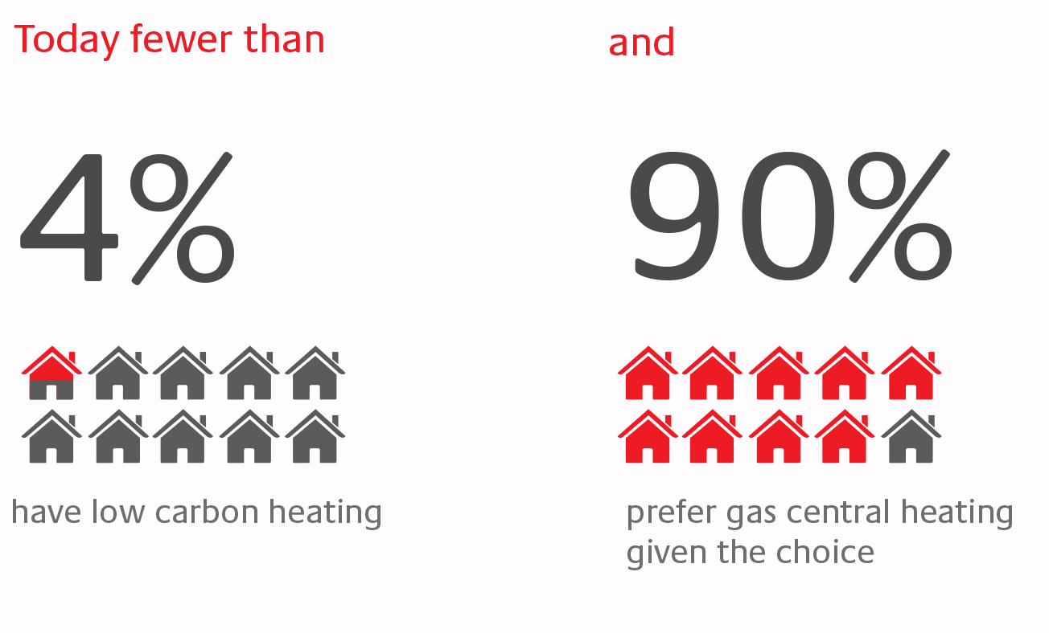
Decarbonising heat is the most cost effective way to decarbonise the UK
But today fewer than and
© 2017 Energy Technologies Institute LLP

Slide 5
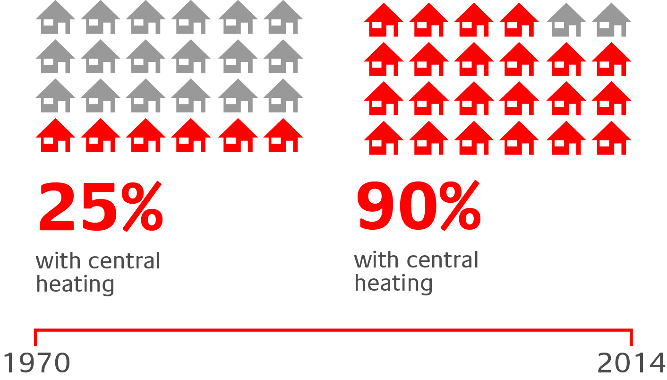
Rapid change is possible
© 2017 Energy Technologies Institute LLP

Slide 6
But you need to integrate the right components in each place
© 2017 Energy Technologies Institute LLP

Slide 7
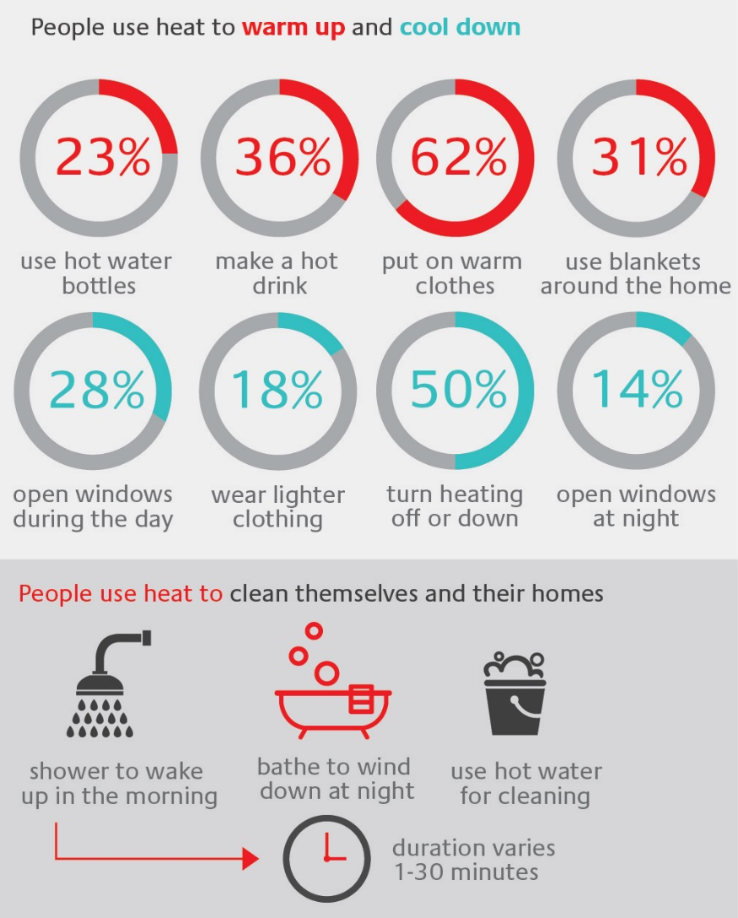
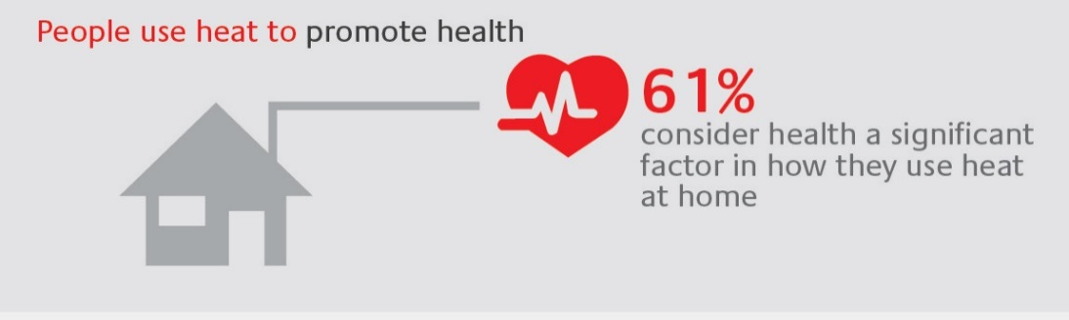

And everyone wants something different
© 2017 Energy Technologies Institute LLP

Slide 8

Digital has transformed our lives
Travel
TV
Energy

Slide 9
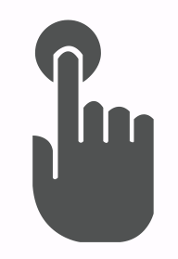
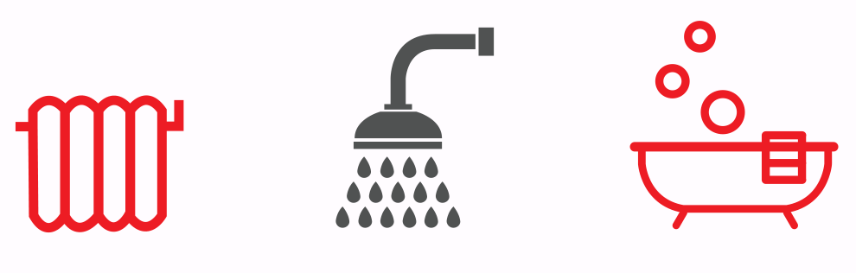
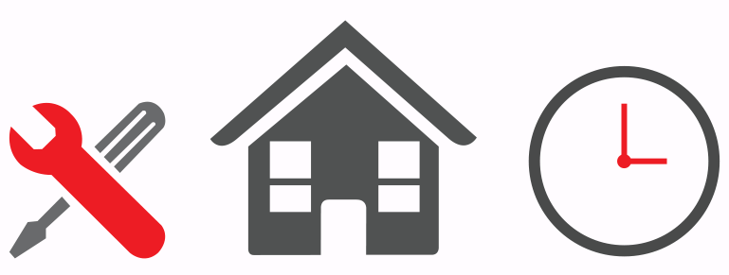
Could digital help tackle challenges to low carbon heat?
  Challenge 1: Make low carbon heating easy to control
  Challenge 2: Improve low carbon heating experiences
  Challenge 3: Make low carbon heat systems simple to install

Slide 10

Energy services might hold the key
Last year I spent
£1,380 on
14,983kWh of gas and
4,125kWh of electricity.
Next year, I’ve no idea
How much fuel I need
What it will cost, or
What experience I will get.
I want to warm
the rooms I choose…
…to the temperatures I like…
…when I am home.
For a fixed monthly price!
© 2018 Energy Systems Catapult

Slide 11
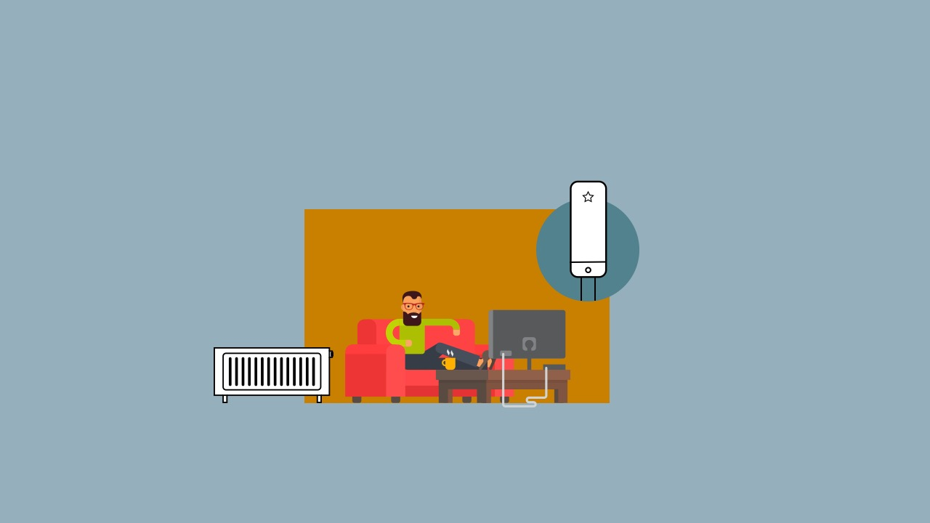

Services could be decarbonised
© 2018 Energy Systems Catapult

Slide 12

Services could make interests compatible
Policy makers
Businesses
Consumers
Citizens
© 2018 Energy Systems Catapult

Slide 13
Part 2: What have we focused on?

Slide 14


Problem: different expectations
© 2017 Energy Systems Catapult

Slide 15
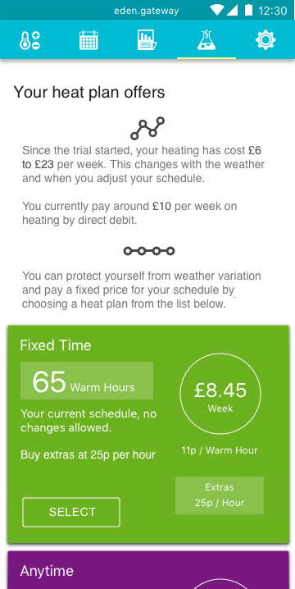
Solution: use a new language to buy a plan
Heat plan: Fixed price for service level the customer wants.
Pence per warm hour: The price for each warm hour in the plan (a home heating “mpg”).
Warm hours: How many hours any room is warm (0-24 per day).
Extras: The price for warming rooms outside the schedule.
Schedule: The temperature of each room at different times.

Slide 16
Problem: limited foresight
2. [But I do]
- more hours
- maximum temperatures
- all rooms
- with open windows
1. ”I want…
- few hours
- medium temperatures
- some rooms”
3. “I’m so annoyed with my supplier, they are a nightmare”
4. “But you never knew what you needed…”
© 2017 Energy Systems Catapult

Slide 17
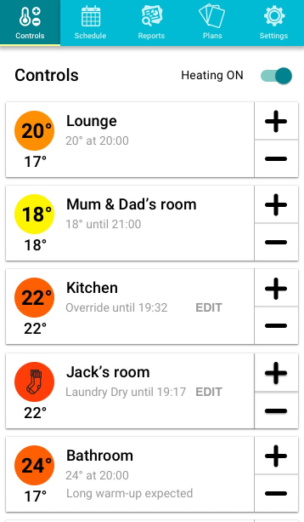
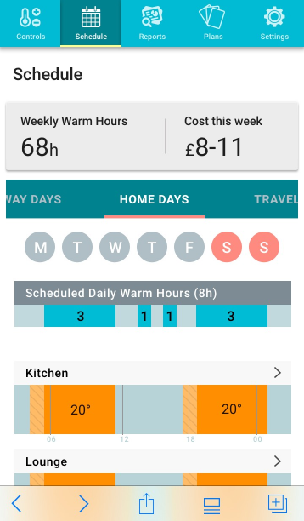
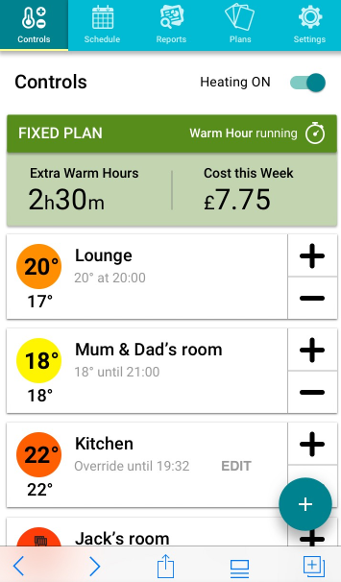
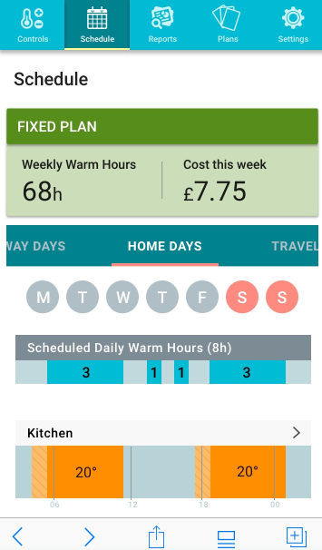
Solution: learn the language through use
Designed to understand, shape and bound expectations
Time to warm

Slide 18
Problem: lots of questions for service providers
How should I price my service?
What do customers expect?
What might it cost to deliver?
How can I shape expectations so they are realistic?
How low should I price it to attract customers?
How can I explain what is excluded?
© 2017 Energy Technologies Institute LLP

Slide 19
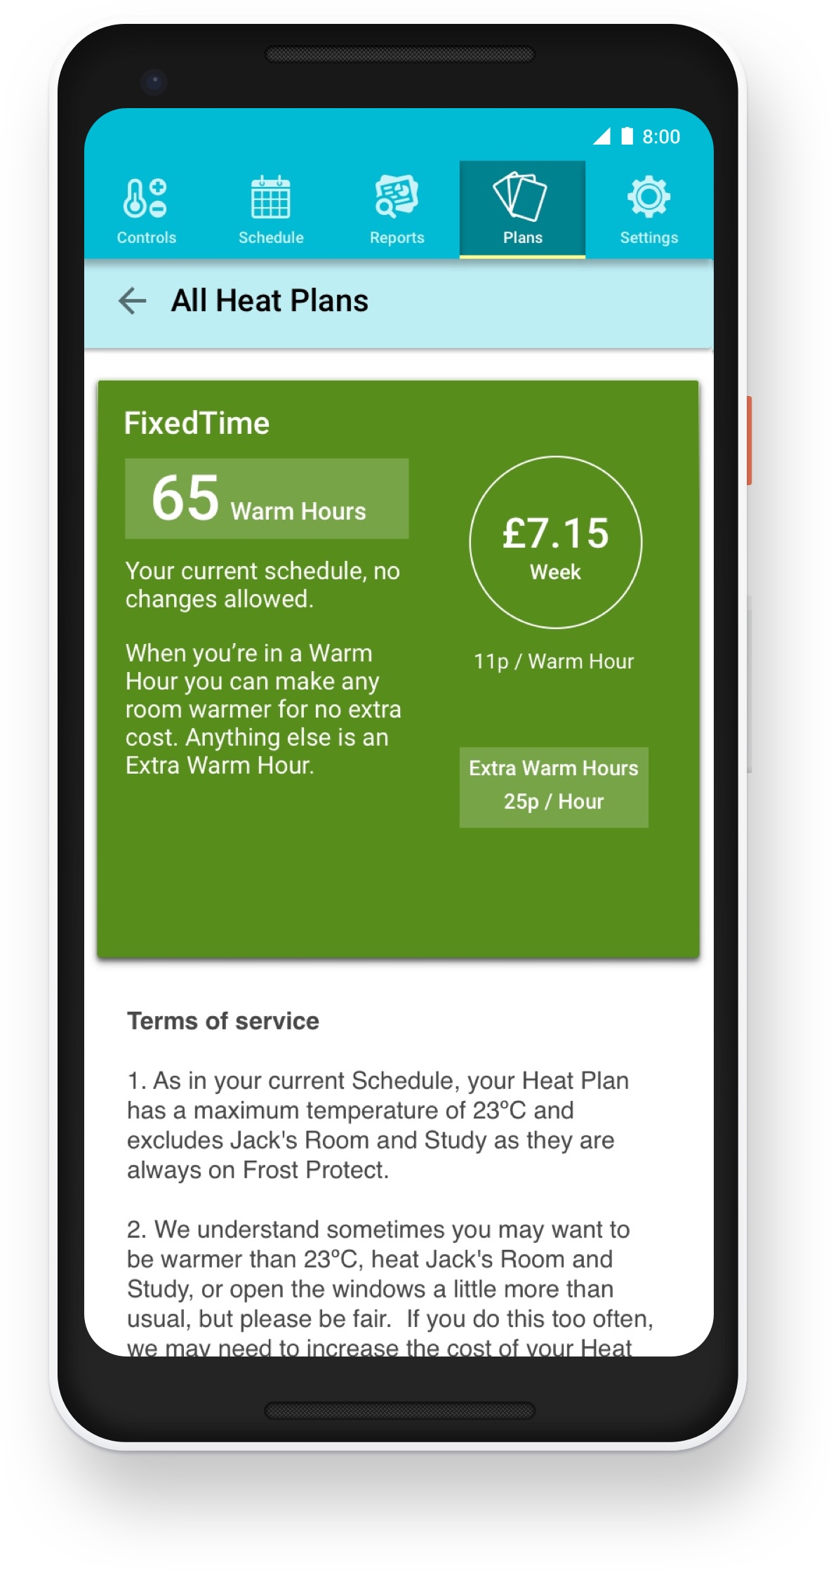
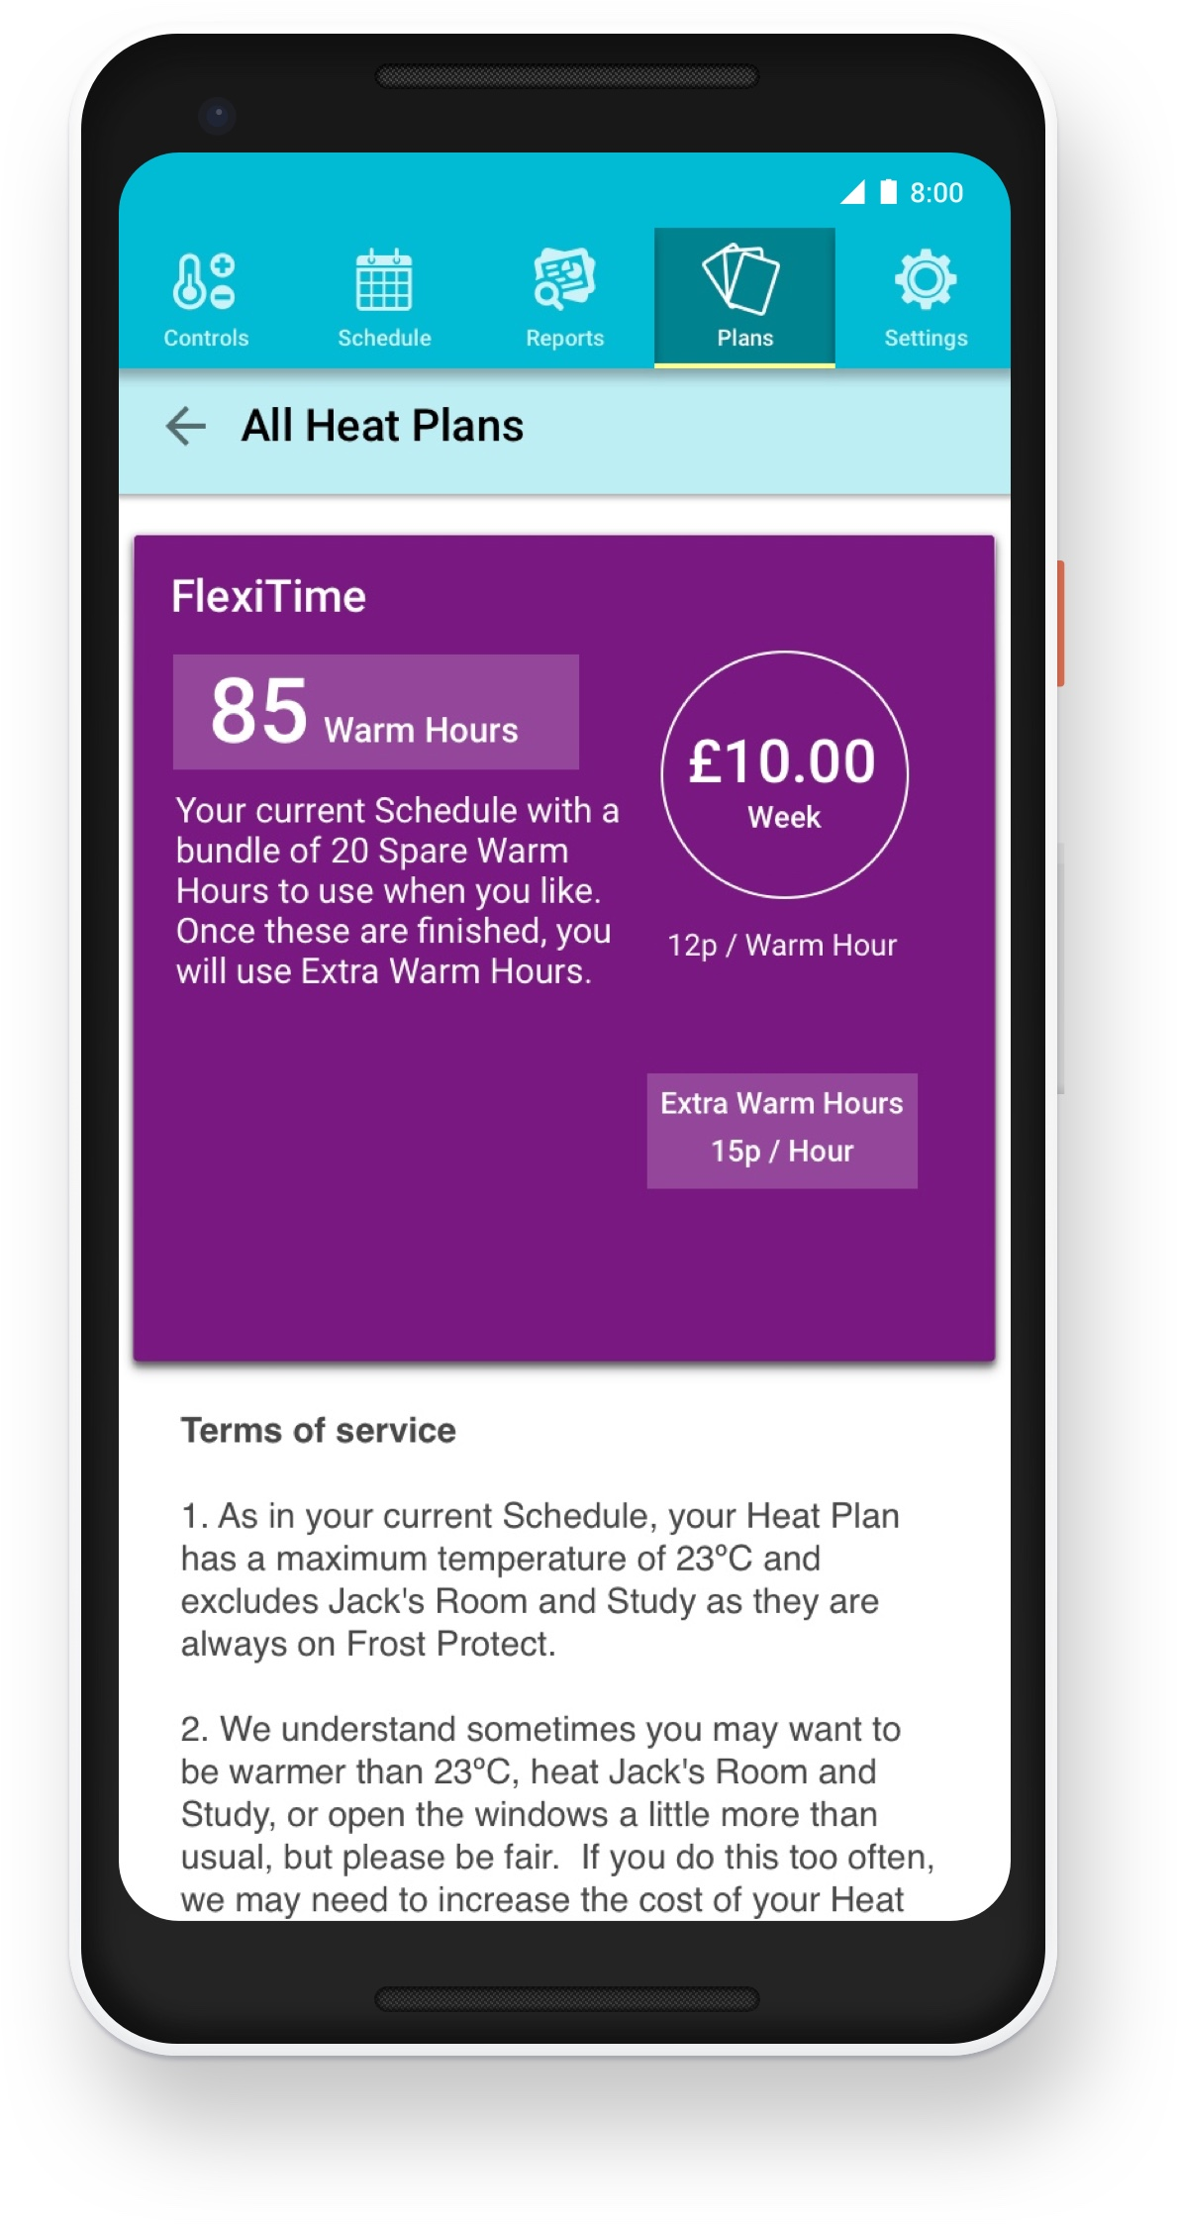
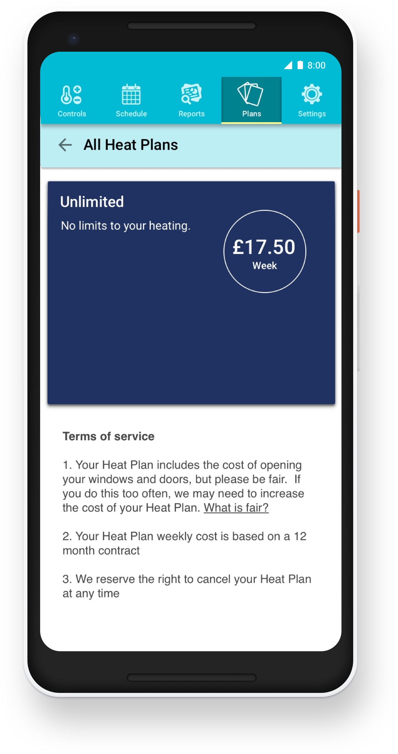
Solution: Test and learn by offering 100 tailored heat plans
Designed around how people use heat
Priced on expected cost in their home
Pay no more than the cost of their plan
Call to learn how they pick a plan
Policy to discover what is fair
Monitoring uptake to estimate ‘profit’

Slide 20
Part 3: What have we found?
(Caution: early findings)

Slide 21
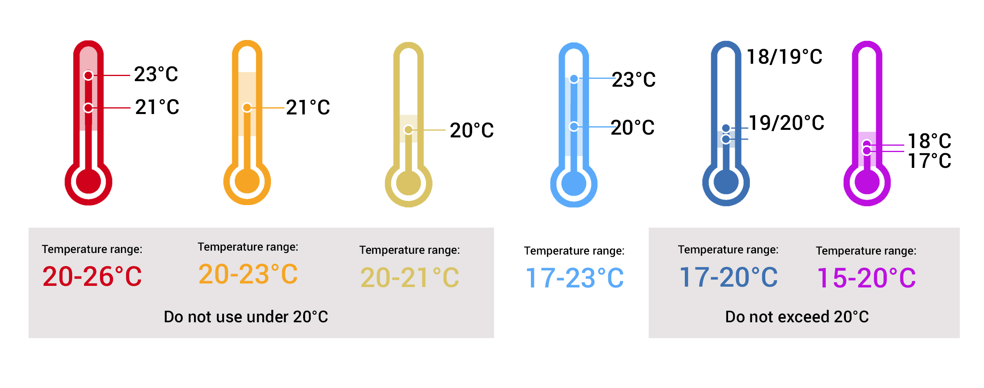
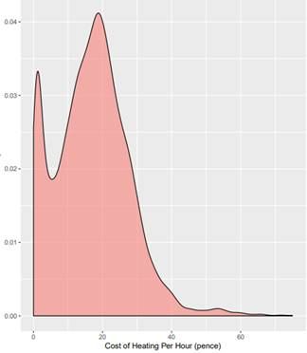
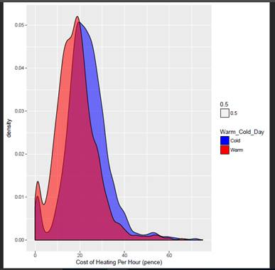
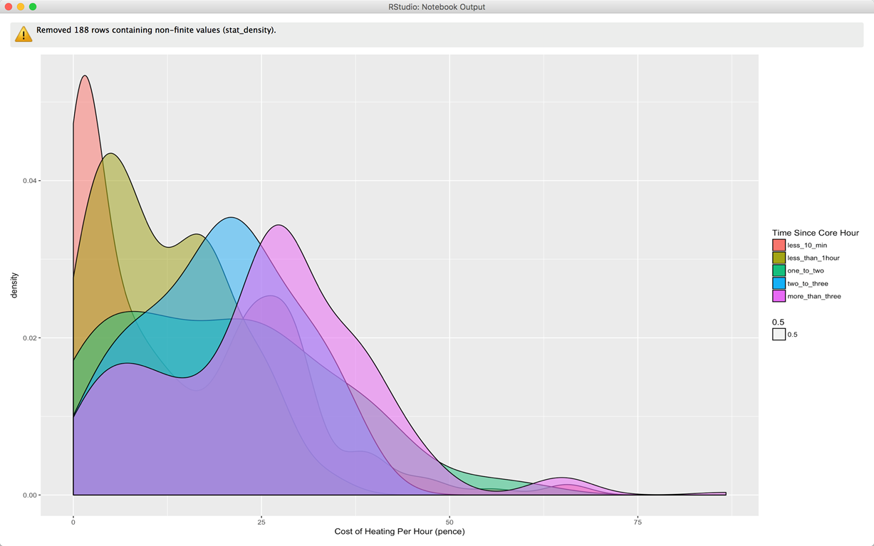
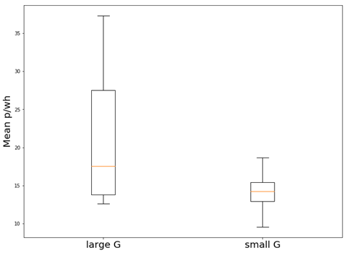
Different factors drive value and cost
People value different levels of service: temperatures, hours, flexibility (e.g. six thermal preferences)
The cost to serve is also shaped by the weather, the building and when it is being kept warm
Cost to serve
Weather
Time of extra hour after a block <10 mins
< 1 hour
1-2 hours
2-3 hours
3-4 hours
Building
Warm days
Cold days
Overlap
Probability
0 0.01 0.02 0.03 0.04
Probability
0 0.01 0.02 0.03 0.04 0.05
Probability
0 0.02 0.04
Mean cost of heat (pence/hour)
10 15 20 25 30 35
0 20 40 60
Cost of heat (pence/hour)
0 20 40 60
Cost of heat (pence/hour)
0 25 50 75
Cost of heat (pence/hour)
Poorly insulated Well insulated

Slide 22
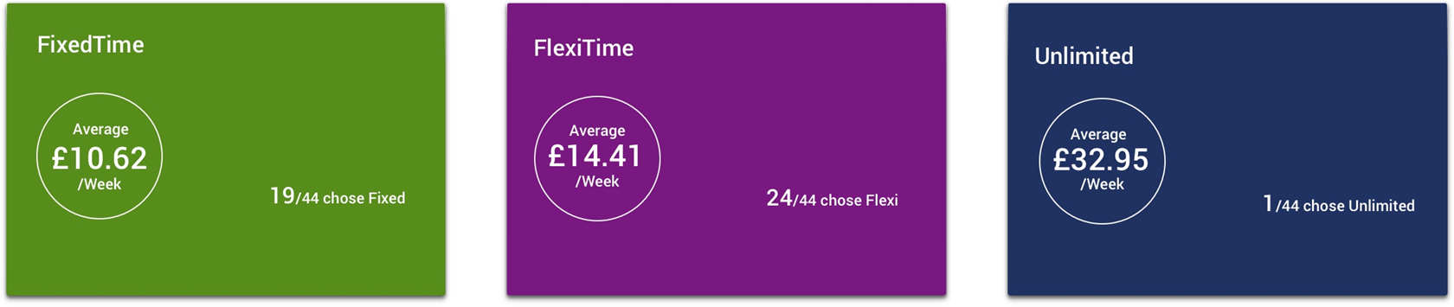
Heat Plan ‘sales’ figures
Higher uptake than expected
Why did some participants not ‘buy’ a Plan
Inflexibility
The biggest issue, cited by around 1/2, related to the design of the basic Plans we offered
“The winter was almost over and did not see the value of changing”
Price
Around 1/3 did not want to pay more than their current bill.
“Overall cost seemed expensive and we think it would of cost us more”

Slide 23
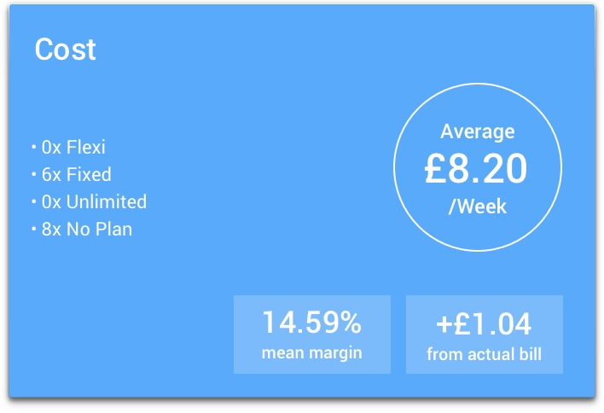
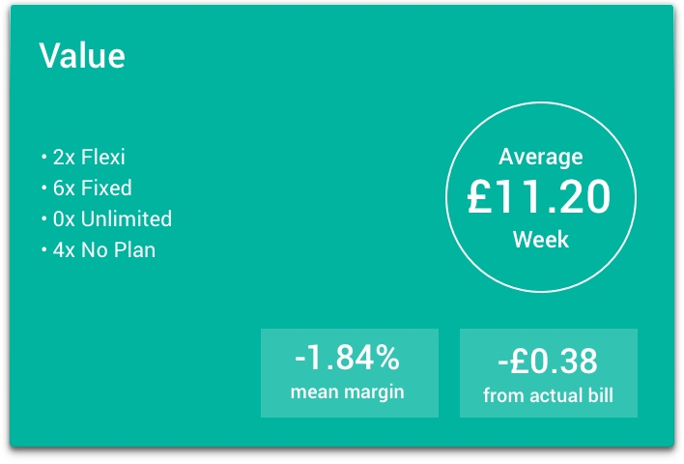
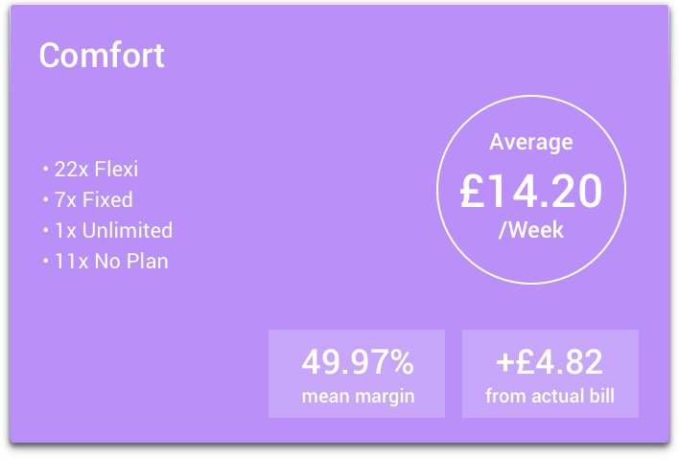
Heat Plan ‘sales’ figures
Who was most likely to ‘buy’ a Plan?
What were their reasons?
Comfort focused
People who ‘bought’ a Plan were more likely to have more hours and less likely to worry about cost
‘Comfort certainty’
People who ‘bought’ a Plan were more likely to have found their home more comfortable during the trial
“The house has never been so warm…………I’ve noticed a massive difference in the house. It’s probably costing us an absolute fortune, because now, you know, when I feel it’s nice and warm, it’s nice to keep it that way. You know, that’s where you’ve got to pay if you’re comfortable.”.

Slide 24
This level of uptake is high for something so new

Slide 25
Part 4: Where next?

Slide 26
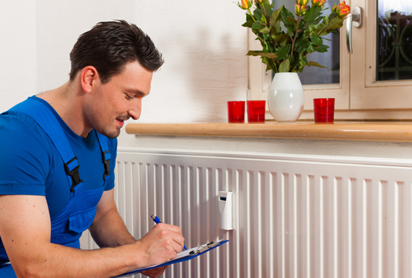
The opportunity
Society
  Consumers could enjoy higher quality services
  Service choices could reveal what energy systems people want to pay for
  Providers could decarbonise their services
  Services could create new ways to reduce fuel poverty
Service Providers
  Win market share by offering a range of tailored services
  Delight customers by improving their experiences (e.g. retrofit)
Challenges to overcome
  Consumers have to discover the value of services through experience
  Services may be hard to explain until standard language emerges
  It will be hard to design services people enjoy without testing them in real life

Slide 27
Problem: how to share the value
Device vendors
Service providers
Customers
© 2017 Energy Systems Catapult

Slide 28
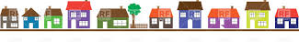
Solution: convert a 100 home trial into a Living Lab
To accelerate the design of better Energy Services
Winter 2017-18
Winter 2017-18
Winter 2018-19
Winter 2017-18
Winter 2018-19
Future
Many ESPs
Many Services
ESP offers
Heat as a Service
ESC simulates an ESP
Heat as a Service
HESG
1,000s of homes
100 homes
Many Hubs
Hub
Many Devices
Many Controls
Many Sensors
Boiler Control
Wireless Controls
Sensors

Slide 29
Part 5: Summary

Slide 30
Summary
Decarbonising heat is a cost effective way to tackle climate change, but consumer demand is low because:
  Prices are higher
  Experiences are worse
  Installation is harder
Digital energy services create a route to decarbonisation that:
  Harnesses market forces to reduce cost
  Provides data to improve quality
  Reveals ways to factor heat into home improvement
  Creates new ways to reduce fuel poverty
We have focused on trying to prove the art of the possible by:
  Designing a (starter-for-ten) Heat as a Service
  Selling bespoke Heat Plans to real households
  Collecting data on building physics and occupants’ preferences in 100 homes
We are extending the trial and converting the 100 homes into a Living Lab
  Working with Pioneers who want to become Energy Service Providers
  Working with Ofgem to discover how to sell Energy as a Service

Slide 31


Slide 32
Thanks
Matthew Lipson
Head of Consumer Insight
matthew.lipson@es.catapult.org.uk

