Slide 1
From Airbnb to Solar:
Toward a Transaction Cost Model of a Retail Electricity Platform
Lynne Kiesling, Purdue University
Michael Munger, Duke University
Alexander Theisen, Northwestern University

Slide 2
Digital technologies are transaction cost reducers
Digital devices, commerce, exchange
Falling transaction costs
Actor A
Actor B
Transaction costs
Source: digital.gov

Slide 3
Disruptive home energy technologies & evolving consumer choices shape the need for and pace of grid modernization
Source: http://www.thefabricofthings.com/2016/07/22/smart-kitchen-appliance/
Source: https://www.ecobee.com/ecobee4/
“A smart … appliance does more; it saves time, energy and money, and all with exceptional levels of performance. … By delegating more tasks and options to the appliance, we can save time and effort, as the appliance will even choose the best time to operate and the most economical program to use, taking away the worry of selecting the most economical program.”
Source: https://www.tesla.com/solarroof

Slide 4

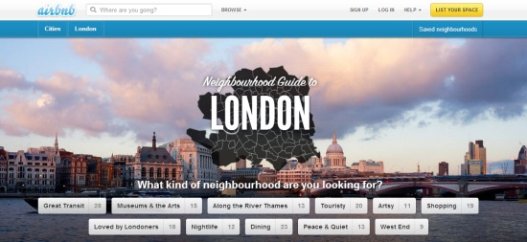
A platform business model: Airbnb
Notes:
The growth of business models based on digital platform sharing -- with Uber and Airbnb standing out as obvious examples -- has attracted both popular and scholarly attention. But there has been little price-theoretic analysis of the underlying economic forces driving these dramatic changes.

Slide 5
The paper’s research questions
What are the effects on asset ownership when transaction cost reductions make a decentralized rental market possible?
How do these general effects manifest themselves in the case of residential digital home energy management and distributed energy resources (DERs)?

Slide 6
Inspiration from and contribution to multiple literatures
Empirical analyses of residential DERs
Transaction cost economics
Platforms and the sharing economy

Slide 7
A transaction cost model
Building on Horton & Zeckhauser (2015), adding an outside option
Economy with n agents, subjective preferences over asset ownership and substitutability
Stage 1: asset choice
  Asset market
  Agent chooses to purchase asset or not
Stage 2: energy choice
  Given Stage 1 decision, agent chooses (1) how much to consume and (2) own supply if an owner or grid supply, or both
  Two cases in this stage: no rental market, rental market
Solve the model by backward induction in two different cases
  Without a rental market
  With a rental market, after transaction cost-reducing innovation

Slide 8
Implications for asset ownership decision
Without rental market
  Subjective individual parameters (α,λ) matter for asset ownership decision
  If own-supplied and grid-supplied energy are perfect substitutes, ownership only occurs if asset has a low price relative to the outside option
With rental market
  Ownership decision no longer depends on agent’s individual use of the asset (α), so the option to rent using a market platform changes the ownership decision
  Existence of rental market makes the opportunity cost of excess capacity salient
  Subjective preference over substitutability (λ) drives ownership – preference for green power, preference for local/community

Slide 9
Parameter heat maps show combinations of use intensity (α) and substitutability preferences (λ) that lead to increased DER ownership with platform markets

Slide 10
Breaking apart the price of grid power
Physical reality: wires delivery is inescapable
p_{g} = p_{e} + p_{w}
Grid-purchased power is a multi-product purchase
This gives us another important empirical dimension: split between energy price and wires price – grid services
Implications for grid defection – invest in asset to avoid p_{w}
Implications for incidence of the grid services fee

Slide 11
From a one-way road to the grid of things: Regulated wires company as a grid services platform

Slide 12
Further work
Retail transactive energy platform market design – devil in the details (e.g., DSO, who operates markets)
Economic experiment design based on
  Transaction cost model of market for excess capacity
  Platform design proposals discussed in current policy frameworks
Modeling the regulatory institutions compatible with electricity distribution platforms

Slide 13
Conclusion
Digital technologies reduce transaction costs
We model a platform business model arising from this reduction
  Creates new market in excess capacity & new gains from trade
  Shifts the distribution of asset owners
  Increases asset capacity if net ownership increases
Apply to the electric distribution utility, which is facing disruption
  Innovation at the distribution edge and incentives to purchase capacity in e.g. solar PV, EVs
  Rather than grid defection, reinvigorate the value of distribution assets by the utility becoming a grid services platform company

Slide 14
Thank you for your time and attention!

