Slide 1



Continuity and Disruption in UK energy system change: Consumers at the Heart of the System?
Dr Michael Kattirtzi and Dr Mark Winskel, University of Edinburgh
BIEE Conference, University of Oxford,
19th September 2018

Slide 2
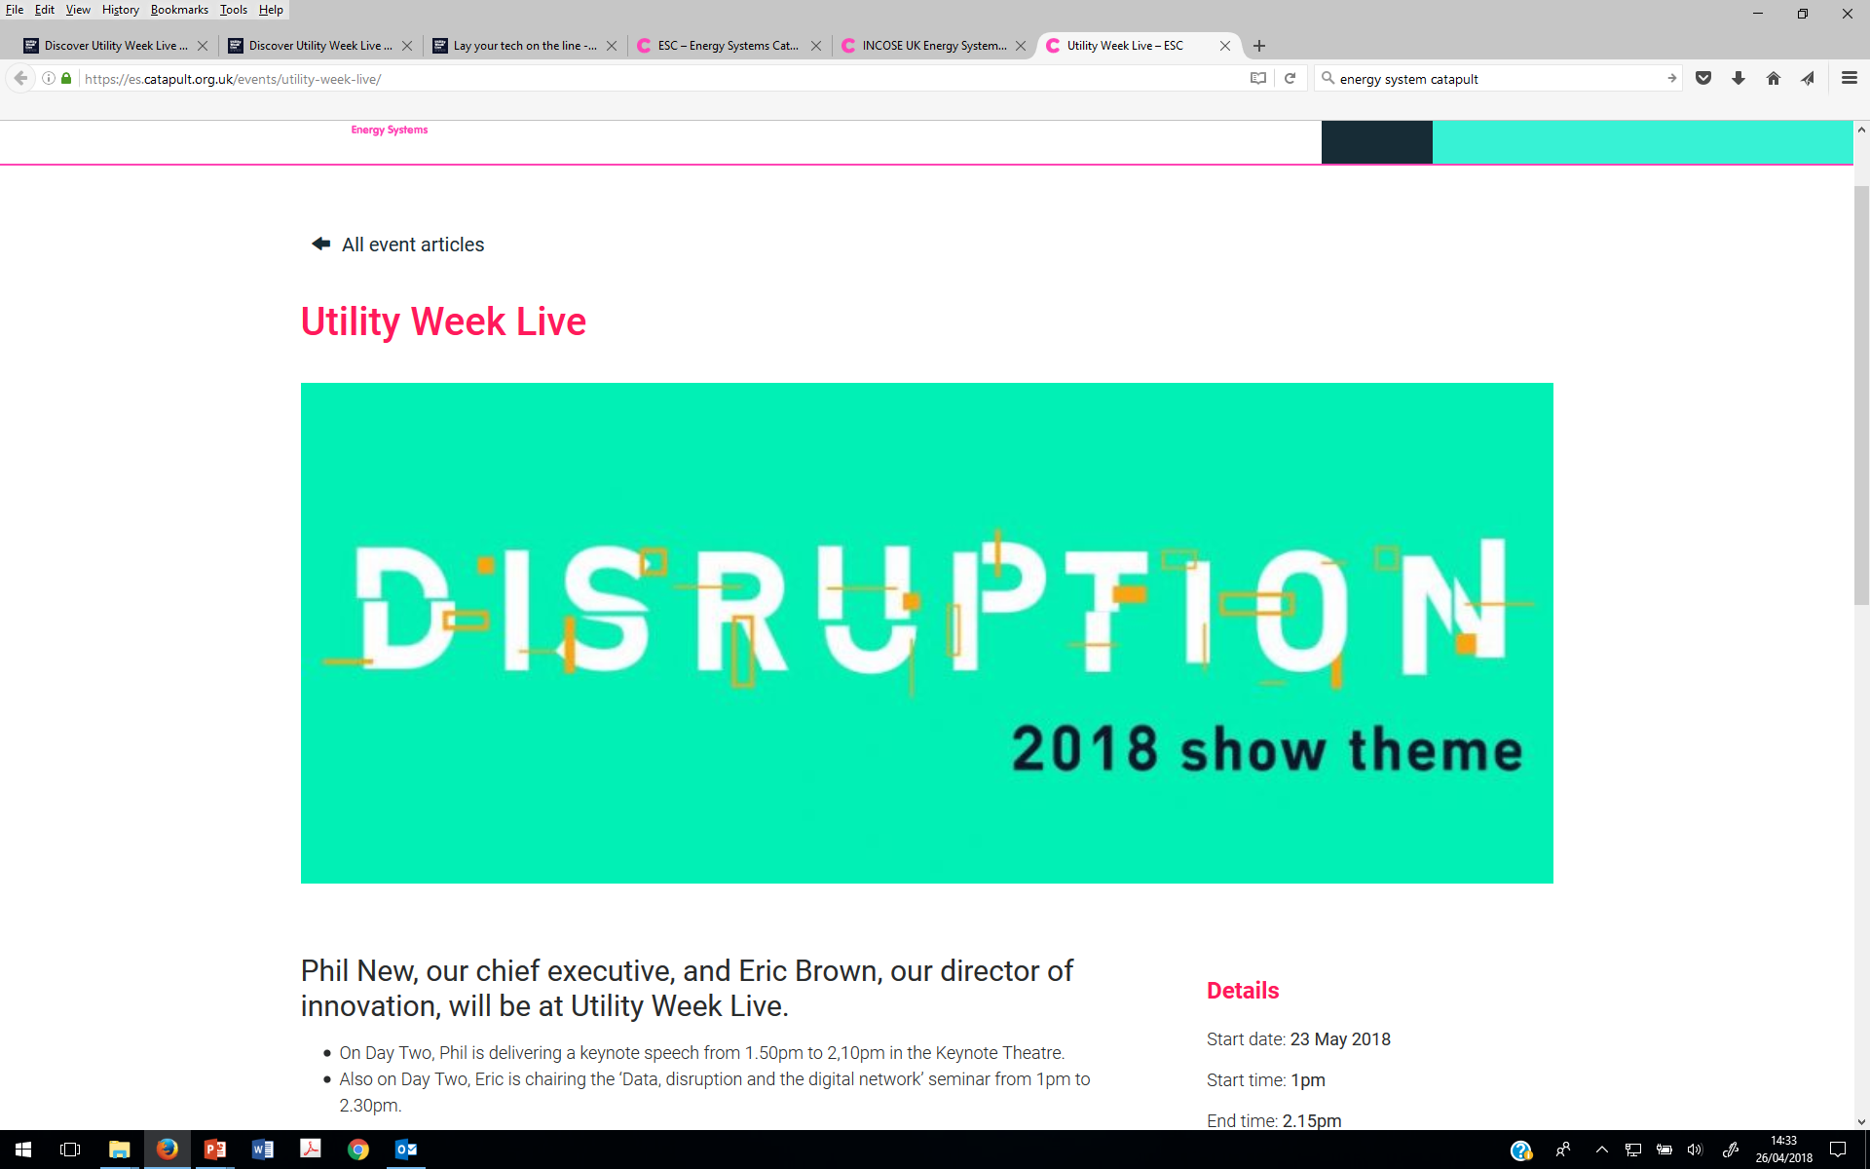
Context (1): disrupted energy systems
Today’s energy system is undergoing a quiet revolution, driven by an everchanging global political landscape, climate change challenges and a range of innovations influencing energy consumption
(IET, 2017)
The pace of … change is accelerating well beyond the speed the power sector believed possible. From a scale-driven, centralised and standardised model, the sector is set to evolve to one that is digital, distributed and personalised.
(PWC, 2016)

Slide 3
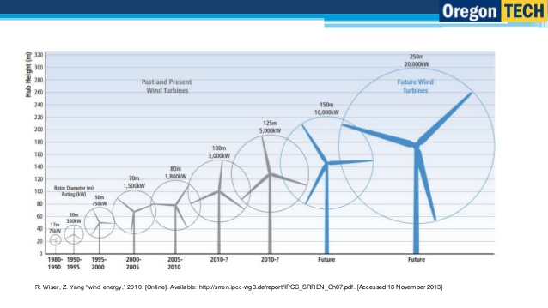
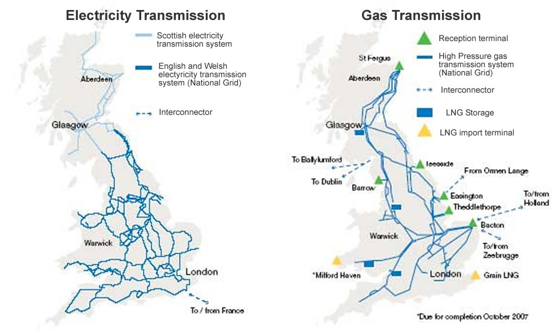
Context (2): Continuity-based energy system change
[Energy] innovation is ‘known to be incremental, cumulative and assimilative’ (Fri, 2003)
Some incumbents are capable of absorbing and driving innovation: ‘creative accumulation’ rather than ‘creative destruction’ (Bergek et al., 2013)
Scale economies still matter in some key areas, e.g. offshore wind, grid balancing, interconnectors

Slide 4

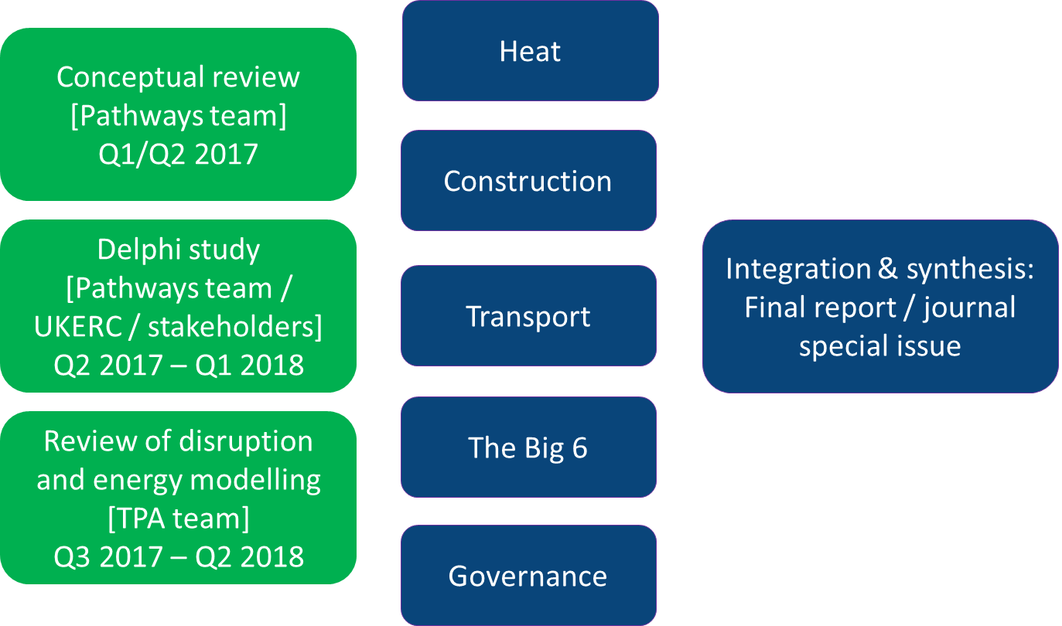
Research Aims and Questions
Allow a diverse range of researchers and stakeholders to articulate and contest their views on UK energy futures
  As a counter to confirmation biases (see UKERC’s Reflecting on Energy Scenarios report)
  Policy problems typically have multiple discourses and viewpoints, dispersed by region, role and discipline
  Part of a bigger ongoing UKERC project on continuity and disruption
Do experts agree or disagree on the likelihood of continuity-led and disruption-led change in UK energy system changes between now and 2040?
  Which aspects show greater consensus or dissensus?
  What arguments are made to support expectations?
  Do differences relate to different types of expert (researchers, policymakers, businesses, NGOs, etc.)?

Slide 5


Survey Design: Different Scenario Logics
In a Continuity-based future, system change is pursued mainly by adapting and repurposing existing organisations and infrastructures
New technologies, business models and behaviours are adopted, but as extensions and adaptions of existing ones
Scale economies remain important; national strategy and regulation dominate
Wider public don’t actively participate much, beyond switching supply
In a Disruption-based future, new technologies, business models and behaviours provoke a fundamental remaking of the UK energy system
Existing organisations and infrastructures can’t respond sufficiently and are largely displaced
Wide-ranging decentralisation of the system, both technically and institutionally
End users become more actively involved as prosumers and in DSR

Slide 6
Consumers
Do survey participants consider it likely that the role of citizens and consumers in the UK’s energy system will change by 2040?
Do survey participants deem it desirable for citizens and consumers to be more actively involved in the energy system by 2040?

Slide 7
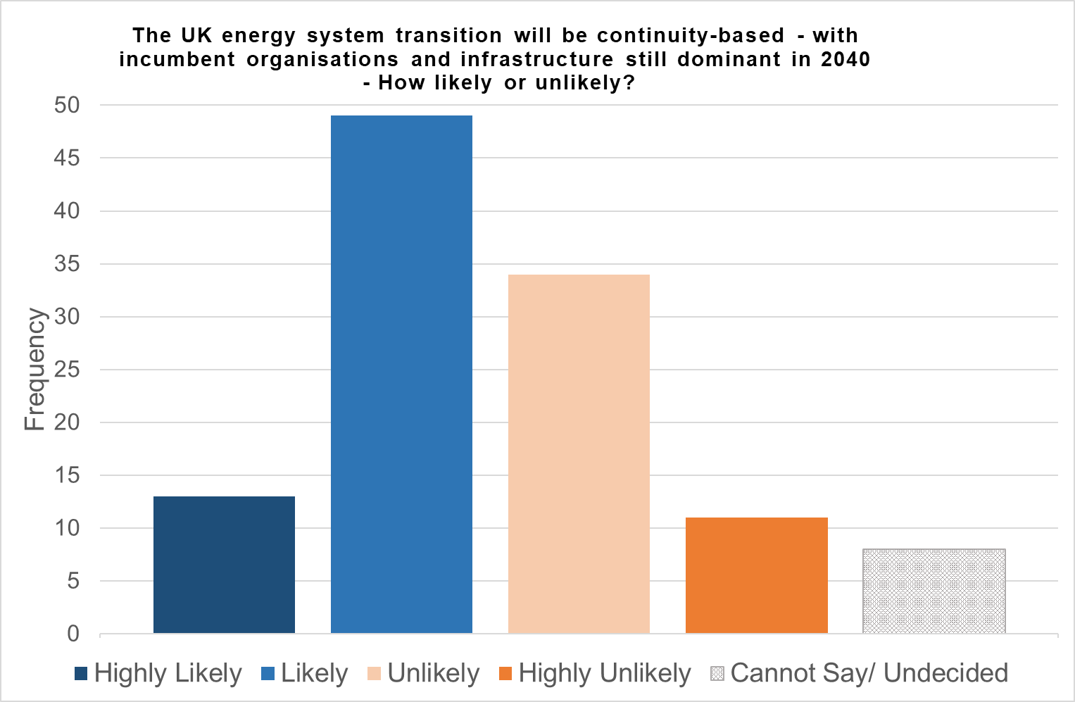
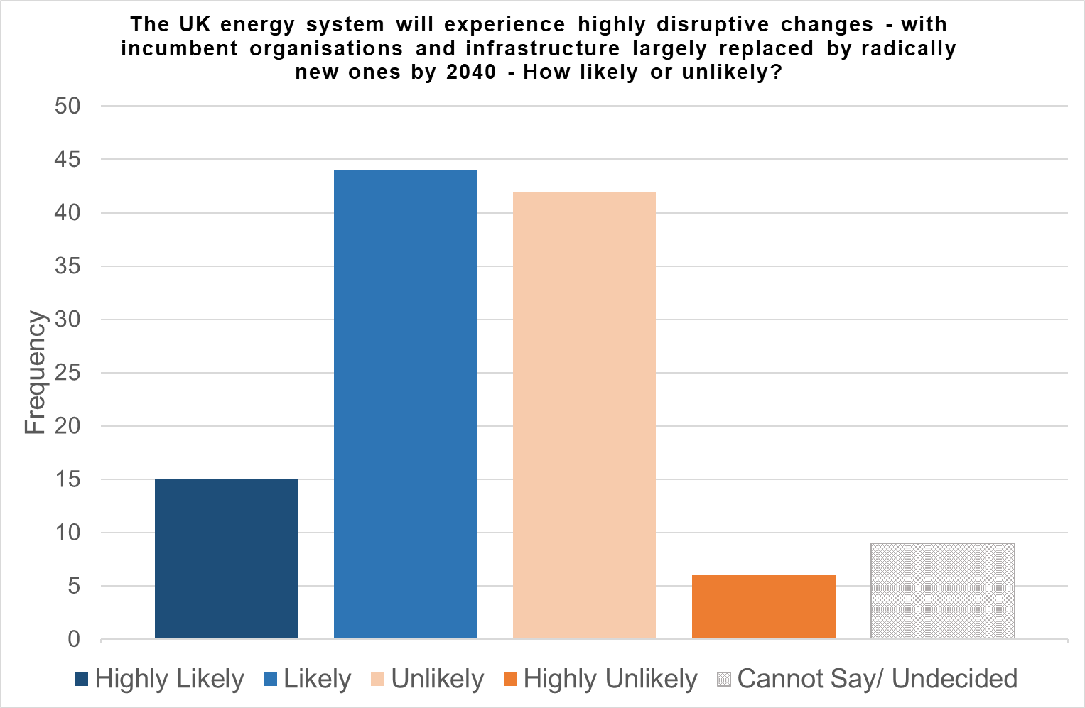
Overall System Change
Continuity…
… or Disruption ?
Comments Anticipating Disruptive Change
“I'm cynical about how much politicians and citizens generally are prepared to engage in radical change.”
A senior academic social scientist
“The energy system is going through a paradigm shift driven by a change in generation mix and consumer expectations.”
CEO of a large energy efficiency firm

Slide 8
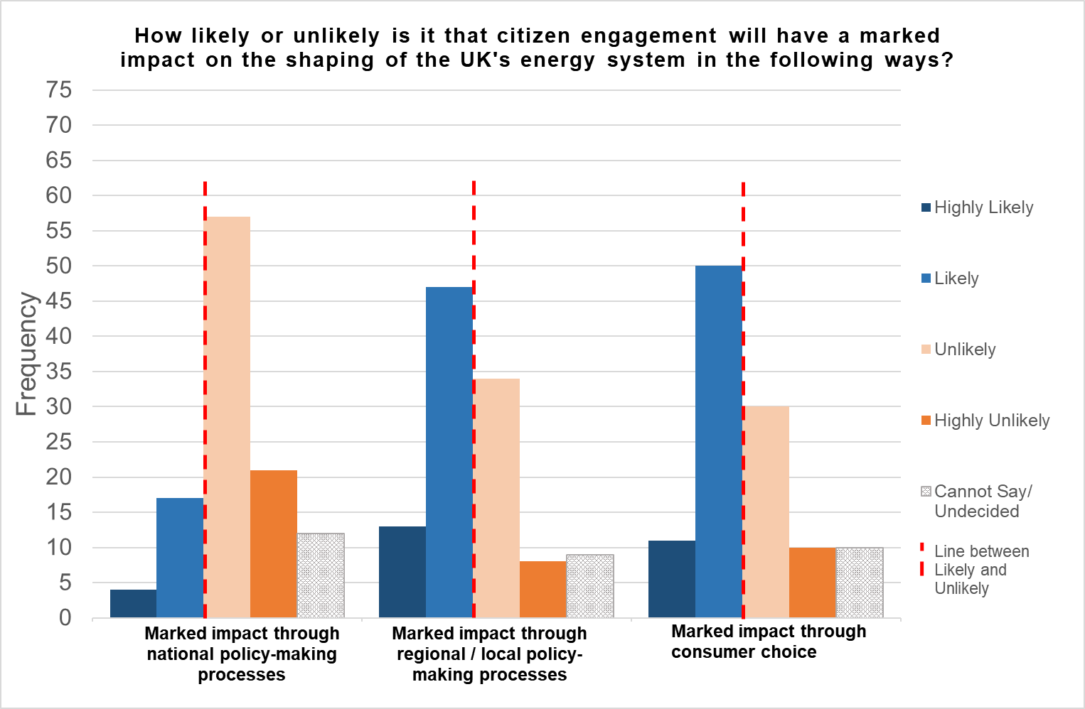
The Role of Citizens and Consumers
Consumer Choice will have a Marked Impact
Consumer Choice will not have a Marked Impact
“The impact of citizen engagement tends to be overestimated by many in academia. Evidence about consumer switching to alternative suppliers is not encouraging from this perspective”
A Professor of Engineering
“[T]he big six energy firms lost 140,000 customers in the last year”
An academic biologist

Slide 9
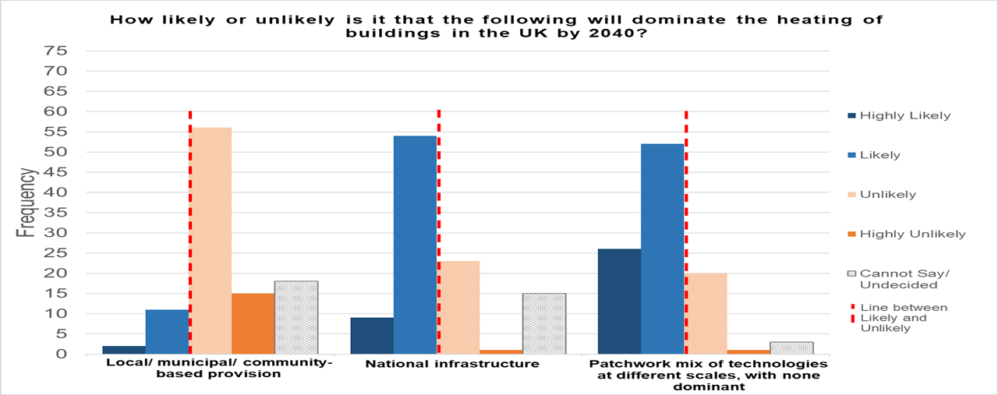
Heating in Buildings
Comments Anticipating Disruptive Change
Comments Anticipating Continuity-Based Change
“The appropriate mix of technologies is not clear at the moment… Once you combine that with different preferences in particular parts of the country it is difficult to see a one-size-fits-all solution”
“Public opposition to the disruption likely to be caused by moving to local heating solutions will slow down developments”
A senior analyst at a public sector body
An academic economist

Slide 10
Innovations Expected to Make the Largest contribution to Decarbonising the Heating in Buildings by 2040

Slide 11
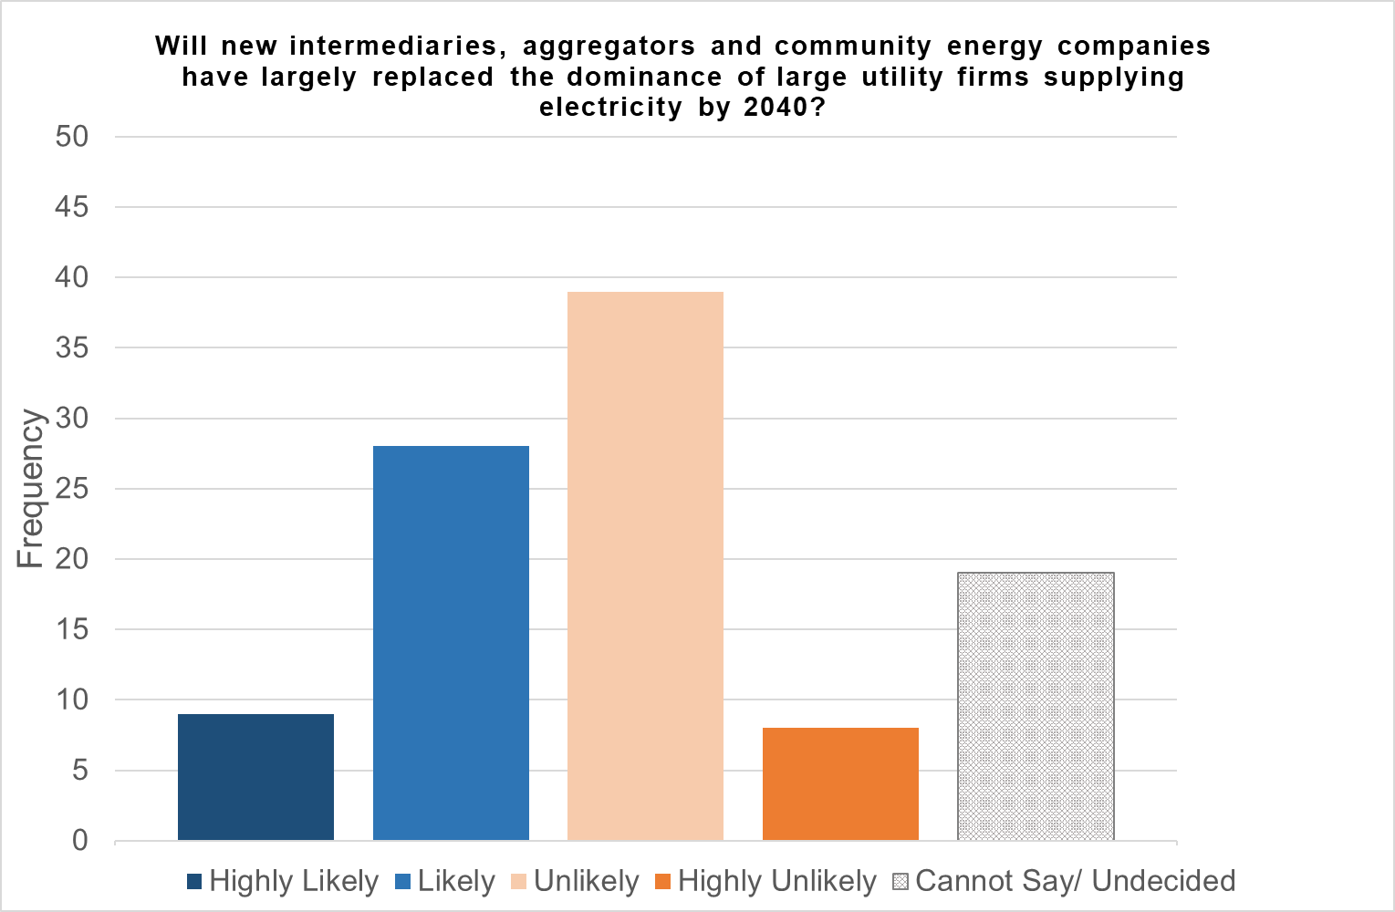
Power Sector: Supply Model
Comments Anticipating Continuity-Based Change
Comments Anticipating Disruption-Based Change
“I really don't believe that the great British public care that much. I also think they just want this done for them”
An independent consultant
“Real competition in electricity supply will occur over the next 2 decades as consumers begin to realise they can have energy tailored to their specific needs by smaller and bespoke energy companies”
An academic economist

Slide 12
Innovations Expected to Make the Largest contribution to Decarbonising the UK’s Electricity System by 2040

Slide 13
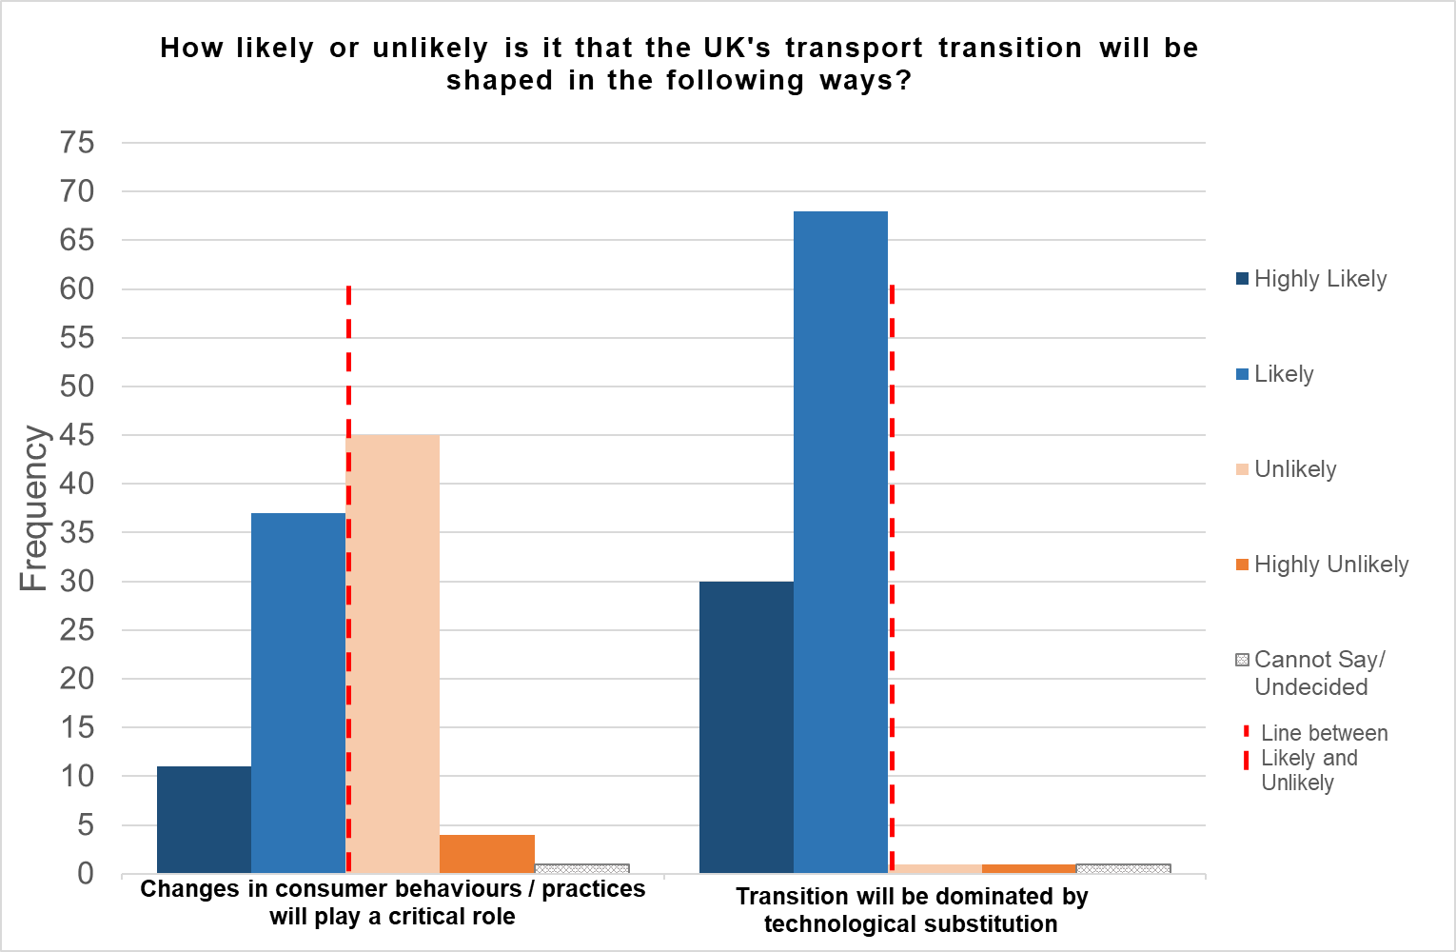
Transport Sector Transition
Comments Anticipating Continuity-Based Change
Comments Anticipating Disruptive Change
“I think mode shift will be relatively small in importance, particularly outside London”
An energy modelling researcher
“Millenials will come to adopt mobility as a service which will couple with the electrification/low emission/wireless charging to dominate”
A Director at a Large Environmental NGO

Slide 14
Innovations Expected to Make the Largest contribution to Decarbonising Personal Transport by 2040

Slide 15
How should UK Government Act?
UK Government should… | Percentage of participants who agree/ strongly agree | Valid total
...establish energy demand reduction as an energy policy priority | 92% | 101
...support greater citizen involvement in regional and local planning for energy projects | 87% | 89
...facilitate a devolved approach to energy system change to emerge, with support focused on early pilot studies | 81% | 85
...assist new entrants in the market, including peer-to-peer trading and new aggregators | 81% | 84
...seek to empower consumers over the choice of provider, fuel type and origin | 81% | 94
...support greater citizen involvement in national energy policy decision-making | 75% | 89
...take over ownership of energy infrastructure and organisations | 38% | 76
...regulate energy prices and / or consider introducing price caps | 35% | 82

Slide 16
Summary (1)
Experts are divided on whether UK energy system change will be broadly continuity-based or disruptive
  For those anticipating a continuity-based future, consumers are expected to play a largely passive role
Among those anticipating disruptive change, many believe changing consumers’ will become a driving force for change
  Consumer choice seen as more significant than active citizenship
Expectations by sector:
Buildings’ heating: most anticipate continuity-based changes, with consumers either passive or resistive.
  At the same time, high expectations for improved buildings fabric and insulation
Electricity supply: majority believe large suppliers will adapt and will continue to dominate, though others believe that they will be overtaken by new entrants / trading models.
Personal transport: vast majority expect technology substitution to dominate
  Less than half expect modal shift and behaviour change to play a critical role

Slide 17

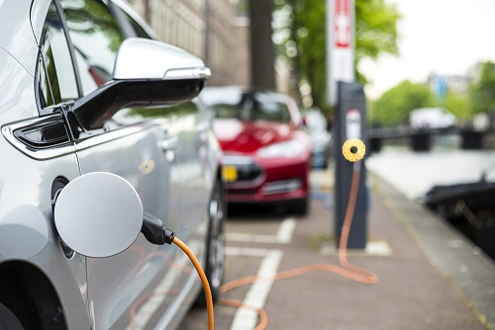
Summary (2)
Mismatch between expert expectations of likelihood and desirability:
  Most experts believe the UK Government should encourage a more active role for citizens
Overall, the results suggest caution in casting consumers at the heart of the UK’s energy transition:
  While there are increasing possibilities, many energy experts doubt this will occur in practice

Slide 18

Thank you michael.kattirtzi@ed.ac.uk mark.winskel@ed.ac.uk

