Slide 1

Modelling take-up of residential Solar PV
BIEE Conference
Sophie Heald
September 2019

Slide 2
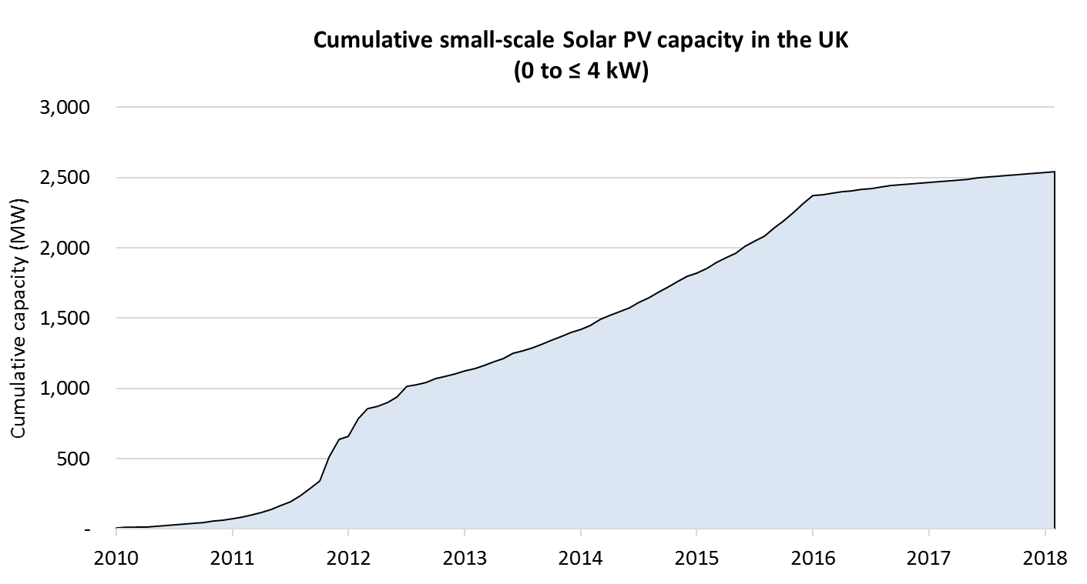
A history of residential Solar PV policy
Feb 2016: Solar FiT reduced from 12.47 p/kWh to 4.39 p/kWh
Aug 2012: Solar FIT cut to 15p/kWh; available for 20 years
Oct 2011: Solar FIT cut from 43p/kWh to 23p/kWh
April 2010: Solar FiT launches

Slide 3
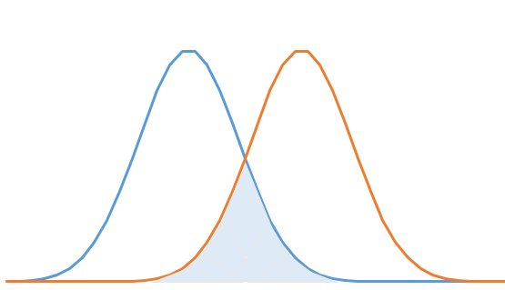
Modelling future take-up
Distribution of cost-effectiveness
Determined by:
load factor
CAPEX and OPEX costs
interest rate
electricity price
self-consumption ratio
Distribution of consumer preferences
Determined by non-price factors, such as:
access to information
aesthetics
consumer perceptions
X% of consumers
in this area invest in a given year
increasing cost-effectiveness
increasing consumer preference

Slide 4
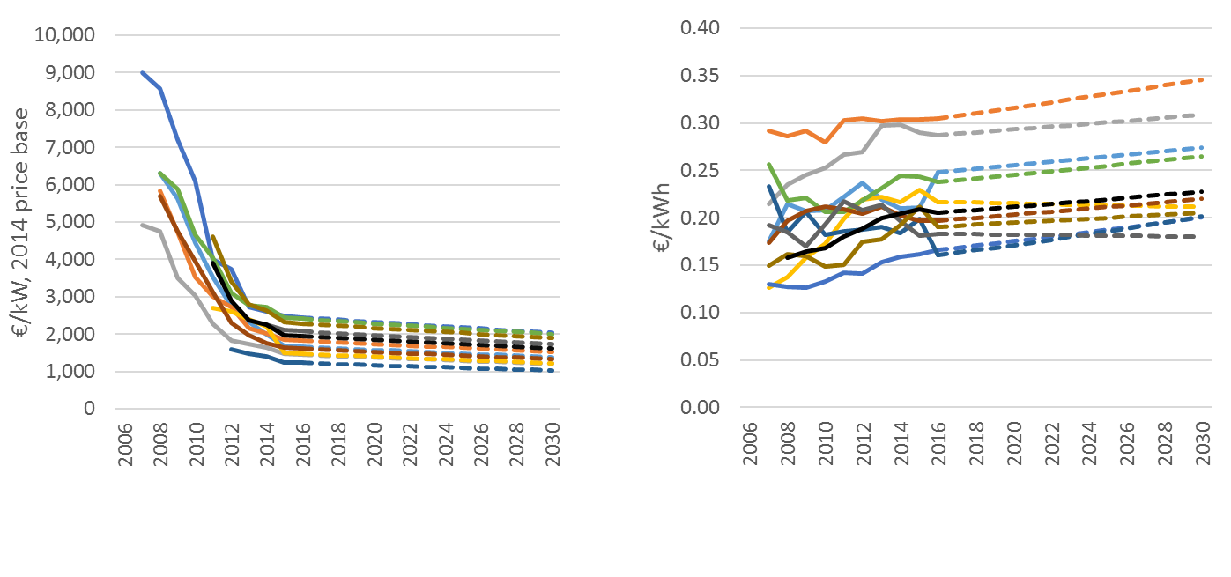

Key assumptions
CAPEX costs
Electricity prices

Slide 5
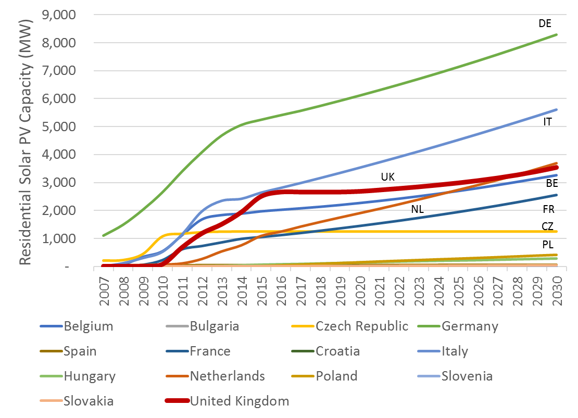
Baseline projections

Slide 6
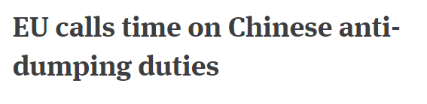
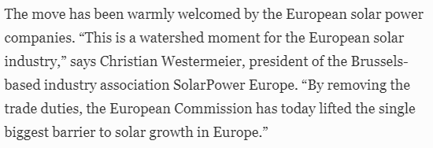

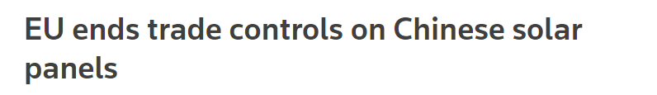
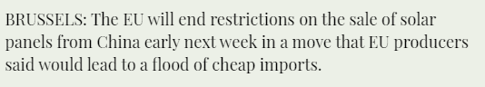

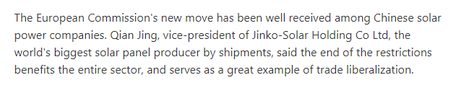

3rd September 2018:
EU relaxes anti-dumping legislation

Slide 7
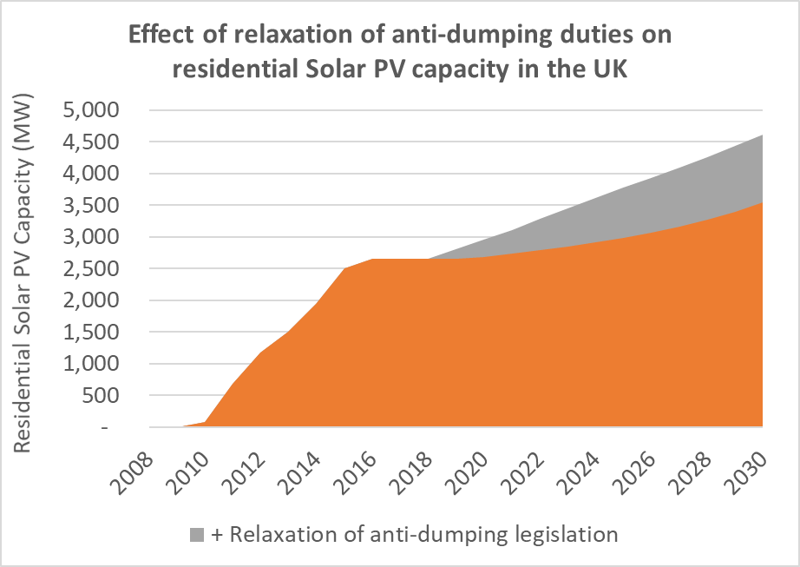
Residential Solar PV projections with relaxation of anti-dumping legislation
+1 GW

Slide 8






1st April 2019:
Government plans to end FiTs for Solar

Slide 9
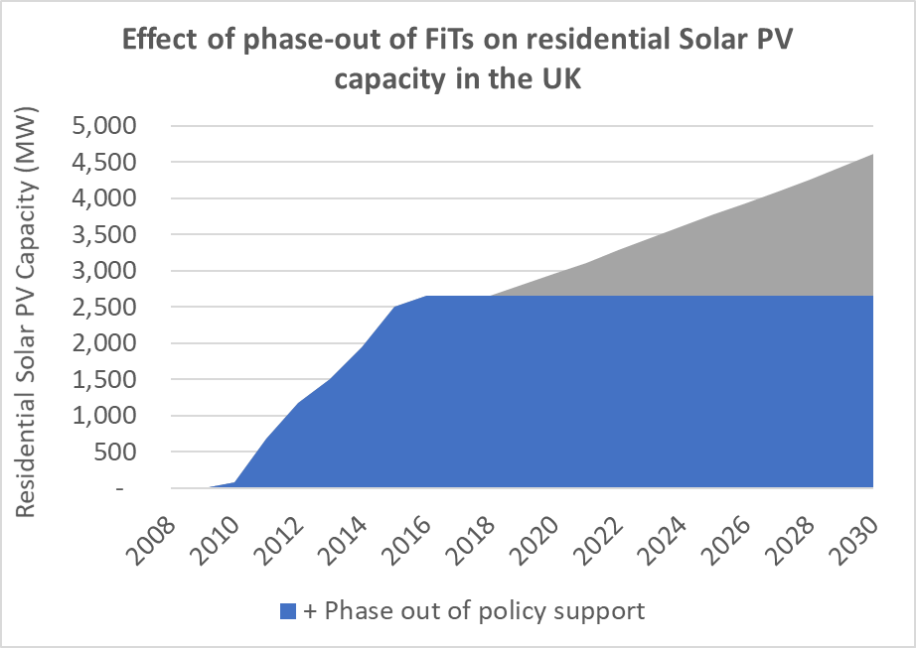
Residential Solar PV projections with phase-out of FiTs in April 2019
- 2 GW

Slide 10
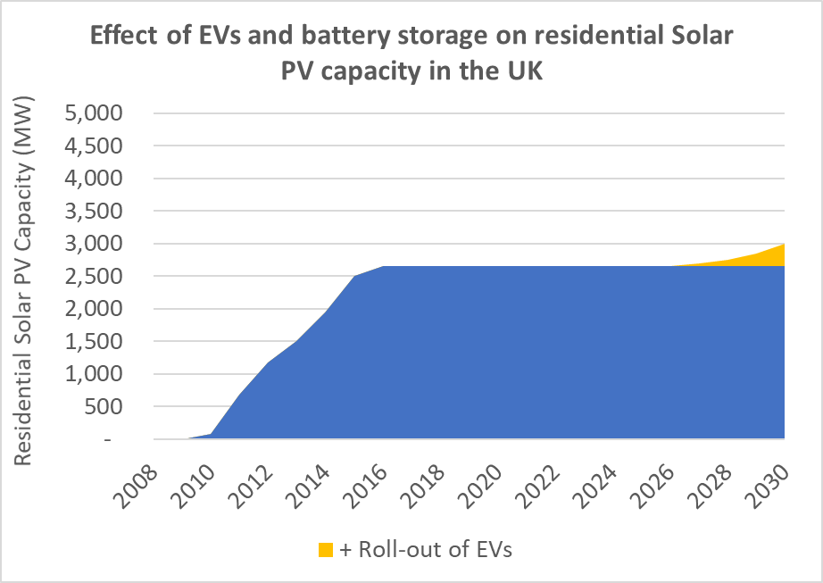
Residential Solar PV projections with 70% self-consumption ratio by 2030
+0.5 GW

Slide 11
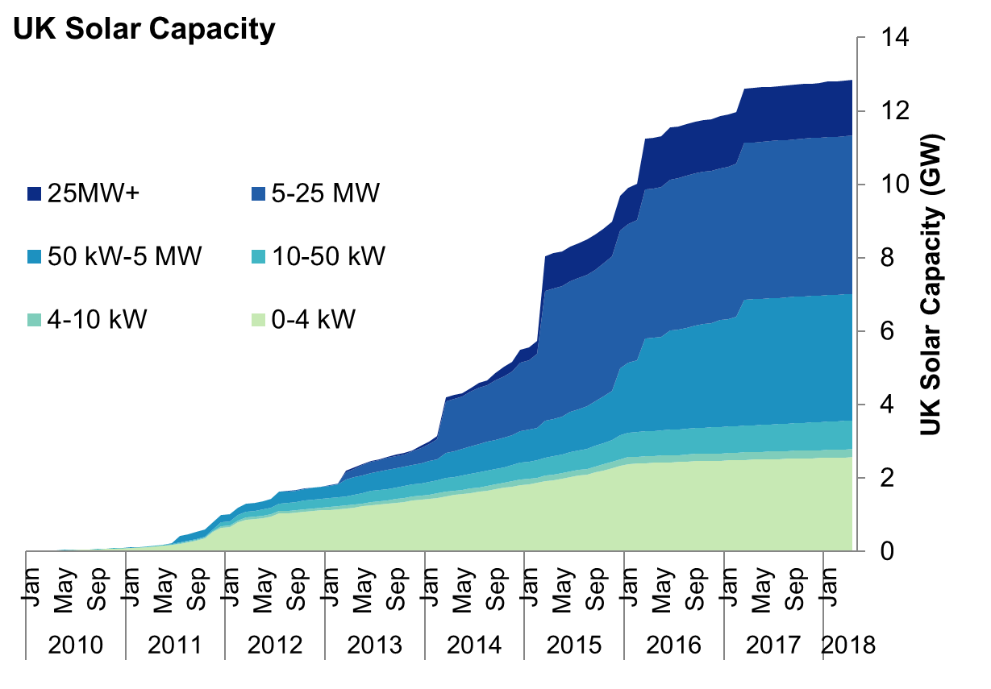
Consumers at the heart of the energy system?
Notes:
Chart shows 2017 data on payback period for installing residential Solar PV against Solar PV load factor
In general, higher levels of solar insolation = higher load factor = lower time to payback
But.. There are differences in other factors e.g. electricity prices, CAPEX costs
Pick out a few key example countries

