Slide 1
Noone Left Behind -
Consumer empowerment, protection and universal service in the low carbon transition
Chris Harris
BIEE 2018

Slide 2
Agenda
Market development and arrangements
Social justice
Consumer choice
Universal Service and backstop provisions
Conclusions

Slide 3
Agenda
Market development and arrangements
Social justice
Consumer choice
Universal Service and backstop provisions
Conclusions

Slide 4
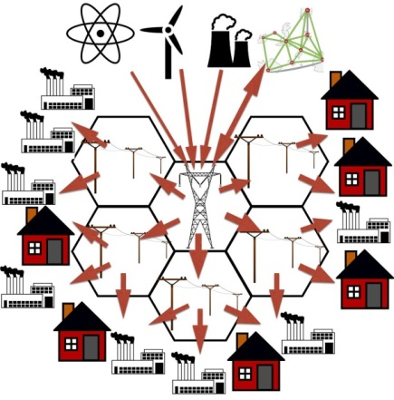
Central Station Model for Electricity

Slide 5
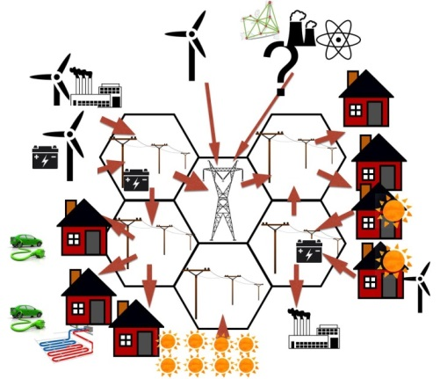
Decentralised Model

Slide 6
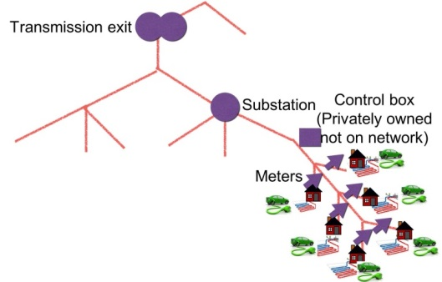
The Grid Edge

Slide 7
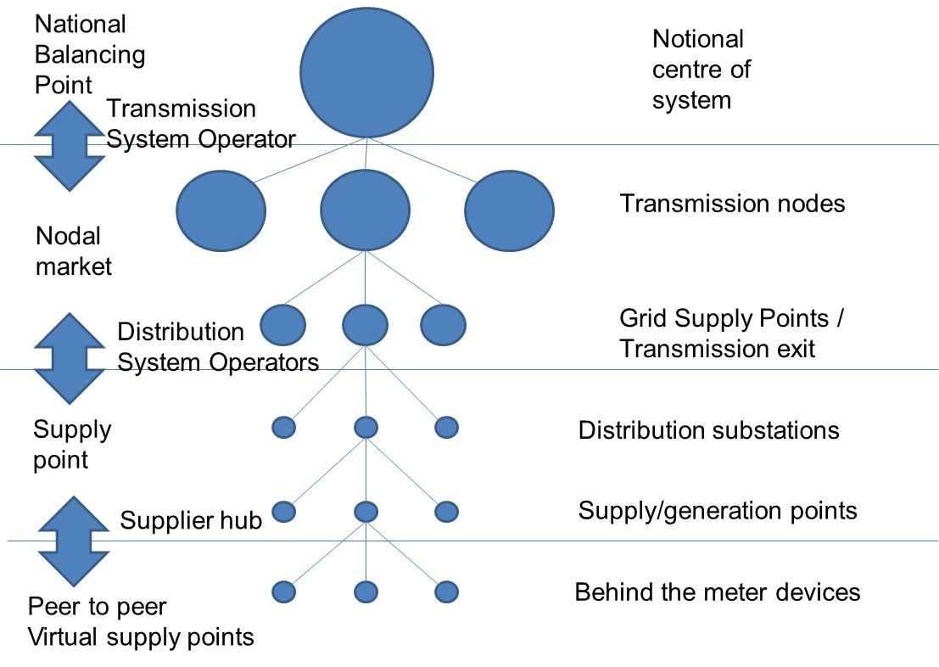
Linking Decentralised Markets
Top down central station market
Bottom up decentralised democratised market

Slide 8
Agenda
Market development and arrangements
Social justice
Consumer choice
Universal Service and backstop provisions
Conclusions

Slide 9
Key Elements of Social Model
Society’s Welfare
Which society?
Aggregation and Social Choice
“Welfarism” and Paternalism
Individuals’ Welfare
Rational “mistakes” – Information gaps;
Psychology of “bad” choices
Altruism and “Commitment”
Individuals’ Choices
Meaning of the “Utility Function”;
Preference-Satisfaction theory of “the Good”
“Rational Choice” and examples of the lack of it
Individuals’ Preferences
Source. Beckerman, W. (2011) – “Economics as Applied Ethics – Value Judgements in Welfare Economics” – Palgrave

Slide 10
The Threshold Approach to Consumers
Threshold/s
£total
Paternalist
Lexical
Efficient under money metric
Welfarist policy
Amount of wealth
Choice challenged
Choice enabled
Gap to median
£0
0
Number of people
everyone

Slide 11
Inequality Effects of Efficiency Actions
Drive market forward
Rely on welfare system to resolve residual distributional issues
Or prevent to avoid locally regressive outcome and bad choice risk?
Externalities
Efficiency
Win-win but may be slow
Iso-welfare
less
more
Equality

Slide 12
Agenda
Market development and arrangements
Social justice
Consumer choice
Universal Service and backstop provisions
Conclusions

Slide 13
Basic Decision Architecture
Opportunity set
Decision process
Outcomes
Bad
Best for all
Best choice but unfair

Slide 14
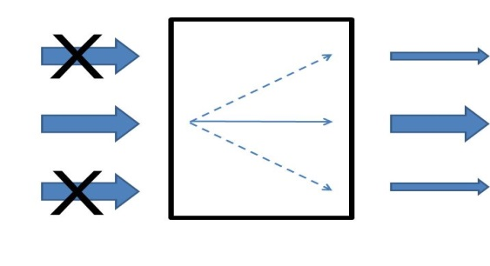
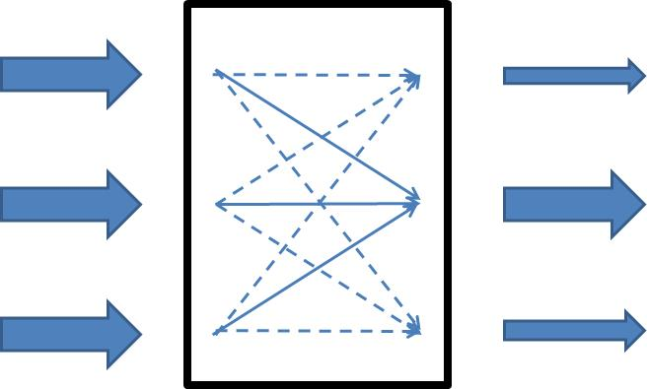
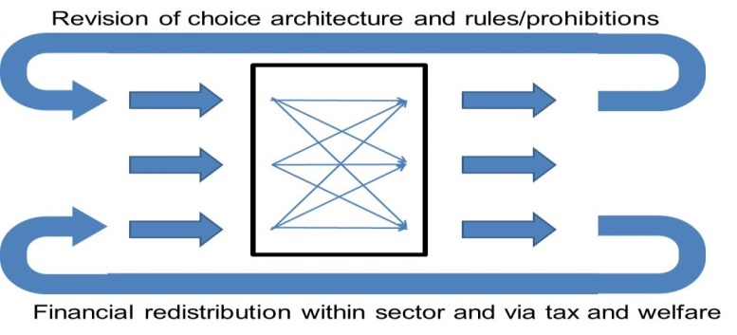
Choices for Decision Architecture
a) Restrict choice b) direct choice
c) Ex post resolution
c) Ex post resolution

Slide 15
Architecture for ex post Decision Resolution
End of Pipe Regulatory/Policy/Structural
Choice Architecture Resolution
Sweep Up – convert bad choices to good
Consumers
and
Choices
common
themes
Collective lexical/cohort outcomes
Individual outcomes
Sweep Up – financial resolution of bad choices?
End of Pipe Financial Resolution in Tax and Welfare and within Energy System

Slide 16
Financial Remedy for low Choice Resources not “Bad Choices”
Less choice resource
“Bad choices”
Inadequate subsidy
Less choice resources
“Bad choices”
Less choice resource
Good choices
No subsidy needed
Adequate choice resource
“Bad choices”
No subsidy “deserved”
Less choice resource
“Bad choice” effect offset by subsidy
Adequate choice resource
“Bad choices”
Undeserved offset received
Less choice resource
But good choices
Subsidy windfall
Cohort subsidy
Adequate choice resource
Good choices
Windfall gain

Slide 17
Agenda
Market development and arrangements
Social justice
Consumer choice
Universal Service and backstop provisions
Conclusions

Slide 18
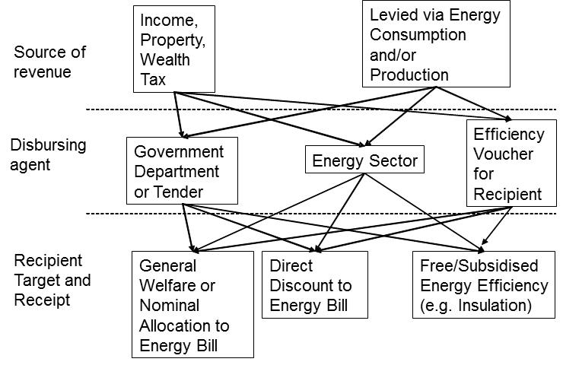
Policy Choices for Subsidy Delivery

Slide 19
Income elasticity of normative and actual demand for essentials and “non essentials”
a) Normative/Paternal
b) Actual/Libertarian
Spend
Spend
NE
Threshold
heat requirement
E
£
H
Income
Income of individual n
Income at threshold
NE=“non essential”
H= heat
E=other essentials

Slide 20
Policy Choices for Subsidy Spend Discretion
Libertarian
“bad” financial choices (spend on other things)
Give money
Offset to energy bills
Potentially welfare inefficient
Give insulation and other kit
Welfare maximum
Paternal

Slide 21
Agenda
Market development and arrangements
Social justice
Consumer choice
Universal Service and backstop provisions
Conclusions

Slide 22
GOVERNMENT/REGULATOR
Fiscal solutions for universal service and backstop provision
Fiscal resolution/
redistribution
Choice enablement/
support
OUTCOMES
PROSUMERS
Individual benefits with negative externalities resolved
Civic responsibility
Decision Architecture
Individual benefits with positive externalities
Procurement
Innovative take-up develops the market
Rhythm of life
Innovation
Market access
Universal service and backstop provision
PRIVATE SECTOR

Slide 23
Thanks
Chris.Harris@npower.com

