Slide 1

Do consumers want the new business models we can offer?
Dr Stephen Hall, University of Leeds; Prof Jillian Anable, University of Leeds; Dr Jeff Hardy; Imperial College London; Yvonne Matthews, Statistical Research; Dr Chris Mazur, Imperial College London; Dr Mark Workman, Energy Systems Catapult.

Slide 2

Utility 2050 - Phase 1
How Much are Energy Futures Worth? What Business Might be Operating? And How will Consumers Respond to New Energy Service Value Propositions in 2035 to 2050?

Slide 3







Drivers for new system value / avoided cost
“The UK could save £17-40 bn across the electricity system from now to 2050 by deploying flexibility technologies”
Smart systems and flexibility plan
25% 2016
50% 2050
“The UK is uniquely placed to lead the world in a Smart Power Revolution. If we get this right we could save consumers up to £8bn a year”
NIC Smart power report
25 million 2050
15 million 2050
This research suggests that by 2050 up to £21 billion per year of new financial value is available in the UK electricity system…
Utility 2050 project
74 billion 2025

Slide 4
Scenarios
 |  | NGrid - No Progression | DECC 2050 - Higher RE, more EE | DECC 2050 - High Nuclear, less EE | DECC 2050 - Higher CCS, more Bioenergy | NGrid - Gone Green | RTP - Market Rules | RTP - Central Co-Ordination | RTP - Thousand Flower
Electricity Demand | TWh | 309 | 490 | 555 | 461 | 361 | 504 | 402 | 301
Power Generation (incl. Import) | TWh | 349 | 530 | 610 | 556 | 454 | 573 | 464 | 370
Conventional Generation Capacity (excl. CCS) | GW | 49 | 0 | 0 | 0 | 18 | 15 | 5 | 0
CCS equipped Generation Capacity | GW | 0 | 13 | 2 | 40 | 11 | 46 | 32 | 23
Low-Carbon Generation Capacity | GW | 42 | 121 | 97 | 49 | 119 | 104 | 90 | 84
Number of Electric Vehicles | mln. | 3.9 | 24.2 | 31.0 | 24.4 | 9.7 | 25.2 | 25.2 | 25.2

Slide 5







Total Values to be captured per Pool
Up to £21 bn of new value is available to electricity utilities per year by 2050
Plant efficiency
£75 – 1809 m
Service provision
£5 – 9 bn
Local LC generation
£42 – 4600 m
Large LC generation
£0.61 – 8 bn
Flexibility optimisation
£400 – 2000 m
CCS
£-0.14 – 1669 m

Slide 6

Market size and new value in 2050

Slide 7





Capturing value: New business models
Pure low-carbon generator
New electrifier
Producing low-carbon power and selling directly to large customers or wholesale market
Traditional utility that is helping consumers switch to electric heat and mobility, including installing equipment and automating DSR
Peer-to-peer
Energy Service Company
Third party control
P2P customers directly buy, sell or swap electricity with each other.
An ESCo delivers energy services to customers, such as comfort and illumination, rather than units of energy like a traditional supplier.
A third party, such as a price comparison website, takes decisions on consumers’ behalf, like automatically switching energy supplier.

Slide 8

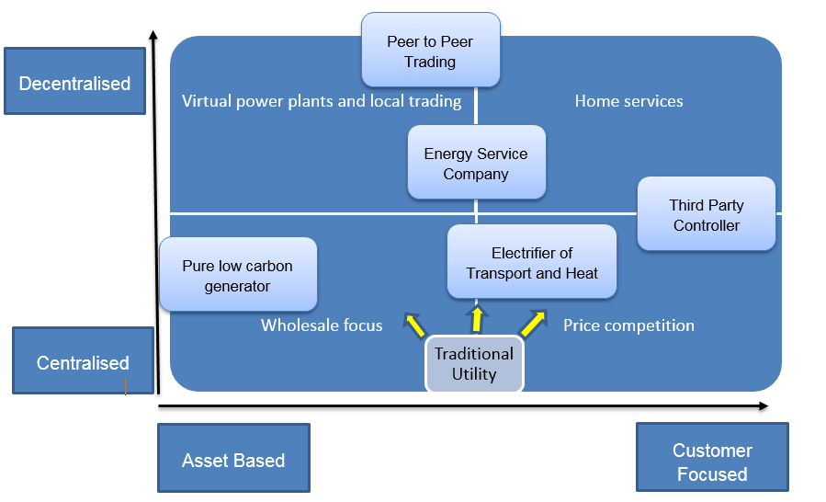

Slide 9
Same but Smart
Free to switch companies as and when you want to
You will have a ‘smart meter’ with ‘live’ information at home and on your phone etc
Your supplier can see how and when you use electricity
You can change your behaviour (not use the washing machine etc) when you see that electricity is cheaper
New Electrifier
You have a two-year contract
You get a discount for switching your home from gas to electric heat
It will cost about the same as now
You might have some new things installed like electric radiators or a heat pump
Your supplier can pause your heating occasionally for up to 15 minutes at a time, or take control of when to charge your electric car to help you avoid paying the highest prices, though you can opt out of this
3rd Party Controller
You have a multi-year contract
You tell the company how you want to live your life and it takes decisions on your behalf to deliver this
You receive one bill for all your energy, broadband, TV, mobile phone, electric vehicle and water services
Your company may offer to install equipment like insulation and a home energy management system to make your home more efficient and smarter
Your company can pause your heating and appliances (such as your fridge) occasionally for up to 15 minutes at a time, or take control of when to charge your electric car to help you avoid paying the highest prices, though you can opt out of this
Energy Service Company
You have a 10-year contract
Your energy bills are guaranteed to be lower than you are currently paying for the duration of the contract
You receive one bill for all your light, heat and any electric car needs
You might have some new things installed, like insulation and a home energy management system
Your supplier can pause your heating and appliances (such as your fridge) occasionally for up to 15 minutes at a time, or take control of when to charge your electric car to help you avoid paying the highest prices, though you can opt out of this
Peer to Peer
You have no contract with an energy supplier
You use an app on your phone choose who to buy energy from - you can choose based on price, type or location of energy. (For example, you might want local green energy, even though it might not be the cheapest)
You can change who you get your energy from as often as you like
If you have a solar panel on your roof you can make money by selling the energy from it through the app
Paired Comparison design (=10 binary choices)

Slide 10
England & Wales Questionnaire Survey (2017)
To stress test 5 BMAs, + the current utility model (BAU), against consumer acceptability and acceptance
To measure importance attached to and acceptance of key BMA attributes (e.g. flexibility, control, automated switching, complexity, data ownership, reliability, greenness, ‘localness’, bundling of services, cost to consumer, peer to peer trading)
To identify consumer segments which differ on the basis of engagement, motivations, preferences, trust and stated intention to accept each BMA

Slide 11
Questionnaire design
Section | Topics
1. About your home | House type; Ownership; Attachment to the home
2. About the supply of energy to your home | Fuel supply; joint or single elec/gas supplier + reasoning; billing/ tariff/expenditure; understanding of bills
3. Heating your home | Heating methods and fuel; satisfaction with heating system; perceived insulation level
4. Your energy use | Perceived comfort; affordability and economic stress; concern re future energy prices; likely responses to price increases; engagement with current energy usage; smart meters; trust in information sharing; attitudes to demand control
5. Choosing your energy supplier | Reasons for choice; satisfaction; switching behaviour and attitudes; switching other suppliers; trust in energy companies vis a vis other industries; general risk behaviour and innovativeness
6. Thinking about the future of your energy supply | Paired choices between each archetype; attribute ratings for each archetype; overall likelihood to adopt each archetype
7. About your travel patterns | Current car ownership and usage; attitudes towards electric vehicles; attitudes towards shared mobility
8. Other thoughts about energy and society | Attitudes towards different forms of energy generation; energy supplier regulation; environmental beliefs/concerns
9. About you and your household | Age; gender; household composition; disability; children; education; economic status; income etc

Slide 12
Sampling and achieved sample
Aim for representative sample of electricity bill payers in England & Wales
Online Survey administered through panel provider
Final achieved sample N= 2024
Included only those with some responsibility for energy supply in the household:
“Which one of the following describes your level of involvement in decisions about which company your household uses to supply gas and/or electricity?
It is my responsibility entirely
I have equal responsibility with someone else in the household
I have some involvement in the decision
I have no involvement at all THANK & CLOSE

Slide 13

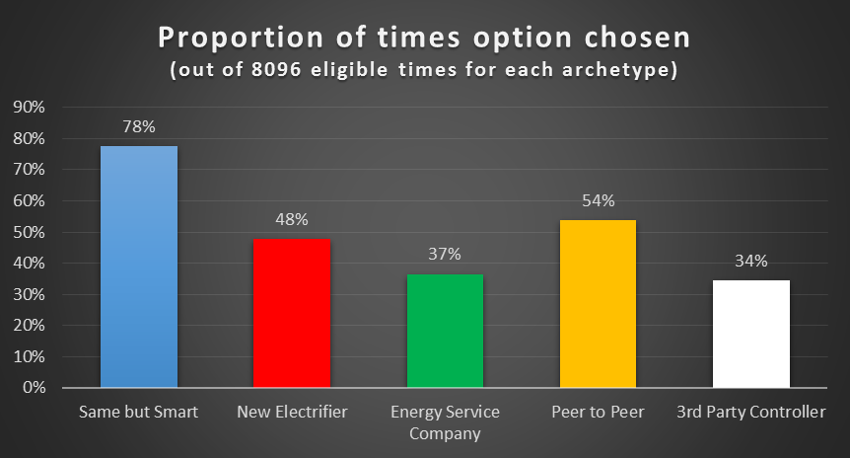

Slide 14
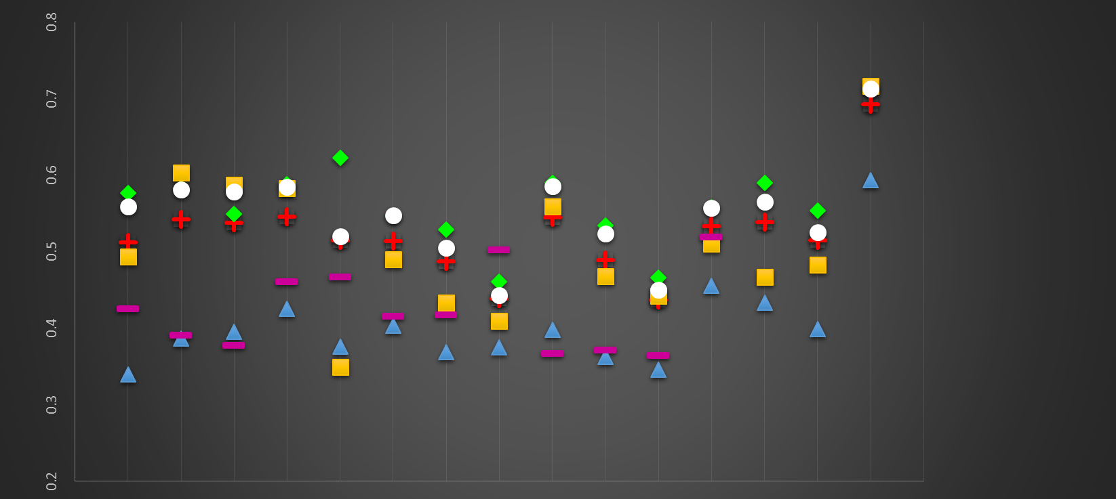
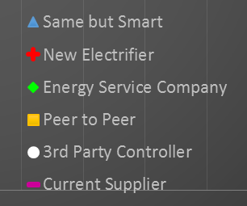
Positive Attributes
Negative Attributes
Each archetype + current supplier were rated on various attributes
(sliding scale between different ‘poles’)
Attractive
Straightforward
Predictable
Relaxing
Flexible
Trustworthy
Fair
Interesting
Safe
Good
Efficient
Cheap
Liberating
Popular
Same as today
Unattractive
Complicated
Unpredictable
Stressful
Inflexible
Untrustworthy
Unfair
Boring
Risky
Bad
Inefficient
Expensive
Oppressive
Unpopular
Different from today
Notes:
Each archetype + current supplier were rated on various attributes
(sliding scale between different ‘poles’)

Slide 15
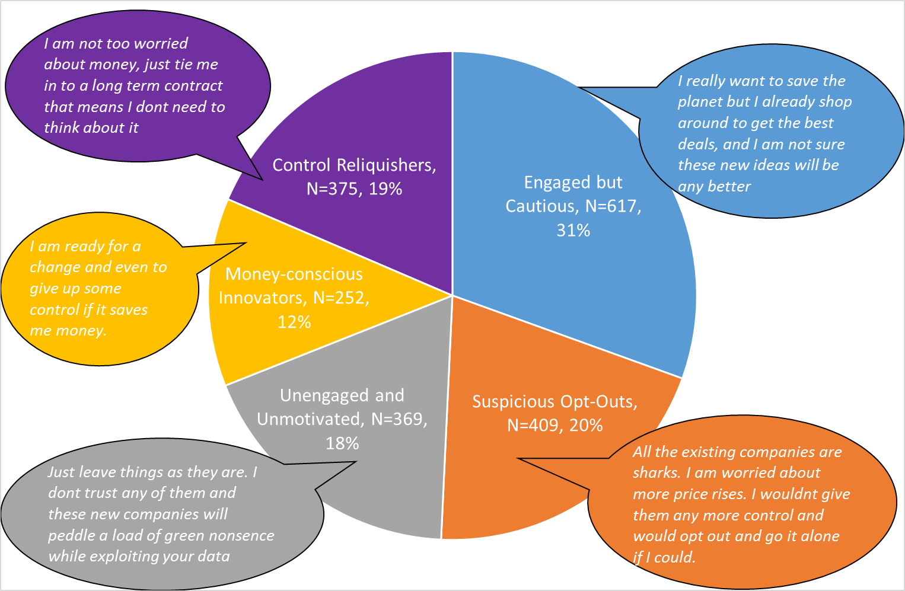

Slide 16
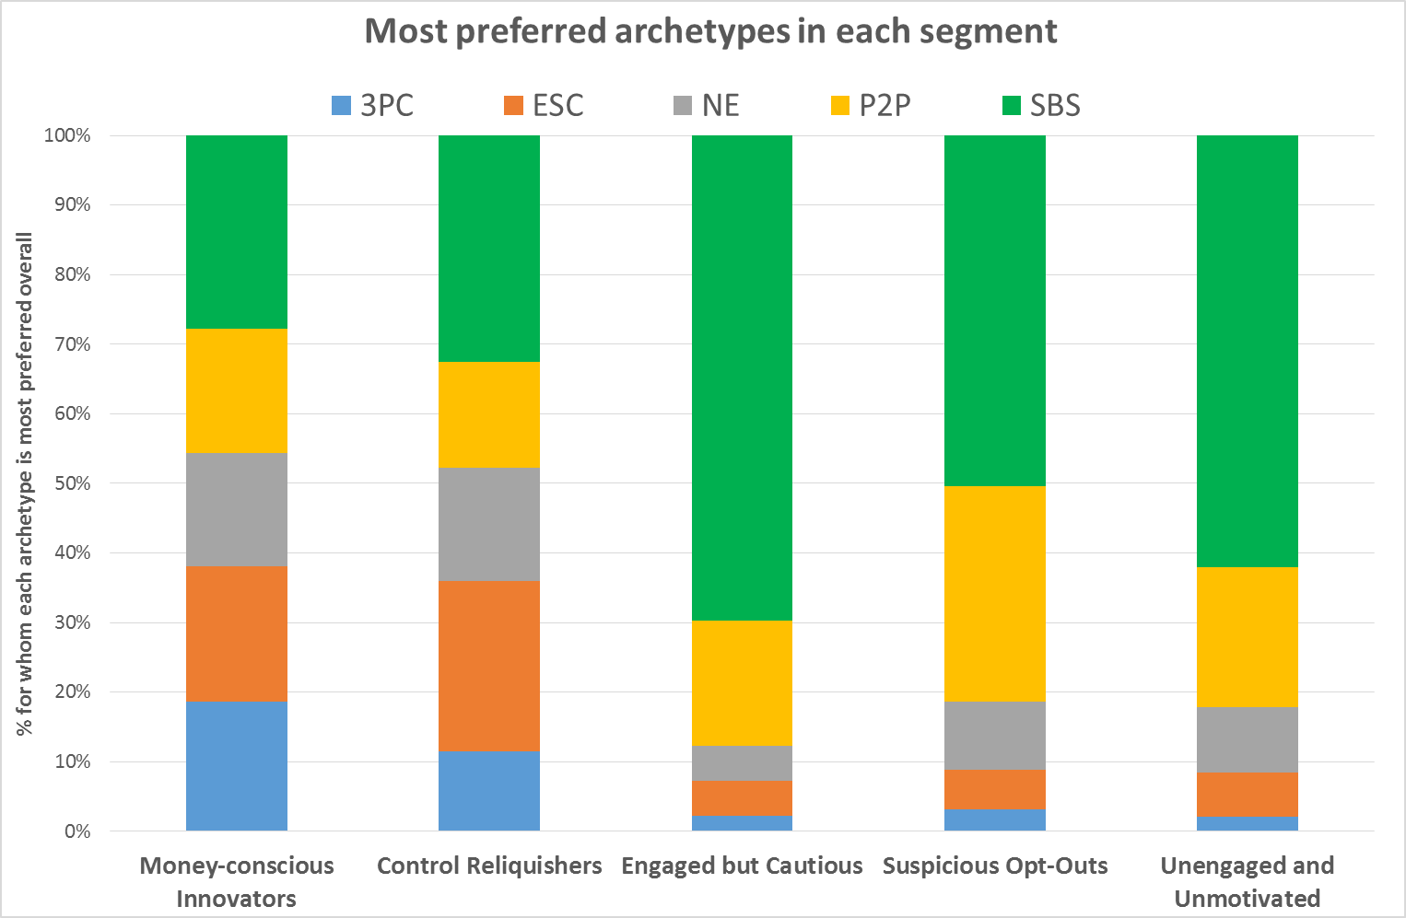

Slide 17
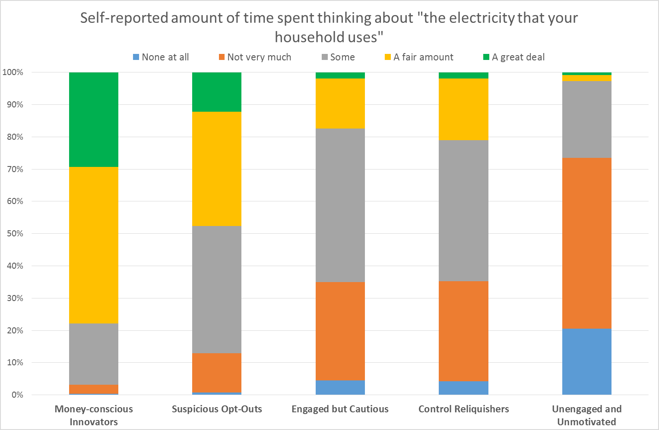

Slide 18
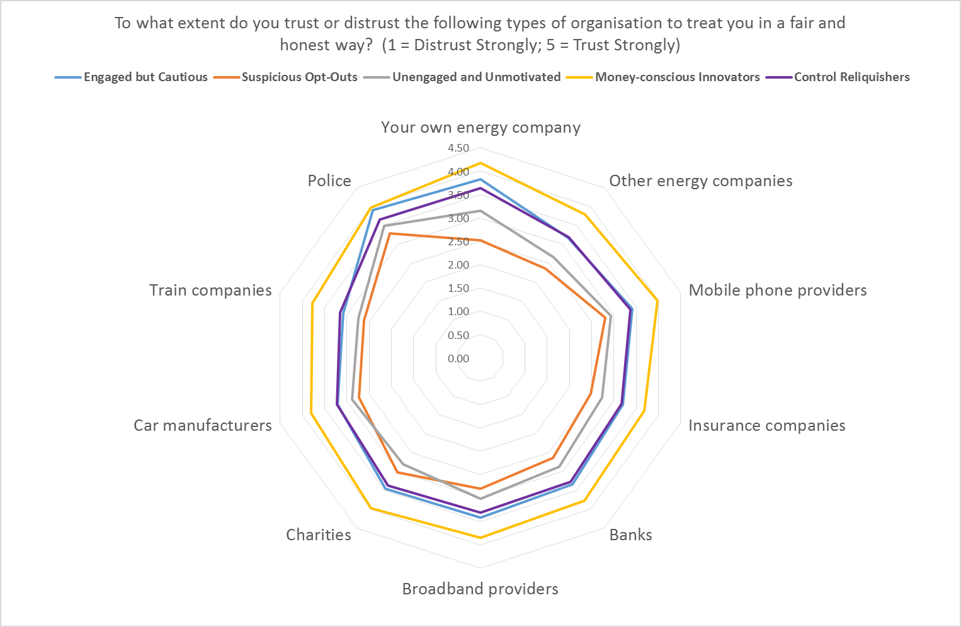

Slide 19
Demographic profiling
More likely:
*Female
*Not in work
*No kids
More likely:
*Female
*Younger
*Renting
More likely:
*Male *Older
*Own home
*No kids
*Low edu
More likely:
* Younger
*Renting
*With kids
*High edu
Working
More likely:
*Male
(otherwise average)

Slide 20
Conclusions
Consumers might be much more engaged than we think when offered meaningful choices.
There is a market segment for each business model but messaging is critical. For peer 2 peer, suspicion of the regime is a driver. How legitimate or sustainable are pseudo peer to peer offers backed by a big 6 utility?
Millennial renting families with high education may go for a third party control ‘google runs your life’ but how stable are those preferences given the demographic?
Trust is critical in the existing retail market, these data show trust and participation in new business models are pivotal. This would support a much more explicit role for innovation policy in building and understanding consumer trust
TAKE HEART!! All this innovation does have a consumer base to go at. We just need to understand it better!

Slide 21
YES!! [some] Consumers DO want the new business models the sector can offer.
BUT we must be EXTREMELY cautious if consumer trust, participation, and business model legitimacy are going to be a key determinant of the next phase of the energy transition.

Slide 22
Dr Stephen Hall. University of Leeds. s.hall@leeds.ac.uk
Prof Jillian Anable. University of Leeds J.L.Anable@leeds.ac.uk

