Slide 1




Energy Entrepreneurship business model innovation: insights from European emerging firms
Michael Hamwi and Iban Lizarralde
ESTIA Institute of Technology
Consumers at the heat of energy system?
BIEE Oxford Research Conference 2018

Slide 2
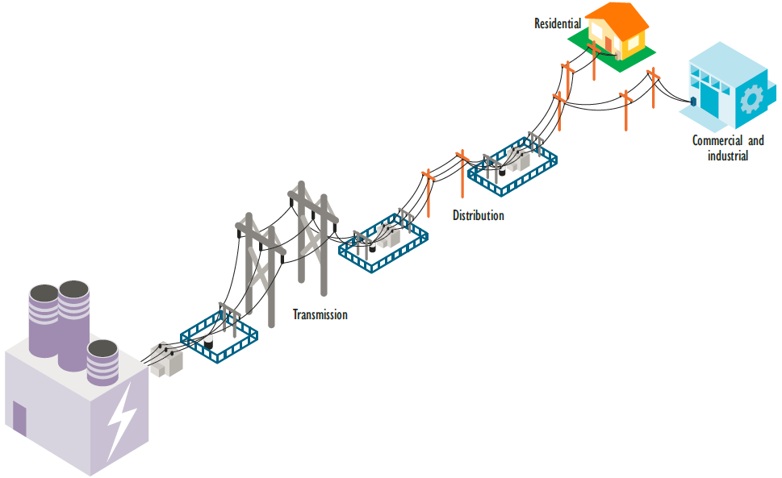
Energy transition
Innovation
Business model
Entrepreneurship
Organization of the power sector

Slide 3

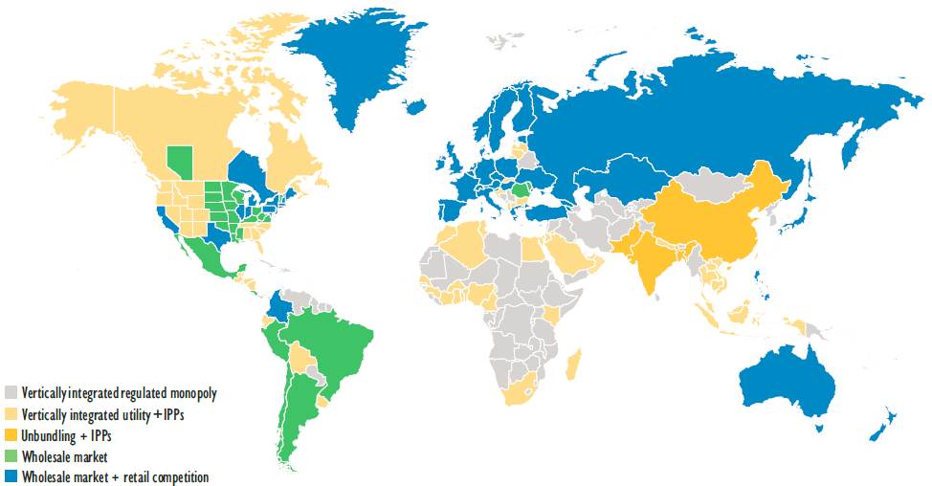
Electricity markets have been restructured in most jurisdictions with different degrees of competition being introduced
6%
IEA and Renewable energy and Energy efficiency partnership (REEEP) policy database 2012-2013

Slide 4
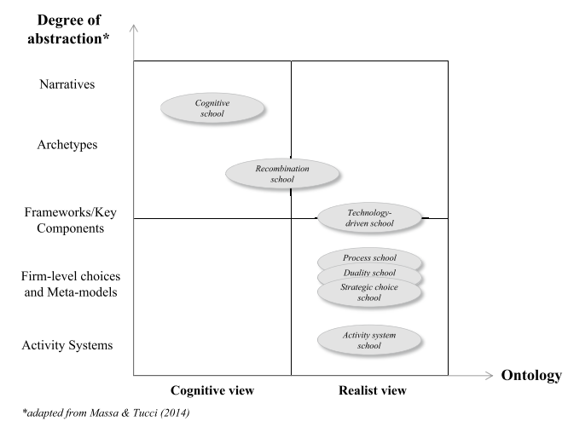
New rules !
New roles !
New actors !
Business model concept ?
Gassmann O. et al 2016

Slide 5
Business model analytical framework
Content
Structure
Governance
Value capture
What ?
Define the activities
How?
Define connections
Who and where?
Define responsibilities and roles
Why?
Define the economic model
Novelty
Lock-in
Complementarities
Efficiency
Novel product, service or business model
Retain customer and stakeholders
Bundle products and services
Reduce transaction cost
Adopted from Zott and Amit 2010

Slide 6


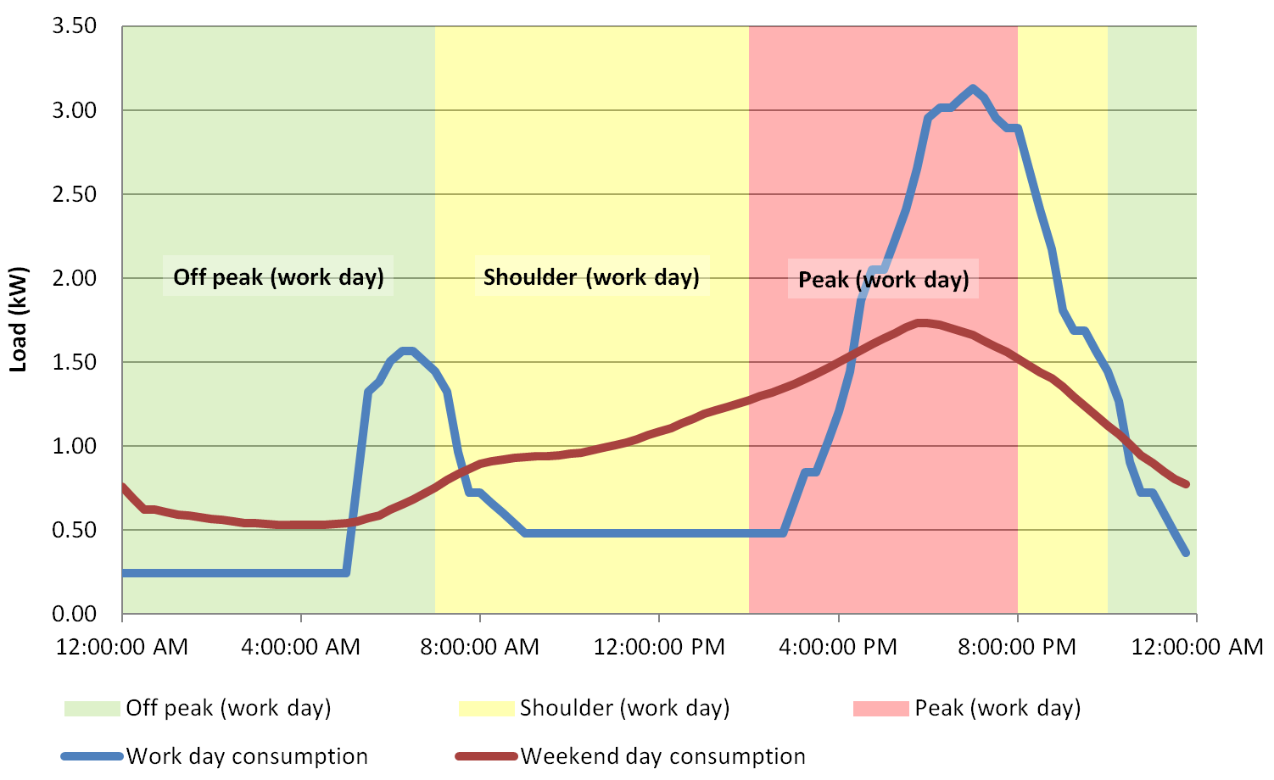
Methodology: interviewing three distinct firms
Enie.nl
Stimergy
Energy Pool
Residential renewable energy
Energy efficiency
Demand response
Producing solar energy at the residential customer sites
Reducing the energy consumption of commercials and buildings
Shifting the energy consumption from peak periods to off-peak periods of industrials plants

Slide 7
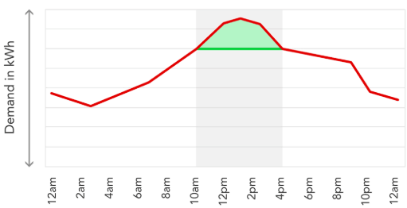
Demand response case: Energy Pool
The need:
Balancing the demand and supply of the energy grid
The Traditional business model:
Contracting with a fast ramping energy plant (e.g. gas turbine)
New business model:
Aggregating the industrial plants load flexibility and offering them in the energy and reserve markets

Slide 8
The demand response case: Energy Pool
Content
Structure
Governance
Value capture
Identifying flexible industrials plants
Supporting the creation of flexible load
Installing reliable and fast communication infrastructure
Intermediating TSO and industrial plants
Aggregating several plants’ load
Translating TSO signals into curtailments
Defining suitable and customized response plan for each industrial plant
Define control strategy
Two contracts types: Availability and Call
Having an income from TSO
Remunerate the plants for their flexibilities
Novelty: Balancing by adjusting demand
Complementarities: bundle consumption with load balancing service
Efficiency: reducing the need of additional energy plants and network infrastructure

Slide 9
The energy efficiency case: Stimergy
The need:
Energy efficiency
The Traditional business model:
Installing more efficient distributed generation (e.g. CHP)
New business model:
Combining the datacenters services and energy efficiency in one business model

Slide 10
The energy efficiency case: Stimergy
Content
Structure
Governance
Value capture
Service1: datacenter service: renting virtual computing servers
Service2: energy efficiency: installing digital boilers
Establishing a link between datacenter customers and energy efficiency customers
Transferring the fatal energy of one sector to an energy efficiency for another sector
Providing solution
Maintain product ownership and responsibility
Guarantee specific efficiency level
Selling datacentre service
Novelty: transforming fatal energy into energy efficiency
Complementarities: bundling datacentre service with energy efficiency
Lock-in: Expense of the datacentres transformed into an income for commercial customers

Slide 11
The renewable energy case: Enie.nl
The need:
More sustainable and cost efficient renewable energy resource
The Traditional business model:
Selling PV solar panel as a product
New business model:
Offering a comprehensive solar energy service including financing, installation and supply.

Slide 12
The renewable energy case: Enie.nl
Content
Structure
Governance
Value capture
PV purchasing
PV financing
PV installation
Intermediating the PV manufacturer and the residential consumer
Providing solution
Maintain product ownership and responsibility
Benefiting from tax credit
Benefiting from feed-in tariff
Selling kWh of solar electricity
Novelty: Solar PV as service
Complementarities: bundling services: financing, installation and energy supplier
Lock-in: long-term contract up to 15 years

Slide 13
Energy business model innovation characteristics
Decentralized and small scale assets
Intermediate model
Service oriented solution
Relationship and process focus
Consumer co-provider
Pay-per-use
- Distributed PV systems
- Distributed flexibilities
- Decentralized IT service
- Unit of produced kWh
- Availability + kWh of curtailment
- Unit of heat
- PV manufacturer and PV customer
- TSO and industrial plants
- Datacentre service and heat consumer
- Rooftop
- Flexibility sources
- Fatal energy
- Selling solar kWh
- Flexibility generation and sales
- Guarantee efficiency level or selling heat unit
- PV, Communication infrastructure, Digital boiler are parts and not core of the offer
12

Slide 14
Perspectives
The aim is to expand the presented framework by integrating a sum of 15 start-ups in the network of InnoEnergy
12

Slide 15
References
Gassmann, O., Frankenberger, K. and Sauer, R., 2016. Exploring the field of business model innovation: New theoretical perspectives. Springer.
Zott, C. and Amit, R., 2010. Business model design: an activity system perspective. Long range planning, 43(2-3), pp.216-226.
IEA and Renewable energy and Energy efficiency partnership (REEEP) policy database 2012-2013

Slide 16
Thank you for your attention
Any question ?
Michael Hamwi
m.hamwi@estia.fr

