Slide 1



UK Energy Expenditure Shares – A Long Term View
High quality independent research into competition policy and regulation
David Deller and Catherine Waddams
With special thanks to Glen Turner
Part of the UK Energy Research Centre (UKERC) project: Equity and Justice in Energy Markets
competitionpolicy.ac.uk
competitionpolicy.ac.uk

Slide 2


Energy affordability contextualises the UK energy market’s politics and policy
The UK retail energy market is highly political e.g. legislation for a price cap on default (SVT) tariffs
Can energy affordability help us understand these political pressures and policy interventions?
Energy expenditure shares (ENEXShr) provide an evidence base for discussing the distribution of energy market outcomes
Aim: Description of ENEXShr across: (i) household groups, (ii) through time and (iii) ‘casual empiricism’ re: link to policy interventions (e.g. Winter Fuel Payment)
High quality independent research into competition policy and regulation

Slide 3
Key results: Unsurprising given energy has inelastic PED, YED
Low ENEXShr of early 2000s more exceptional than current high ENEXShr
By 2014 ENEXShr similar to 1992 level, but average energy consumption 25% lower
As incomes decline ENEXShr increase: the salience of energy varies systematically by income
ENEXShr for low income households much higher than expenditure shares for: telecoms, water or transport
Those aged 80+ have ENEXShr similar to low income households, but those aged 65-70 have ‘average’ ENEXShr
High quality independent research into competition policy and regulation

Slide 4
Key results: Affordability support policies introduced when ENEXShr low, not high
Key Policy 1 - Winter Fuel Payment (WFP): its value increases dramatically before the take off in ENEXShr
WFP focuses on pensioners not on low incomes; represents a shift in the balance of affordability support
Key Policy 2 - First Fuel Poverty Strategy (FPS): again introduced when approaching the low in ENEXShr
After take off in ENEXShr: fuel poverty measurement altered and eradication target softened
Intervention potentially linked as much to government ideology and election cycles as to energy affordability
High quality independent research into competition policy and regulation

Slide 5
Focus on equivalised after housing costs ENEXShr
Data from the Living Cost and Food Survey (and precursors) for 1992-2014, also 1977, 1982 and 1987
Nationally representative sample c. 5,000-7,500, annual cross section data
ENEXShr reflects total expenditure (i.e. income), consumption and energy efficiency as well as prices
Equivalisation and deducting housing costs emphasises relative affordability differences across households
De-seasonalisation follows methodology of Advani et al (2013): OLS regressions containing month dummies and a wide range of controls
High quality independent research into competition policy and regulation

Slide 6
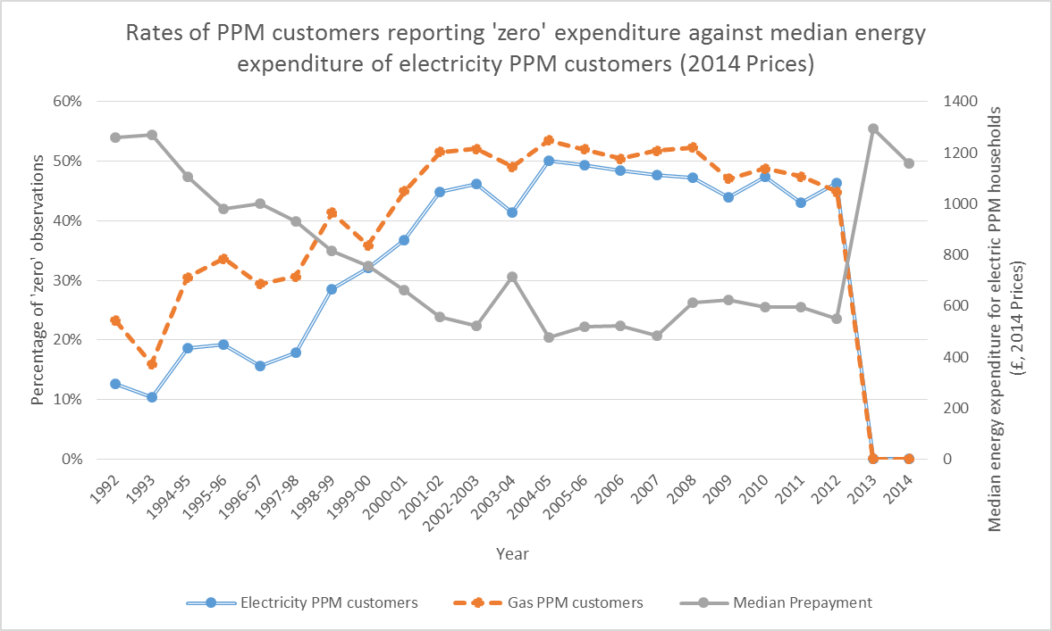
Data Issue: Prepayment (PPM) data involves ‘excessive zeros’ that correlate negatively with energy expenditure
2013, New two-part question: (a) amount of last top up, (b) how long would this amount typically last?
PPM expenditures recorded in ‘expenditure diary’ covering all expenditures in a two-week window
By the early 2000s 15-20% of households have a PPM for gas and/or electricity (35-40% in the bottom income decile, 1-3% in top income decile)
High quality independent research into competition policy and regulation

Slide 7
PPM Correction: Treat ‘excessive zeros’ as missing data and impute values
We argue the ‘excessive zeros’ should be treated as missing data since:
  2013 question change eliminates issue
  PPM-specific consumer surveys report 65-75% of households top-up weekly (Waddams et al, 2001; Mummery and Reilly, 2010)
We use OLS regressions utilising non-zero PPM data to impute energy expenditure for households reporting zeros
Imputation means ENEXShr are upper bounds (some ‘zeros’ may be real), but <10% of data per year imputed and limited seasonal variation in zeros
High quality independent research into competition policy and regulation

Slide 8
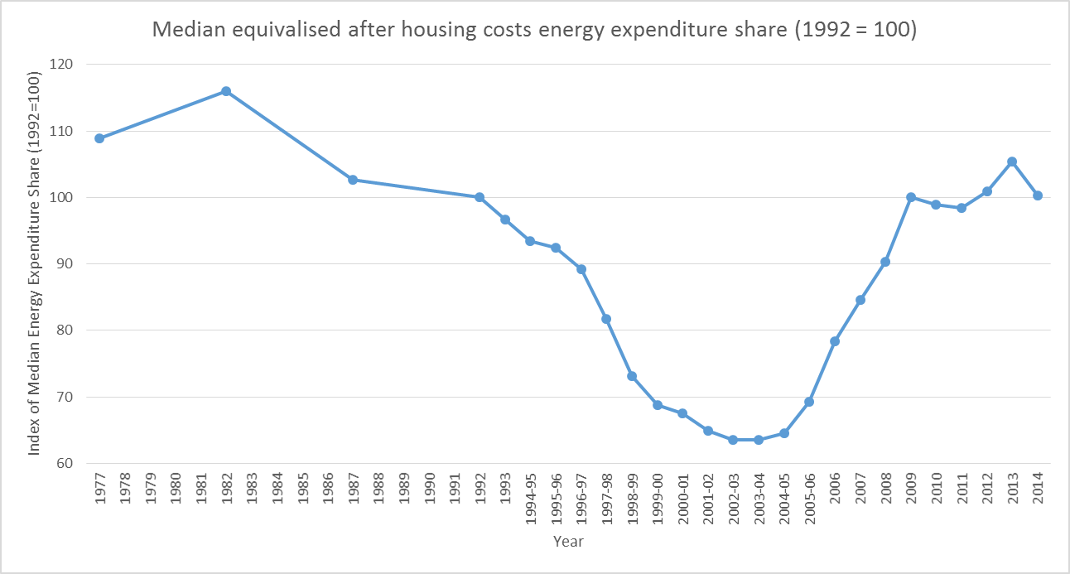
ENEXShr were unusually low in the early 2000s
BUT: (i) consumers likely focus on recent past, (ii) between 2004 and 2014 average household energy consumption fell by c. 25%
High quality independent research into competition policy and regulation

Slide 9
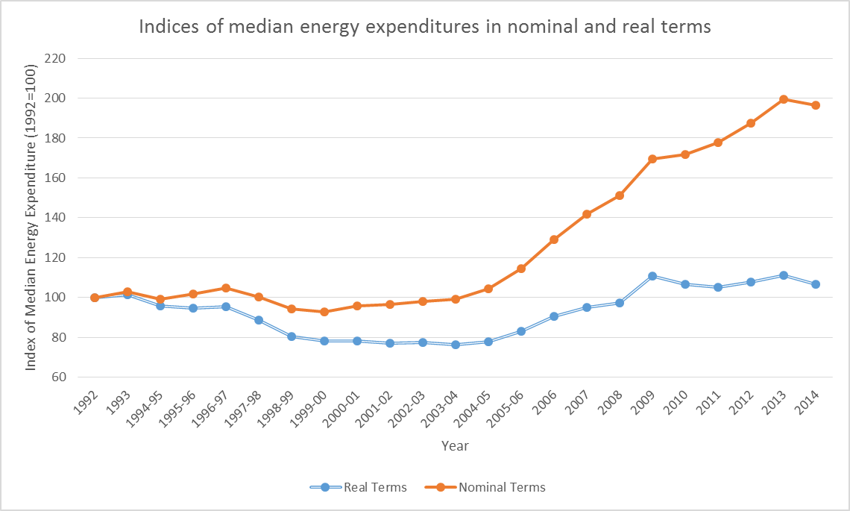
Politics: Can nominal expenditures explain the belief “energy prices only go up”?
2002: Liberalisation complete, final price caps removed
Remarkable stability in nominal energy expenditures (bills) up to 2003-04, then nominal expenditures (bills) double
High quality independent research into competition policy and regulation

Slide 10
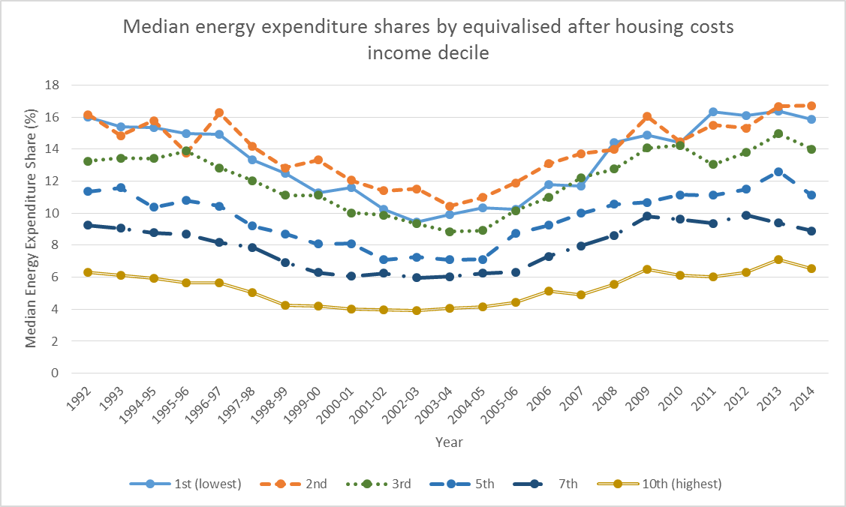
Lower income deciles have noticeably higher ENEXShr: Energy’s salience varies with income
The ENEXShr increase since 2003-04 is greater for those on low incomes: lowest income decile 6.0% points, top income decile 2.5% points
High quality independent research into competition policy and regulation

Slide 11
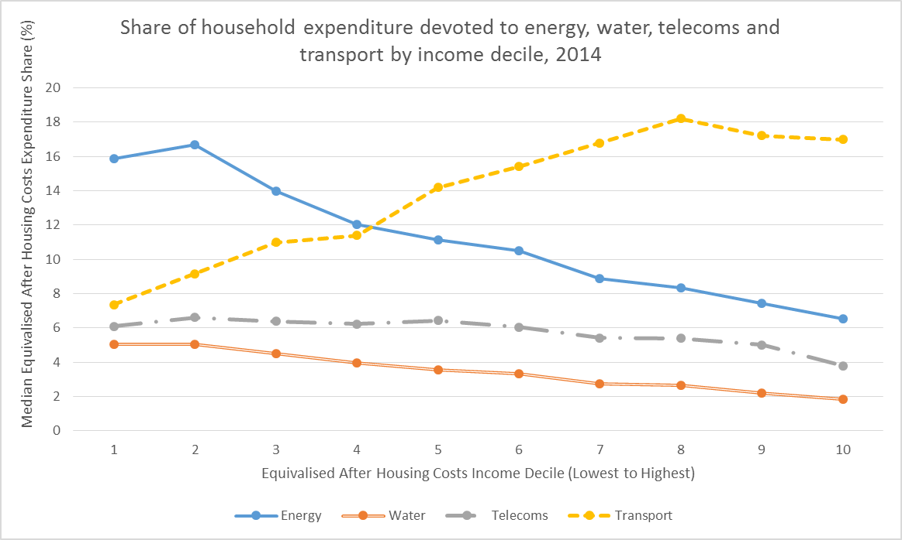
For low income households energy’s share of expenditure is greater than for other sectors
Political questions of ‘fairness’ are likely to be more pronounced in energy than other regulated sectors
High quality independent research into competition policy and regulation

Slide 12
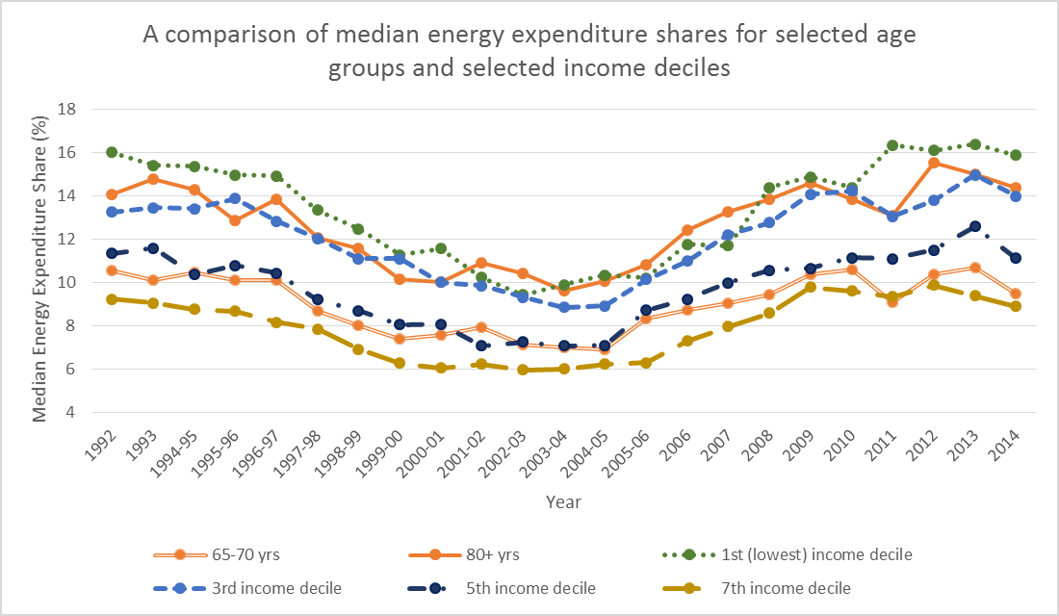
ENEXShr for households with a head aged 65-70 are similar to households with average incomes
Directing support to 65-70 year olds rather than to low income households of working age appears potentially questionable
High quality independent research into competition policy and regulation

Slide 13
Focus on two key affordability support policies: WFP and FPS
Winter Fuel Payment (WFP): Introduced 1997, cost rose from £0.2bn in 1997-98 to £1.9bn in 2003-04
Social benefit (addition to income), 60+ (now 63+) eligible for standard rate, 80+ higher rate
Fuel Poverty Strategy (FPS): Proxy for the policy importance given to energy affordability, summarises multitude of energy efficiency schemes
First FPS in 2001. Statistical definition revised in 2012 with target revised in 2015 to further emphasise energy efficiency
High quality independent research into competition policy and regulation

Slide 14
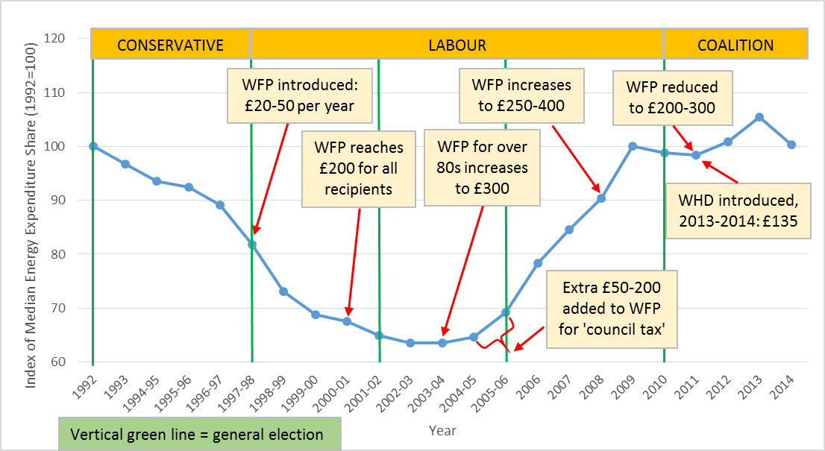
WFP introduced and generosity increased when ENEXShr was falling towards a long-term low
Higher 80+ rate and 2008-09 increase have clearest ‘affordability’ justifications
High quality independent research into competition policy and regulation

Slide 15
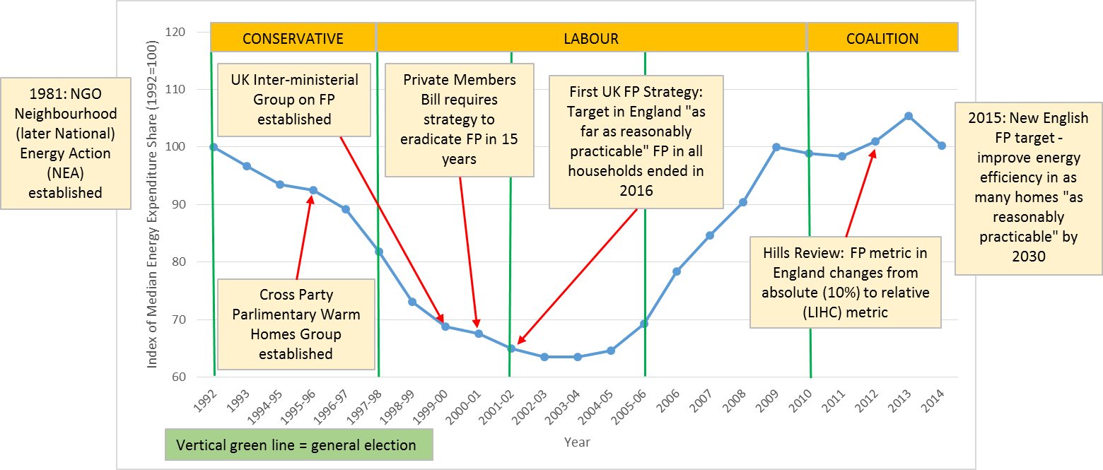
Increased affordability pressures appear to lead to a reduction in FP policy ambition
The new FP target can be met simply by installing energy efficiency retrofits rather than by demonstrating improved household welfare
High quality independent research into competition policy and regulation

Slide 16
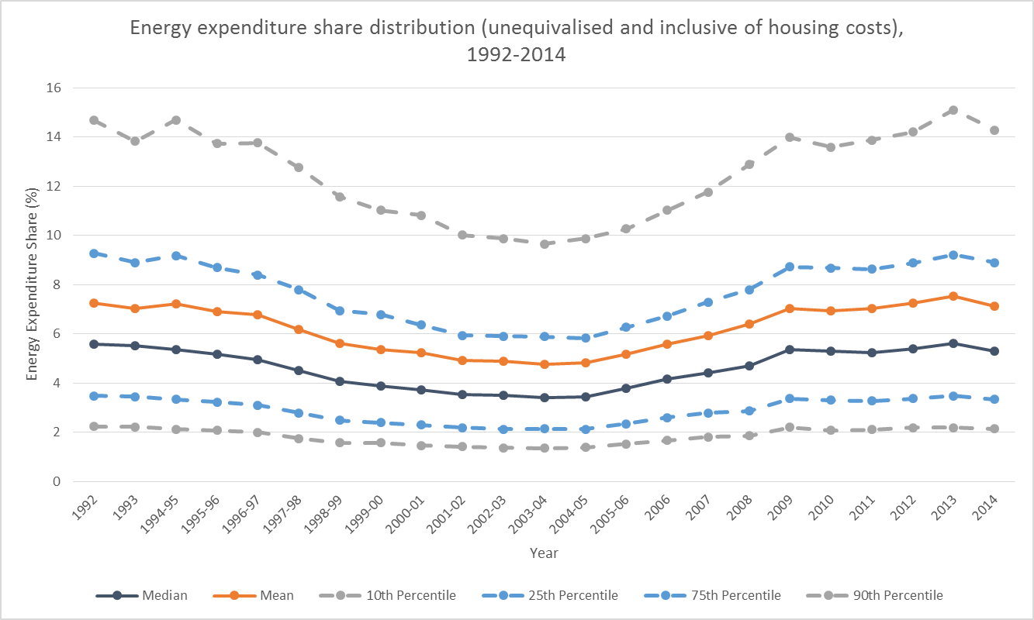
A1: ENEXShr inclusive of housing costs and not equivalised are mechanically lower
High quality independent research into competition policy and regulation

Slide 17
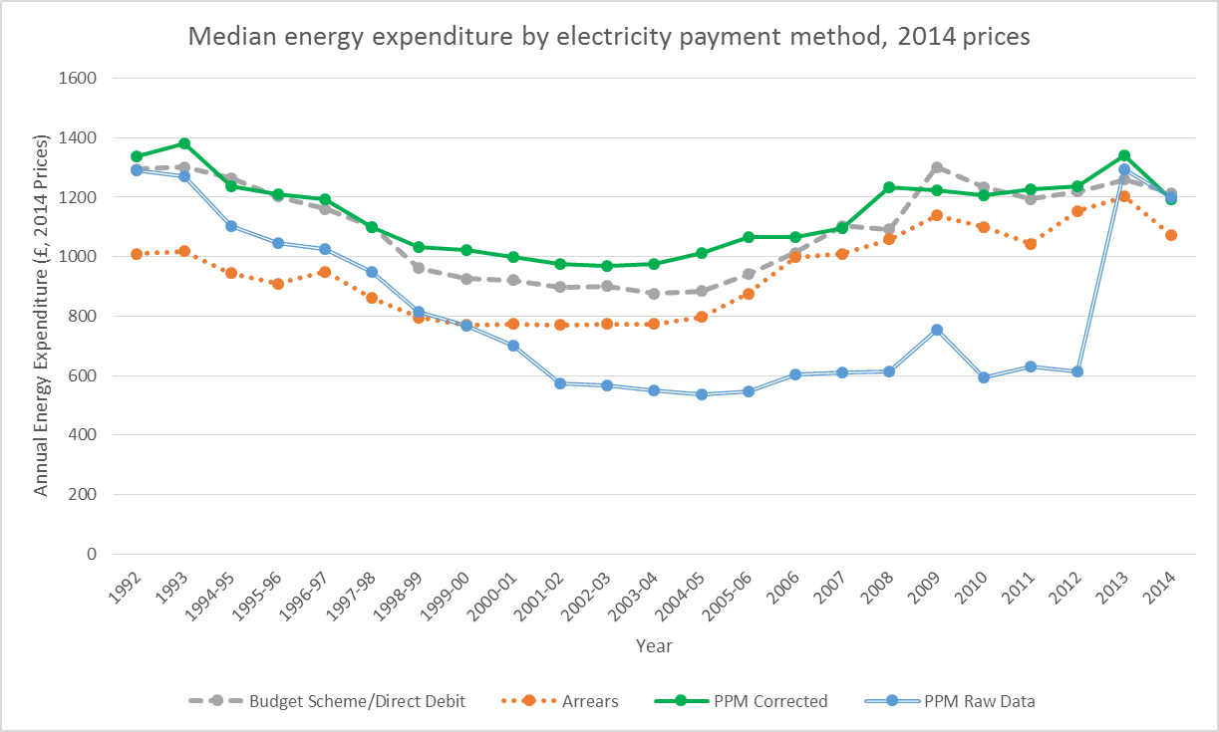
A2: Imputing missing PPM observations has a large impact
High quality independent research into competition policy and regulation

