Slide 1

Choosing energy efficiency – consumer response to operating costs at the point of sale
18 September 2018
Fiona Brocklehurst
Ballarat Consulting
Notes:
Do operating costs at point of sale encourage more EE sales? A review of findings of published studies.
Only time for major points in presentation – more details in paper.

Slide 2
Outline
Why should operating costs make a difference?
What do recent studies tell us?
How could future studies be done better?
Notes:
Also – structure different to paper – as results inconclusive focussing on how studies could be done better
How am I going to tell this? Using images as much as possible – more engaging, more memorable

Slide 3
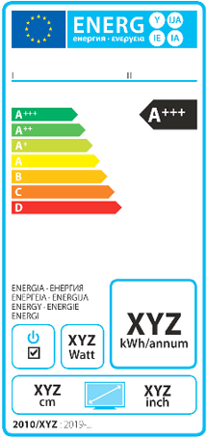

Labels make energy visible
Notes:
Missing information. Manufacturers and retailers provide lots of information on products and features but without regulation generally not energy
Labels fill the gap. Mostly give energy efficiency classification and energy information (eg China, EU, India,

Slide 4
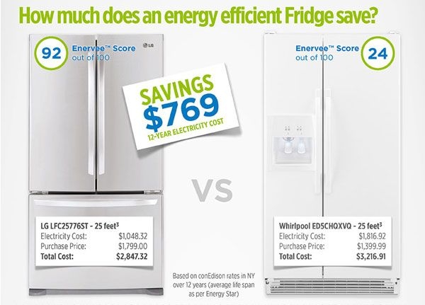
Why operating cost label?
Notes:
Monetizing efficiency,
temporal framing,
framing to induce loss aversion, (lost savings)
Also general assumption for EE (not just cars and appliances)
Higher initial costs – save over lifetime as lower operational (energy) costs
So extra value above energy only label…
Also

Slide 5
But - difficult to make operating cost labels reflect consumer’s circumstances
Notes:
Incorrect information could be worse than none at all
Usage can vary widely for

Slide 6

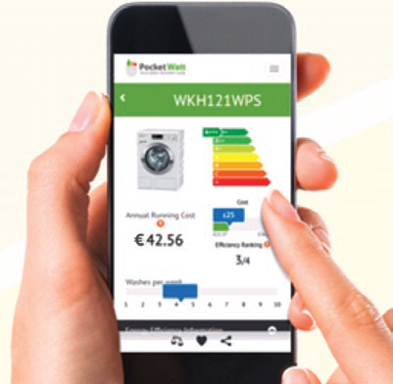

Technology to the rescue?
PocketWatt tool developed as part of Digi-Label project,
funded by the European Commission under H2020
Does operational cost information increase
sales of energy efficient products?

Slide 7

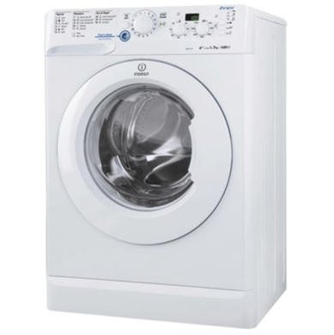

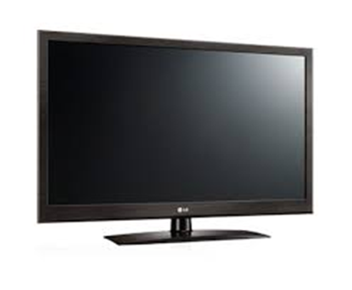
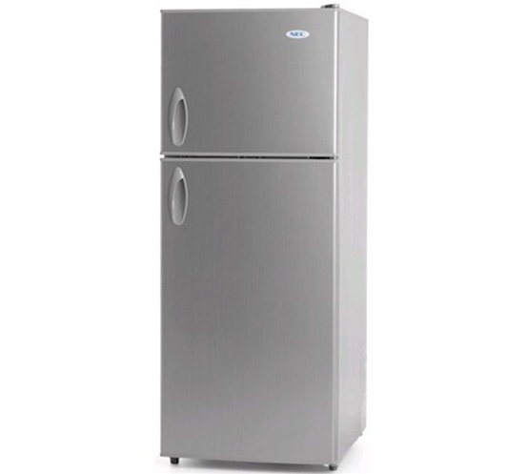
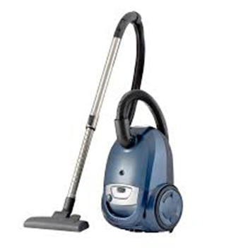
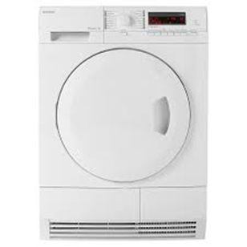
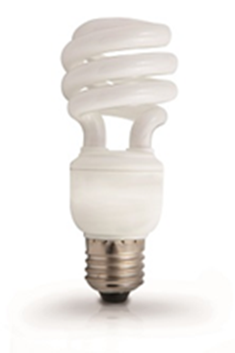
Review 15 recent studies covering a range of products
Notes:
Details in paper
15 selected with use of control groups and no of participants large enough to give stat robust findings

Slide 8
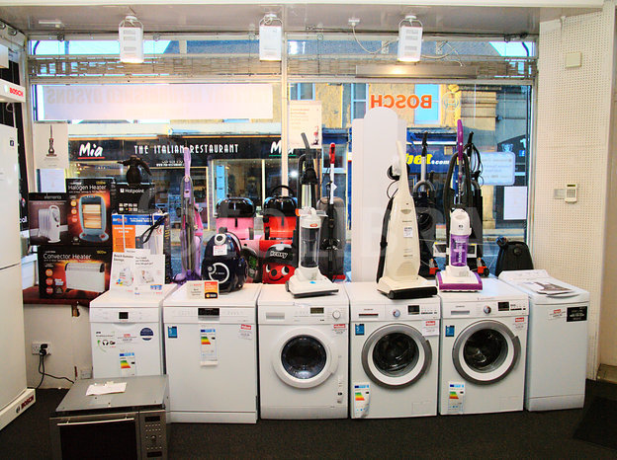

Methods used
Choice experiment
– 11 examples
Field experiment (in store and online)
- 5 examples
(one study included a choice and field experiment)

Slide 9

What did I find?
Notes:
A mess
This is not my desk!
Most found some statistically valid effect - 10 did
3 mixed (for some products not all)
3 no effect
Generally effect small
no progress from previous review (2009).

Slide 10

What can we say?
Notes:
This is hard!! Real data is messy.
Too many variables – can’t pick out under what circumstances get positive result.
Eg Same product, different result!
Methods different, products different, motivation different (and way data presented different – not even starting on that!)
Can only really compare field and online for same products? Indicates online more likely to be positive

Slide 11


What does this mean for policy makers?
Notes:
No compelling evidence for change – not always gain and gains are small.
As data on appliances becomes more accessible (eg EU energy label registration database) market may provide solutions

Slide 12
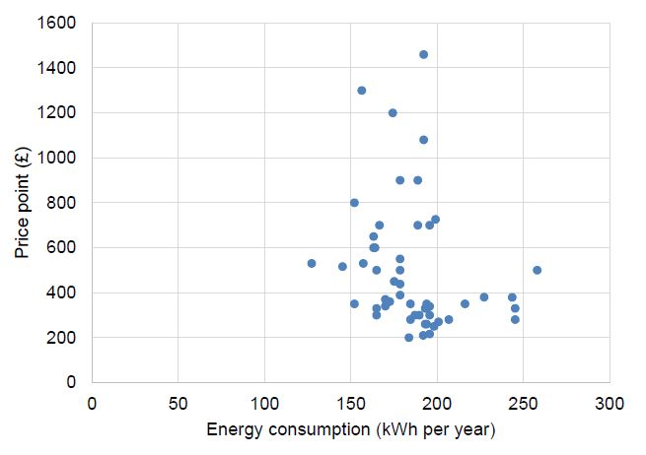
Issues for researchers #1
Initial cost not always α with EE
Scatter plot of price by energy consumption for washing machines (DECC 2014)
Notes:
Most papers/report don’t include market data. Some that do find EE and initial price correlate but some don’t eg
DECC 2014
Similar (low or no correlation) for tumble dryers (condenser and vented) and washer dryers
Sometimes initial costs higher for more EE goods but not always.
How pick out lowest lifetime cost from this? Effect of cost label expected to be lower?
Although still:
Monetizing efficiency,
temporal framing,
framing to induce loss aversion,
Stadelmannm, & Schubert and others have found people overestimate operating costs of appliances – small ones especially.
So, found EU (energy only) label more effective than cost label…
Think about this!

Slide 13

Issues for researchers #2
Effect of scale of savings (absolute)
Use 5 year, 10 year or lifetime costs
rather than annual to increase scale?
Notes:
Thaler and subsequent found small savings heavily discounted – less likely to have effect.
Review backed this up - some studies looked at different time periods for operational savings and most found longer period, higher savings, greater effect.
But not all! Cars - Camilleri & Larrick dip at ‘mid’ level!
If field experiment retailer may restrict (Carroll et al 2016 restricted to 5 years when wanted 10) but in choice experiment why not lifetime?? Or look at range?

Slide 14


Issues for researchers #3
Scale of operational relative to initial costs
vs
Make a difference?
Notes:
Have not found discussion of this in literature but would expect it to make a difference from my own psychology!
Could reinforce point of using as long a period for operational costs as possible
In studies vary from:
operational costs 1/10 (annual costs)
to roughly same as initial costs (for lifetime costs)
Also range of costs – savings of best to least

Slide 15
Issues for researchers #4
Not all products are the same #1
≠
≠
Purchasing process and factors considered are different for different product types

Slide 16


Issues for researchers #5
Not all products are the same #2
≠
≠
If higher energy efficiency means change in technology other factors may come into play
Notes:
Lighting but also car technology

Slide 17
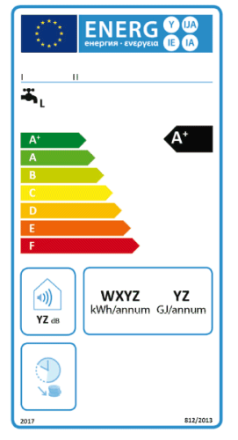
Issues for researchers #6
Familiarity with operational costs?
vs
Notes:
If used to seeing operational cost data on labels does that make a difference?
Not addressed by researchers except Swiss study
Repeat same methodology in different countries? (US vs EU or Australia)

Slide 18
Summary
Analysis of 15 studies since last review (2009)
Range of method, products, timeframe for operational costs
Most (10) showed increase in energy efficiency of purchases with operational cost information but not all (3 mixed, depending on product; 3 none)
Effect generally small
Evidence base not significantly strengthened since last review
Several recommendations to increase utility of future studies

Slide 19

Notes:
Thank you for coming to this session

Slide 20

Questions?
Thank you!
Contact:
Fiona (at) ballaratconsulting.co.uk

