Slide 1
EU Retail Electricity markets in Transition: The Quest for adequate Design
Dr. Luis Boscán (University of Southern Denmark)
joint work with Dr. Rahmat Poudineh (Oxford Institute for Energy Studies)
Presentation at the BIEE Conference
Blavatnik School of Government. Oxford, 18 Septemeber 2018
Session: Distributed and Local Energy: Markets and Regulation

Slide 2
Plan of the talk

Slide 3
The current state of the debate
Cramton (2017): “Retail competition will become increasingly important as smart home technologies are developed and adopted”
Brown and Eckert (2018): “After eighteen years of retail choice, New York regulators have made moves to eliminate retail competition over concerns of market power”
Conejo and Sioshansi (2018): “It may be beneficial to transform the utility into a provider of last resort which primarily maintains distribution capacity ... customers would be expected to contract with competing third party energy-service providers (ESP)”
Newbery et al. (2018): “A genuine market in low-carbon electricity may require a degree of financial and ownership integration between retailers and generators that is very different from the today’s high degree of separation”
But the Clean Energy Package (aka “Winter Energy Package”) is in motion already:
  “Today, 90% of variable renewable electricity sources are connected to distribution grids”
  “The physical nature of RES-E – more variable, less predictable, and decentralized than traditional generation – requires an adaptation of market and grid operation rules”
Notes:
Littlechild (2018): The recent Order, that such suppliers may NOT serve low income customers unless they can prove they would save these customers money compared to the utility default service price, is unprecedented.

Slide 4
The question and some methodological precisions
Our question:
Will the ongoing reforms live up to the challenges posed by the coming stages of the renewable transition?
We focus in the consumer because they can be the key agent for change because:
consumers can support the transition to renewables at a large-scale level, i.e. through demand-side flexibility
they make capital purchase and utilization decisions, and can choose to use more renewables
Methodology:
Our study is documental, qualitative and interpretative → We interpret the legislative intent
We recognise the complexity of policy desings and the ambiguity in the definition of goals
Goals ← Targets ← Instruments
Choice Rule ← (Revealed Preference) ← Outcomes
(Legislative Intent)
Notes:
Helm(2013): goals are ill-defined, are ambiguous
Tinbergen (1952) as interpreted by Knudson (2009): For policy to be effective, policy goals, policy targets and policy instruments must be well-defined
McFadden (1975)
Market design as regulatory tool

Slide 5
Signs (indicators) that we may be in the middle of a transition
Signs (indicators) that we may be in the middle of a transition
The renewable agenda: goals vs results in Europe
Technology is evolving at a rapid pace → Examples of demonstration projects with focus on the distribution network
In the US there appears to be conflict between distributed resources and retail choice
The future scenarios from Dona and Rahmat → cite

Slide 6
Some methodological comments and precisions
Some methodological precisions
We cannot avoid the discussion just by saying that goals are ill-posed, we have to find a way
Market design as a regulatory tool

Slide 7



The current EU Retail Market design (1)
Legal and functional unbundling of DSOs:
DSO must be a separate legal entity with independent accounts and management
Vertically-integrated company
Generation
Target:
Ensuring Non-discriminatory access to the distribution network
Reducing informational imperfections
Goal:
Affordability (by way of competition)
Security of supply (by way of improved oversight)
Distribution (DSO)
Supply

Slide 8



The current EU Retail Market design (2)
Target:
Suppliers compete for customers
Target (implicit):
Consumer engagement
Retail Competition
Target:
Consumers choose their supplier freely
Goal:
Affordability (by way of competition)
Security of supply

Slide 9

The current EU Retail Market design (3)
Distribution (DSO)
Tariff design
(Regulatory Authorities)
Goal:
Affordability, Security of supply, Sustainability
DSOs will (Targets):
Operate, maintain, plan and develop the grid
Incorporate energy efficiency/demand-side measures as alternatives to network investments
Dispatches renewables, waste-fuelled and CHP plants with priority, if mandated
Procure energy to cover energy losses and reserve using non-discriminatory and market-based procedures

Slide 10
The current EU Retail Market design (4)
Direct interventions:
Universal Service: grant consumers the right to have electricity supply at specified prices and given quality
Consumer protection measures:
Regulating contractual obligations,
Regulating smart metering deployment
Wholesale market
Supplier
Supplier
Supplier
Distribution network
Retail market
In summary:
A vertical approach + direct interventions
End customers
End customers
End customers

Slide 11


The current EU Renewable Energy Policy (in connection to Retail)
Priority or guaranteed access → Target: Ensuring non-discriminatory access of renewables to the distribution grid
Priority dispatch (normally a TSO role) → Maximizing dispatch of renewables, according to its availability
Support shcemes → Helping Member States reach their established targets
Goal:
Sustainability (more renewables in the power system)
But who pays?
“it is appropriate to allow the emerging consumer market for electricity from renewable energy sources to contribute to the construction of new installations for energy from renewable sources” Recital 53, EU Renewable Energy Directive (2009)

Slide 12
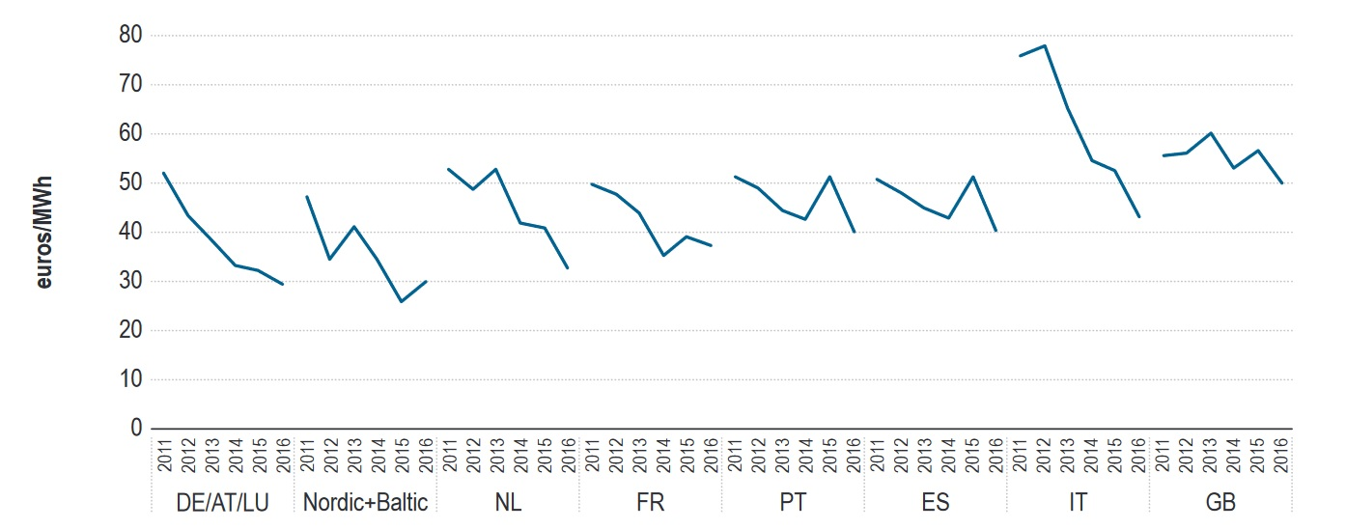
Recent trends in EU electricity markets
Source: ACER/CEER Market Monitoring Report 2016 (Wholesale)
… Day-Ahead wholesale prices in the major European power exchanges have shown a downward trend in the period 2011-2015

Slide 13
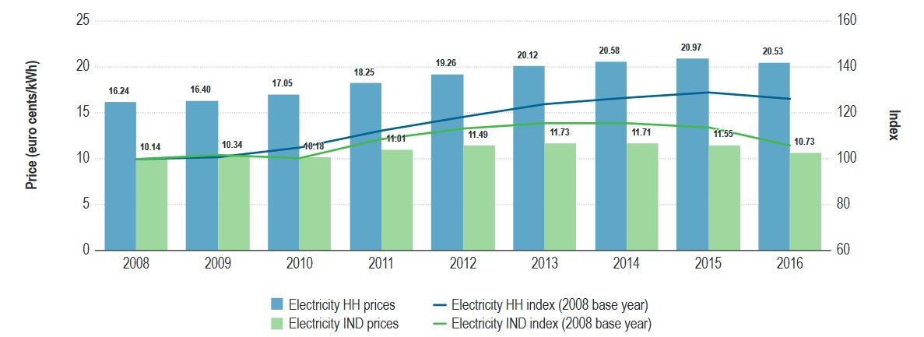
Recent trends in EU electricity markets
Source: ACER/CEER Market Monitoring Report 2016 (Retail)
… while retail post-tax prices (POTP) have shown an upward trend in the period 2008-2016
POTP = Electricity price + (TSO + DSO tariffs) + Retail (Billing, Metering, etc) + VAT + Levies
Notes:
In the period November – December 2016 (when the data were collected) for Houseolds:
In 24 out of the 28 Member States, the energy component was below 50%
On average, the distribution charge was 27%. The country with the lowest DSO charge was Greece, with 15,78%, while the highest was Norway with 48%
Transmission charges were much lower, with an average of 2% with Croatia as the highest (9%)
Energy taxes vary a lot, with countries with NO tax (e.g. GB) and countries with a very big tax component (DK with 37%)
Charges for RES are present in 25 out of 28 countries, and account for up to 22% in Italy

Slide 14
Complementarities and conflicts in the EU Retail Electricity Market Design
1) Fixed retail prices conflict with demand-side flexibility:
ACER/CEER (end of 2015):
Fixed price offers still represent the largest share (46%) of all offers in electricity and the number of such offers is increasing. At the same time, spot-price offers are also increasing.
“Most household consumers face retail prices that do not reflect the variations in wholesale prices”
2) Distribution network tariffs conflict with demand-side flexibility:
ACER/CEER (end of 2015):
On average distribution charges for household consumers accounted for 27% of the final bill (16% in Athens, 48% in Oslo)
CEER (2017):
Wide variation of distribution tariffs in Europe. Traditionally designed for demand-only customers
ToU charges are implemented in several countries (mostly industrial segment); seasonal structure
3) Another potential conflict may arise between dynamic retail pricing and dynamic distribution network tariffs.
Notes:
Actually, ALL surcharges conflict with demand-side flexibility, but there is no free lunch here. If renewables are going to be subsidised, someone has to pay
Page 18 of the ACER 2015 report says that ”At the same time, suppliers in several capital cities offered more fixed-price contracts to consumers”.

Slide 15
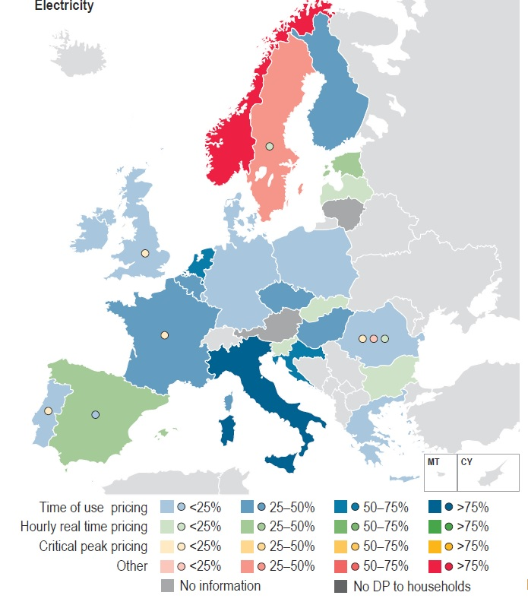
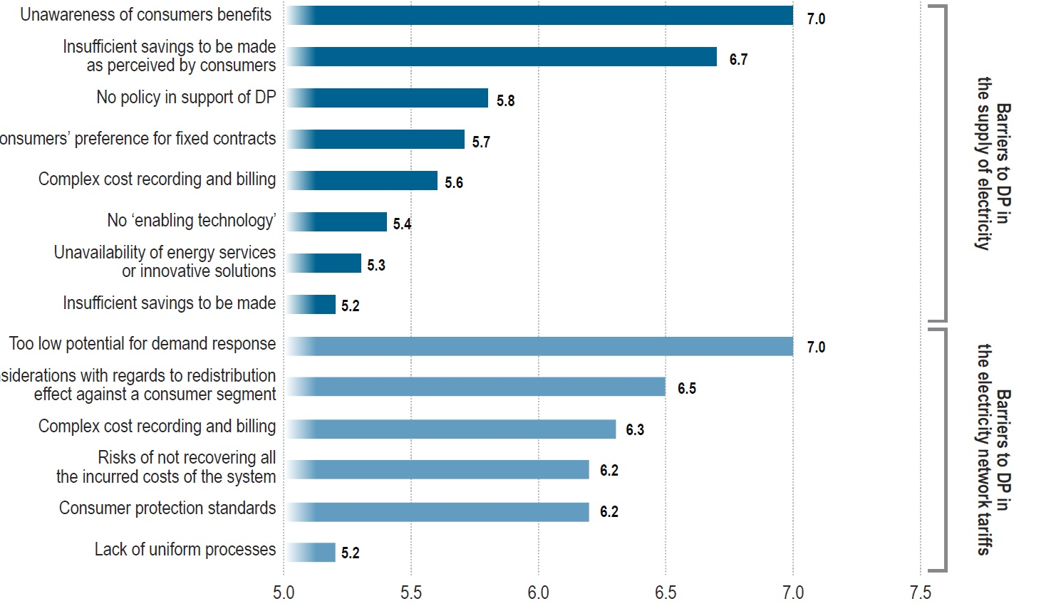
Complementarities and conflicts in the EU Retail Electricity Market Design
Share of standard households with Dynamic Price contracts:
ToU is applied in 17 out of 22 countries (for retail prices)
Hourly real-time pricing in 5 countries
ToU pricing (in distribution tariffs) is applied in 15 out of 22 countries
Source: ACER/CEER Market Monitoring Report 2015 (Retail)
Notes:
Page 18 of the ACER 2015 report says that ”At the same time, suppliers in several capital cities offered more fixed-price contracts to consumers”.

Slide 16
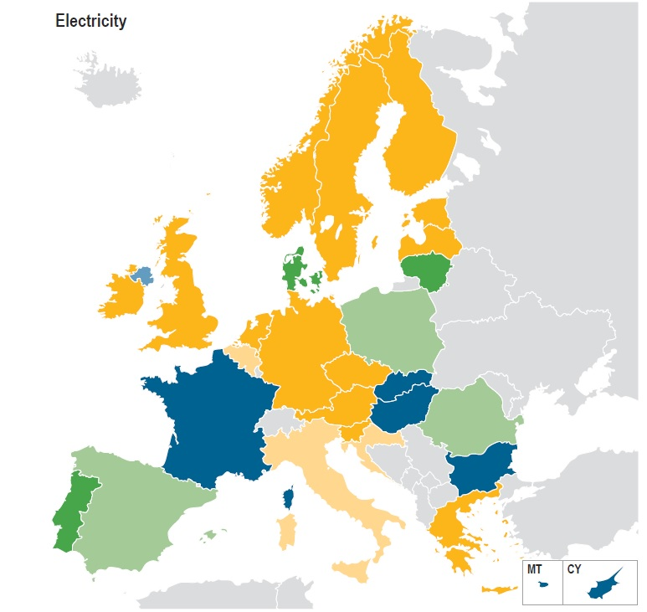
Complementarities and conflicts in the EU Retail Electricity Market Design
4) The introduction of retail price regulations distorts the transparency of the retail market and reduces the possibility of demand response
Member States with end-user price regulations are: Bulgaria, Cyprus, Denmark, France, Hungary, Lithuania, Malta, Poland, Portugal, Romania, Slovakia and Spain
Source: ACER/CEER Market Monitoring Report 201 (Retail)
Notes:
12 countries have price regulations in the housegold segment:
9 countries have price regulations in the industrial segment

Slide 17
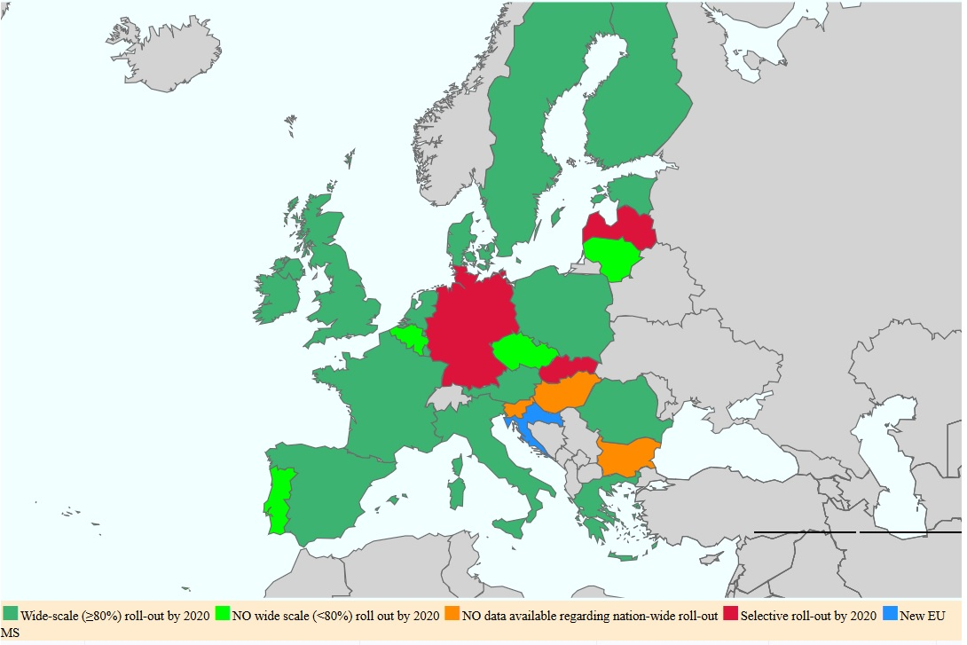
Complementarities and conflicts in the EU Retail Electricity Market Design
5) Smart meter development is a potential source of synergy between sustainability and affordability
EU: “By 2020, it is expected that almost 72% of European consumers will have a smart meter for electricity”
Notes:
12 countries have price regulations in the housegold segment:
9 countries have price regulations in the industrial segment

Slide 18
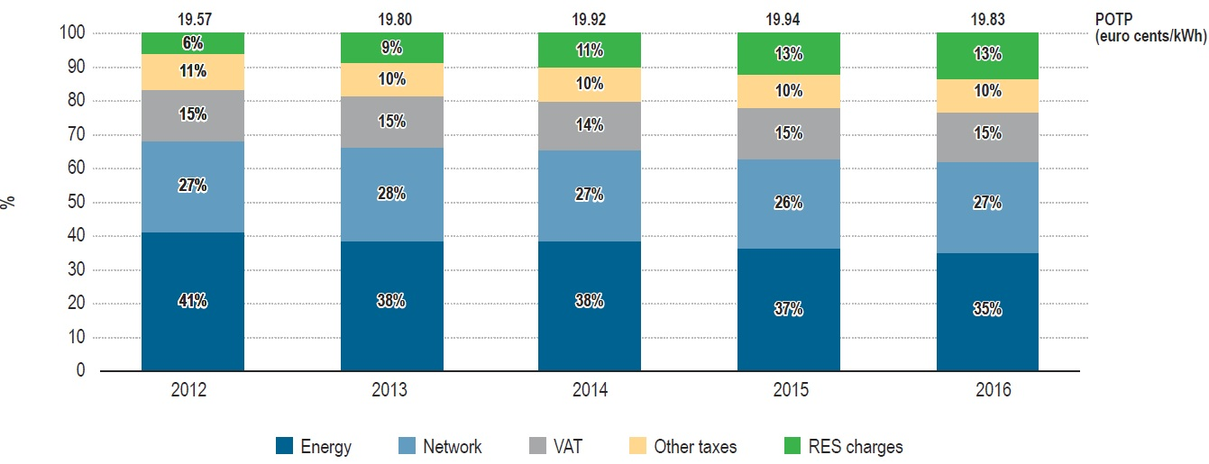
Complementarities and conflicts between the EU Retail Electricity Market Design and Renewable Energy Policy
Tax and non-tax levies used to fund renewable support schemes reinforce the negative impact of fixed retail prices and fixed distribution network tariffs on demand-side flexibility
2) Support scheme funding – through surcharges on consumers’ electricity bills – also make the business case for the electrification of mobility, heating and cooling less attractive relative to fossil fuels.
Weighted average Post-tax prices in standard offers for EU households in EU capitals
Source: ACER/CEER Market Monitoring Report 2016 (Retail)
Notes:
RES charges have more than doubled between 2012 and 2016, from 6% to 13%
The share of energy in the final consumers’ bil has declined

Slide 19
Complementarities and conflicts between the EU Retail Electricity Market Design and Renewable Energy Policy
3) Priority or guaranteed access of renewables to the distribution grid may conflict with quality of service and the equitable structure of distribution tariffs
Both frequency and voltage level can be affected by the connection of DERs (Pepermans, Driesen, Haeseldonckx, Belmans, & D’haeseleer, 2005)
In the presence of tariffs that do not adequately account for cost causality, network users who possess DERs may end up subsidizing those who don’t, leading to an inequitable allocation of costs
4) Priority or guaranteed access of renewables to the distribution grid, coupled with technological progress of storage, may challenge the economic viability of existing networks
Consumers may choose to entirely leave the network (“grid defection”) and possibly migrate to an alternative, closed distribution system, while tolerating a lower reliability standard
Notes:
RES charges have more than doubled between 2012 and 2016, from 6% to 13%
The share of energy in the final consumers’ bil has declined

Slide 20
Forthcoming changes in the proposed EU retail electricity market design and renewable energy policy
DSOs will (Targets):
Procure flexibility services to improve efficiency in the operation and development of the grid
Goal: Affordability, Security of Supply
DSOs will NOT (Targets):
Have stakes in related activities like: a) electro-mobility infrastructure, b) ownership of storage
Behaves in a non-discriminatory manner in relation to data handling
Goal: Affordability, Security of Supply
Notes:
Procurement must be efficient, non-discriminatory manner, which includes energy storage facilities and aggregators.
It should also develop network development plans in consultation with relevant network users and under the oversight of the regulatory authority.
Moreover, it must coordinate with the TSO on the definition of relevant flexibility services.
Market-based procurement procedures are mandated, unless these are considered economically inefficient (Article 31).

Slide 21
Forthcoming changes in the proposed EU retail electricity market design and renewable energy policy
Direct interventions:
Entitlement to a dynamic electricity price contract
Smart metering
Market-based supply prices
Wholesale market
Energy Communities:
Enterprises (Small or Micro), Municipalities NOT operating for financial profit
Can perform ANY activity except from transmission
Supplier
Supplier
Supplier
Aggregators
Distribution network
Retail market
Active customers
End customers
End customers
End customers
Vertical and horizontal transactions can coexist

Slide 22
Forthcoming changes in the proposed EU retail electricity market design and renewable energy policy
Priority or guaranteed access → Target: Ensuring non-discriminatory access of renewables to the distribution grid
Priority dispatch (normally a TSO role) → Maximizing dispatch of renewables, according to its availability
Support schemes → Helping Member States reach their established targets
Support schemes (Article 4, section 1):
“shall be designed so as to avoid unnecessary distortions of electricity markets and ensure that producers take into account the supply and demand of electricity as well as possible grid constraints”

Slide 23
Remaining conflicts and complementarities
The conflict between fixed prices and demand-side flexibility is likely to be removed, given that dynamic price contracts will become available for all final customers.
The entitlement to a dynamic price contract and a smart meter is a potential source of complementarity, as it enables customers to choose efficiently.
The increased cooperation between DSOs and the TSO in the planning of the distribution network and the design of flexibility services to be procured may help to diminish conflicts between flexibility signals coming from the wholesale market and the distribution network.
Because of the diminished initiative for harmonisation, distribution tariffs may still conflict with demand-side flexibility.
Tax and non-tax levies (surcharges) paid in the final consumers’ electricity bills may continue distorting demand-side flexibility and the business case of electricity - fuelled heating and transportation solutions.
The quality-of-service and economic impacts of DERs on distribution networks may continue to be present.

Slide 24
Conclusions and Policy Recommendations
The new market design lives up to the vertical-horizontal challenge
The new market design also lives up to the cooperative challenge
But the devil is in the details. Therefore:
Promote broadly defined consumer engagement
Reconcile the funding of renewable support schemes with the goal of decarbonisation
Ensure that distribution network tariffs are adequately designed.

