Slide 1
MODELLING FUEL (and ENERGY) DEMAND OF HETEROGENOUS INDUSTRIAL CONSUMERS
Paolo Agnolucci
Consumers at the Heart of the Energy System?
Oxford, September 18-19 2018
based of the work of
Paolo Agnolucci, Vincenzo De Lipsis and Theodore Arvanitopoulos
UCL ISR

Slide 2
Outline
Stylised facts: energy and fuel consumption
Motivation
Methodology
Data
Results for Energy Demand
Results for Fuel Demands
Presentation based on
Agnolucci, De Lipsis and Arvanitopoulos (2017), Energy Econ
Paper submitted here

Slide 3
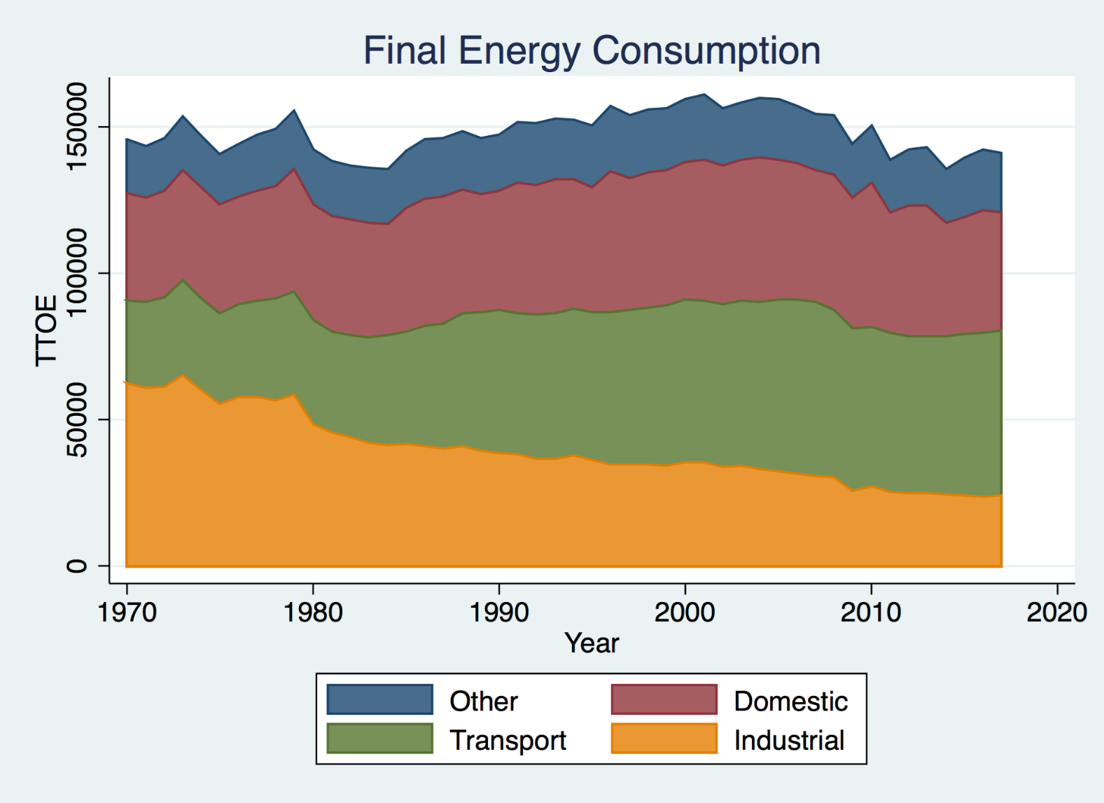
Final Energy Consumption

Slide 4
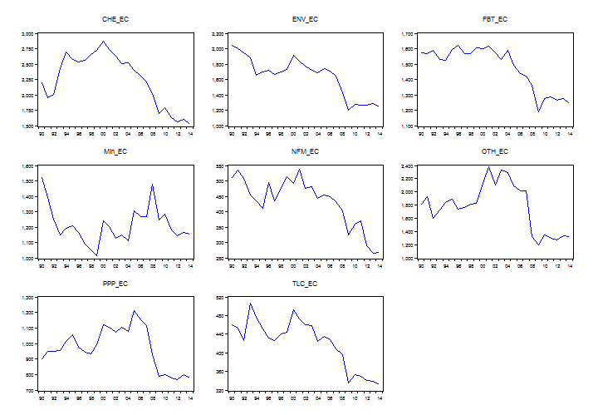
Time Pattern of Energy Consumption in Industrial Subsectors

Slide 5
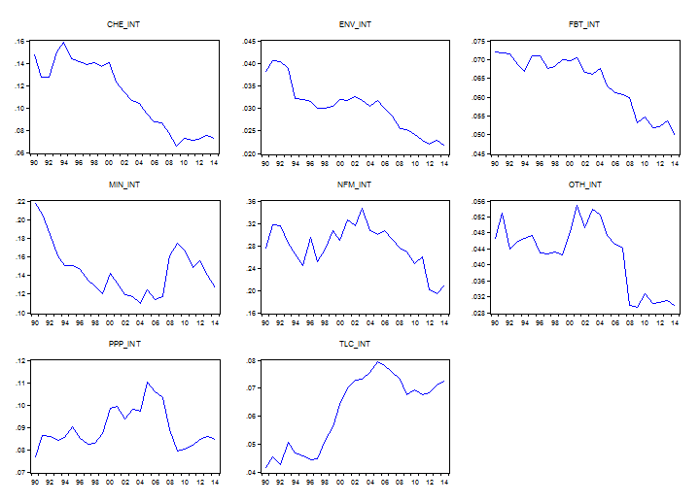
Time Pattern of Energy Intensity in Industrial Subsectors

Slide 6
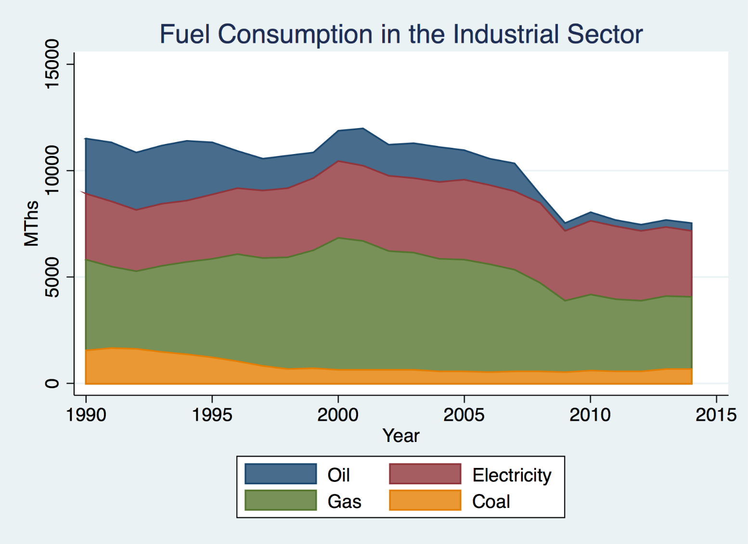
Fuel consumption in the industrial sector

Slide 7
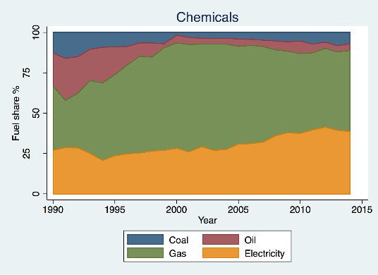
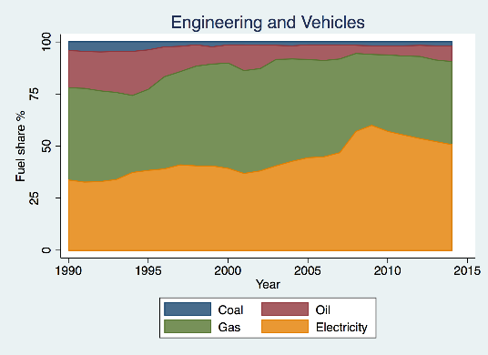
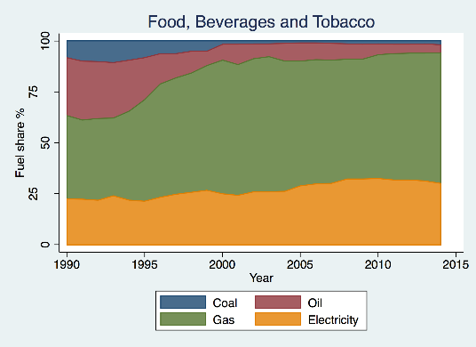
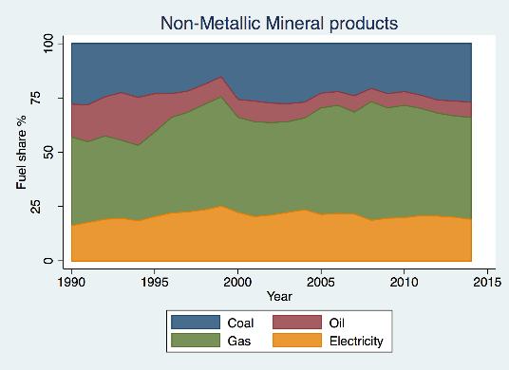
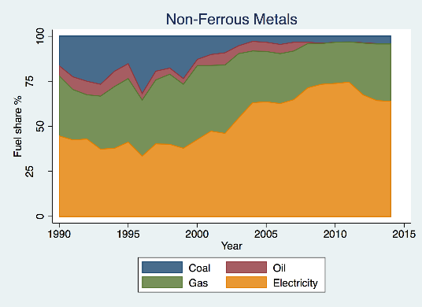
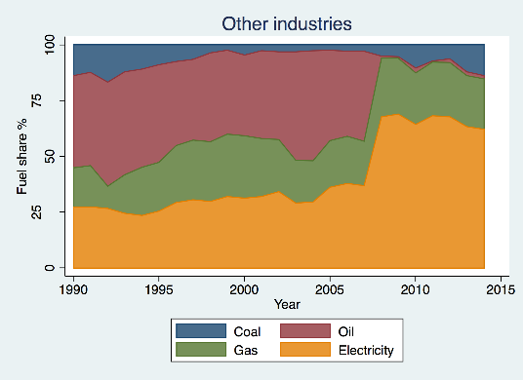
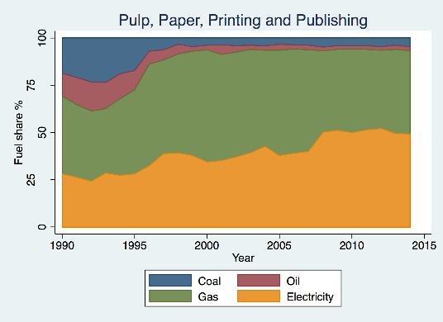
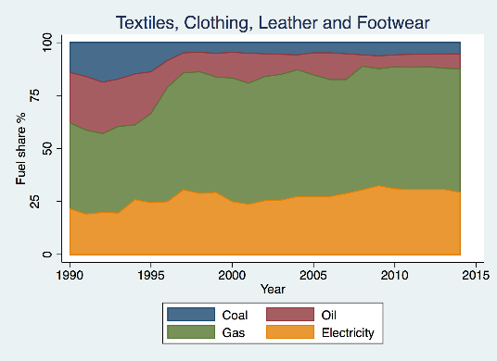
Time Pattern of Fuel Shares in Industrial Subsectors

Slide 8
Implications for our study
Sector | Description
CHE | Chemicals
ENV | Engineering and Vehicles
FBT | Food, Beverages and Tobacco
MIN | Non-Metallic Mineral products
NFM | Non-Ferrous Metals
OTH | Other industries
PPP | Pulp, Paper, Printing and Publishing
TEX | Textiles, Clothing, Leather and Footwear
As granular as possible: 8 industrial subsectors
Limited timespan as drawback: 1990-2014
Allowing both ways interaction between energy and fuel consumption
Fuel demand influence energy price through fuel consumption used as weights
Level of energy consumption proxing for scale effect in fuel demand

Slide 9
MOTIVATION

Slide 10
Our work contributes to existing evidence from a methodological and …
Heterogeneity in terms of
level of consumption and energy intensity
patterns of the variables
Aggregation bias
Difference in estimated parameters depending on the level of aggregation in the data
Findings influenced by functional relationship, extent of heterogeneity at micro-level, etc…
Magnitude of elasticities of substitution decrease with increasing levels of data aggregation (Stern 2012)
Opposite results in Blundell and Stoker (2005) and Halvorsen and Larsen (2013)

Slide 11
… empirical point of view …
Uncertainty related to values of coefficients
Changes in industrial sector composition
Further undermining aggregated approaches
Due to plausible difference in the parameters across sectors, also confirmed in our study
System approach
Well-known advantages of FIML system approach to cointegration
Data-driven approach with regard to number of cointegration relationships
No restrictions on the relationship between fuel and energy demand on one side and their determinants
Exogeneity considerations dictated by the data – particular relevant to energy consumption and GVA

Slide 12
… with clear policy-making impact leading to …
Reliable and robust estimates of price elasticity are crucial information to assess the impact of price-based regulation
Developing the Industrial component of the BEIS Energy Demand Model (EDM) used in Energy and Emission Projections
Crucial importance of price and income elasticity in the projections, as well as regulation (not addressed by our model)

Slide 13
… a number of research questions
What is exactly the value of the relevant elasticities (price, income, own-price and cross-price)?
  lack of consensus in the literature on magnitude of elasticities
  Importance of such estimates for policy
Impact of heterogeneity in energy and fuel consumption across subsectors on elasticities
  literature is dominated by studies at aggregate industrial level
  patchy evidence (due to limited data) at the disaggregated level
Are this relationships stable over the period?
  assessing structural stability across time, exogeneity and adjustment process

Slide 14
METHODOLOGY

Slide 15

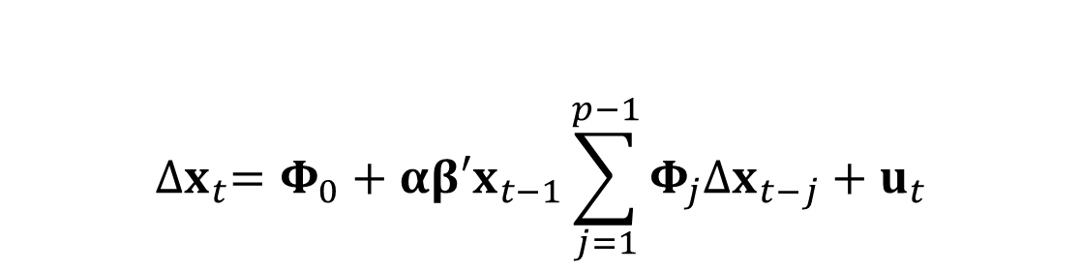
Estimation based on cointegration approach…
Standard Vector Error Correction Model (VECM) approach taking into account
Long-run cointegrating relationship ($β$)
Adjustment coefficients ($α$)
Short-term dynamics ($Φ_{j}$)
$${∆x}_{t}=Φ_{0}+αβ′x_{t−1}\sum_{j=1}^{p−1}{Φ_{j}∆x_{t−j}}+u_{t}$$

Slide 16
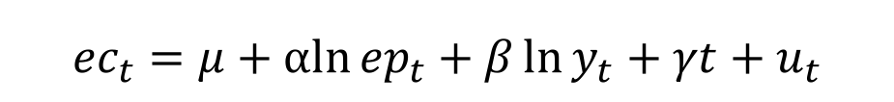
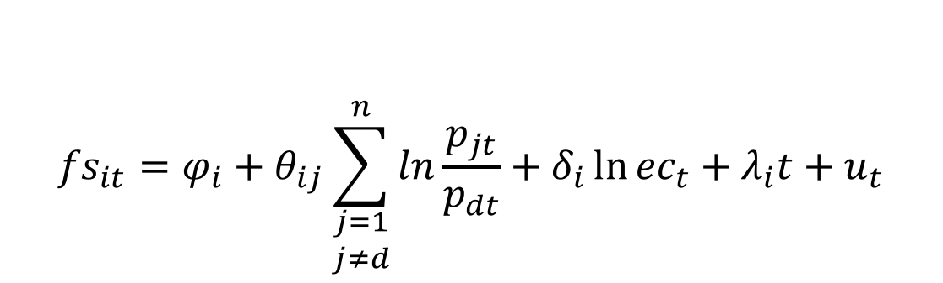
… incorporating energy demand in the first part, and the multiple fuel demand equations in the second part
Adjusted fuel share (to ensure 0-1 boundaries) as function of fuel price relative to numeraire and energy consumption (ec)
Energy consumption function of GVA (y) and energy price (ep - weighted average of fuel prices)
$${fs}_{it}=φ_{i}+θ_{ij}\sum_{\begin{matrix}j=1 \\ j≠d\end{matrix}}^{n}{ln\frac{p_{jt}}{p_{dt}}}+δ_{i}\ln{{ec}_{t}}+λ_{i}t+u_{t}$$
for each fuel i
$${ec}_{t}=μ+αln{{ep}_{t}}+β\ln{y_{t}}+γt+u_{t}$$

Slide 17
DATA

Slide 18
Using standard energy data sources
Annual data in logs over 1990-2014
Variables
  Fuel consumption: DUKES
  Energy consumption: sum of fuel consumption
  Fuel price: QEP - including carbon pricing from 2005 onwards
  Energy price: weighted average of fuel prices
  GVA: Index of production from ONS (2016)
Except for NFM, perfect match in taxonomy between DUKES and ONS
  Strong evidence for unit roots required by cointegration approach (DF-GLS and ZA tests)

Slide 19
ENERGY DEMAND

Slide 20
Contributing to patchy existing empirical evidence for industrial subsectors and to …
Micro data or data from industrial subsectors sometimes used to estimated elasticities for the industrial subsector
  Agnolucci (2009), Energy Economics
  Caloghirou et al. (1997), Energy Economics
  Christopoulos (2000) and Christopoulos and Tsionas (2002), both in , Energy Economics
Only three examples of analyses of elasticities for industrial subsectors
  Floros and Vlachou (2005) , Energy Econ
  Bjorner and Jensen (2002), Res Energy Econ
  Steinbuks and Neuhoff (2014), JEEM

Slide 21
… reducing uncertainty with regard to elasticities in the UK
Substantial uncertainty as to the magnitude of price and output elasticities in the UK (and not many studies either)
Study | Model | Estimation Period | Price | Economic activity
Hunt et al. (2003) | STSM with symmetric price | 1971 - 1995 | -0.2 | 0.71
Dimitropoulos et al. (2005) | STSM with symmetric price | 1967 - 1999 | -0.17 | 0.70
Agnolucci (2009) | Average of several panel estimators | 1978 - 2004 | -0.64 | 0.52
Agnolucci (2010) | STSM with symmetric price | 1973 - 2005 | -0.59 | 0.45
Agnolucci (2010) | STSM with asymmetric price | 1973 - 2005 | -0.65 / -0.47 / -0.37 ⁽¹⁾ | 0.48
Adeyemi and Hunt (2014) | STSM with asymmetric price | 1962 - 2010 | -0.51 ⁽²⁾ | 0.49

Slide 22
Results – Existence of cointegration
Strong evidence for 1 cointegrating vector among energy consumption, economic activity and energy price interpreted as energy demand
Results robust to approach used in the testing (Johansen and Bounds Testing procedure)
Continued with Johansen approach due to gain in efficiency
Standard diagnostics – all good (not shown here – see paper)

Slide 23
Results – value of elasticities
LR test on significance of parameters pointing at strong significance of price impact
Considerable heterogeneity with regard to the value of price and income elasticities, adjustment process (alpha)
LR test on weak exogeneity of energy price and output indicates exogeneity at 5% in all sectors but two – implausible results in OTH though
Some heterogeneity with regard to linear trend
 | y_{t} | p_{t} | trend | constant | Exogeneity
CHE | 0.48^{(*)} | -0.32^{(**)} | -0.02 | 3.87 | 0.58
ENV | 0.32 | -0.30^{(**)} | -0.01 | 4.47 | 0.11
FBT | 0.50⁽⁺⁾ | -0.17^{(**)} | -0.01 | 3.13 | 0.22
MIN | 0.36⁽⁺⁾ |  |  | 3.04 | 0.08
NFM | 1.10⁽⁺⁾ | -0.52^{(**)} |  | 1.50 | 0.93
OTH | 1.42^{(*)} | -0.78^{(**)} |  | 1.09 | ⁽**⁾
PPP | 0.24 | -0.34^{(**)} |  | 4.83 | ⁽**⁾
TEX | 0.12 | -0.44^{(**)} |  | 5.80 | 0.06

Slide 24
Results – Structural stability
Stability of cointegrating relationship based on test by Kejriwal and Perron (2010) → strong evidence towards stability
 | KP statistics | 95% CV | Notes
CHE | 4.82 | 10.88 | qb = 2, trend, trimming = 0.20
ENV | 8.99 | 10.88 | qb = 2, trend, trimming = 0.20
FBT | 15.35 | 10.88 | qb = 2, trend, trimming = 0.20, break date: 2009
MIN | 6.65 | 9.27 | qb = 1, trimming = 0.15
NFM | 8.34 | 12.27 | qb = 2, trimming = 0.20
OTH | 11.18 | 12.27 | qb = 2, trimming = 0.20
PPP | 9.39 | 12.27 | qb = 2, trimming = 0.20
TLC | 5.16 | 12.27 | qb = 2, trimming = 0.20

Slide 25
FUEL DEMAND

Slide 26
Existing empirical approaches
Methodological approaches
surprising popularity of single equation methods
Implying a number of discretionary specification choices (eg which other fuel price to include)
System approach
Implemented through mainly static translog, Normalised Quadratic cost function or Logit model
Only one example of fuel demand through cointegrating VAR
Recent implementations of cointegrating VARs for disaggregated industrial subsectors
only for electricity demand (Bernstein and Madlener 2015, Energy Econ) and fuel intensity (Møller 2017, Energy Econ)
not delivering reduction in estimated parameters through shares summing to one

Slide 27
Existing empirical evidence for gas demand
Source | Estimate | Notes
Andersen et al. (2011) | (-0.62, -0.31) | Long-run, UK, industrial sub-sectors
Bardazzi et al. (2016) | -0.82 | Italy
Burke and Yang (2016) | (-1.09, -1.00) | International
Enevoldsen et al. (2007) | -0.11 | Nordic countries
Huntington (2007) | (-0.29, -0.15) | US
Renou-Maissant (1999) | -0.65 | UK
Serletis et al. (2010) | -0.13 | UK
Serletis and Shahmoradi (2008) | (-1.50, -1.01) | US
Steinbuks (2012) | (-0.94, -0.28) | Long-run, UK, heating and all processes respectively
Suh (2016) | -0.20 | US

Slide 28
Existing empirical evidence for electricity demand
Source | Estimate | Notes
Bardazzi et al. (2016) | -0.46 | Italy
Bernstain and Madlener (2015) | (-0.52, -0.30) | Long-run, industrial sub-sectors
Bjørner et al. (2001) | -0.55 | Denmark
Dilaver and Hunt (2012) | -0.16 | Turkey
Enevoldsen et al. (2007) | (-0.28, -0.10) | Nordic countries
Jamil and Ahmad (2011) | -1.22 | Long-run, Pakistan
Paul et al. (2009) | -0.40 | US
Renou-Maissant (1999) | -0.31 | UK
Ros (2015) | (-0.87, -0.52) | Long-run, US
Serletis et al. (2010) | -0.004 | UK
Steinbuks (2012) | (-1.11, -0.23) | Long-run, UK, heating and all processes respectively
Suh (2016) | -0.11 | US

Slide 29
Results – Existence of cointegration
One fuel discarded as essentially constant across time (coal or oil)
Third fuel used as residual – as sum of shares need to add to unity
Strong and unanimous evidence for 2 cointegrating vectors among electricity share, gas share, their prices (related to the numeraire), and energy consumption (not shown here – see paper)
Continued with Johansen approach as the only approach able to handle multiple cointegrating vectors
Standard diagnostics – all good (not shown here – see paper)

Slide 30
Results – value of elasticities
Table showing
two cointegrating vectors (electricity and gas demand), own- and cross-price elasticity for each demand
heterogeneity with regard to the value of elasticities and linear trend
heterogeneity with regard to substitutability and complementarity between fuels
gas more price-elastic
gas increases with total energy, electricity falls (in almost all subsectors).
 | CHE |  | ENV |  | FBT |  | MIN |  | NFM |  | OTH |  | PPP |  | TEX
 | Ele | Gas | Ele | Gas | Ele | Gas | Ele | Gas | Ele | Gas | Ele | Gas | Ele | Gas | Ele | Gas
Electricity Price | -0.22 | -0.47 | -0.74 | -0.08 | -0.49 |  | -0.44 | 0.48 | -1.39 | 1.12 | -1.90 | 0.14 | -0.61 | 0.32 | -0.22 | -1.17
Gas Price | -0.47 | -1.37 | -0.08 | -0.71 |  | -0.67 | -0.52 | -1.68 | 1.12 | -0.62 | -0.13 | -1.31 | 1.14 | -1.61 | -1.17 | -2.40
Energy | -0.69 | 2.12 | 0.45 | 1.16 |  |  | -0.84 | 1.87 |  |  | -1.56 | 0.38 | -1.50 | 1.82 | -0.62 | 1.52
Trend |  |  |  |  |  |  | -0.01 | 0.05 | 0.04 | 0.00 |  |  |  |  | -0.03 | -0.06
Constant | 4.40 | -16.62 | -2.95 | -9.22 | -0.55 | -0.08 | 5.94 | -14.10 | 1.94 | -2.68 | 15.75 | -3.13 | 11.29 | -13.82 | 2.63 | -8.76

Slide 31
Results – value of elasticities
Very strong statistical significance of the long-run parameters
Strong evidence against exogeneity of prices and level of energy consumption
 | CHE | ENV | FBT | MIN | NFM | OTH | PPP | TEX
Own price - electricity | 4.80^{(*)} | 7.86^{(**)} | 7.88^{(*)} | 8.41^{(**)} | 7.05^{(**)} | 21.85^{(**)} | 9.31^{(**)} | 0.52
Own price - gas | 32.32^{(**)} | 12.25^{(**)} | 5.58^{(*)} | 5.26^{(*)} | 22.69^{(**)} | 16.84^{(**)} | 13.37^{(**)} | 10.64^{(**)}
Cross price | 9.05^{(**)} | 0.08 |  | 13.30^{(**)} | 5.30^{(**)} | 1.63 | 16.65^{(**)} | 17.03^{(**)}
Energy | 52.57^{(**)} | 13.03^{(**)} |  | 16.60^{(**)} |  | 44.76^{(**)} | 13.23^{(**)} | 9.00^{(**)}
Trend |  |  |  | 9.80^{(**)} | 22.39^{(**)} |  |  | 8.14^{(**)}
All | 57.97^{(**)} | 34.28^{(**)} | 9.55^{(**)} | 56.42^{(**)} | 38.58^{(**)} | 82.00^{(**)} | 40.47^{(**)} | 50.91^{(**)}
Exogeneity | 37.23^{(**)} | 26.62^{(**)} | 17.72^{(**)} | 32.51^{(**)} | 4.84 | 38.92^{(**)} | 21.53^{(**)} | 34.73^{(**)}

Slide 32
SUMMING UP

Slide 33
Summing Up (1)
Proving the validity of cointegration methods for estimation of both energy and fuel demand in disaggregated industrial subsectors
Providing an innovative, coherent and parsimonious approach to estimation of fuel demands
Using standard methodologies with standard datasets for standard taxonomy → can be replicated across (at least) OECD countries

Slide 34
Summing Up (2)
Elasticities for the aggregated industrial subsectors in line with those in the literature therefore confirming validity of those we estimated for individual subsectors
Greater than previously thought heterogeneity with regard to
  values of elasticities and linear trends,
  speed of adjustment,
  pattern of substitution and complementarity
Confirming increasing magnitude of elasticities in case of fuel demand when estimated on disaggregated data and gas being more price-responsive
Delivering key information for development of BEIS EDM and Energy and Emission projections, and therefore policy making

