Slide 1
Spatio-temporal analysis of PV diffusion patterns:
an integrated neural networks and agent-based model
Ali Alderete Peralta
Nazmiye Balta-Ozkan
Athanasios Kolios
BIEE 12th Research Conference 2018 - Consumers at the Heart of the Energy System?
Notes:
Good morning everyone, thanks you very much for coming.
My name is Ali , I´m a third year PhD student at Cranfield University. And I feel honored to present some of the emerging results of my research project.
Which focuses on the spatio-temporal analysis of the solar photovoltaic diffusion.
Our approach integrates the agent-based model and the artificial neural networks model.

Slide 2

The UK domestic PV context
PV key role to achieve government’s energy policy goals
Significant drop in PV cost and the financial incentives
Uneven spatio-temporal diffusion of PVs across the UK
Notes:
Let´s start talking about the PVs crucial role towards achieving the UK energy policy goals of the energy sector decarbonisation, security of supply and energy affordability.
In the last couple of year there´s been an rapid increase in the number of domestic PVs, as the result of the decrease in the PV cost and the introduction of financial incentives.
However, the PV spatial and temporal uptake is uneven across the UK.

Slide 3
The challenge
PVs can create reverse flows on the networks
  PV represent a key challenge for network operators
Spatio-temporal diffusion of PVs needs better understanding
  Then provide policy makers with valuable insights
Notes:
But everything comes with a price. The literature has highlighted that high concentration of domestic PVs can create reverse flows, specially at the low voltage network, representing a key challenge for the distribution network operators. As they need useful insights on how to manage and secure enough headroom for these extra flows.
Also, these insighs may help policy makers to shape policies that consider the spatio-temporal nature of the adoption process.

Slide 4
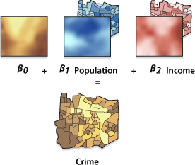
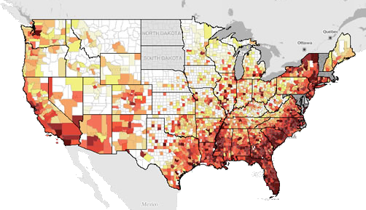
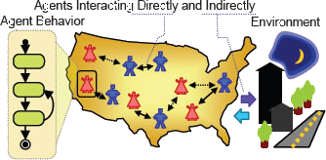
Our approach
Related work
Spatial regression | Epidemic models | Agent-based model (ABM)
Notes:
So, let move to what we already know. We found three recurrent approaches which study the PV adoption process:
The spatial regression, the epidemic model and the Agent-based model
These three approaches exhibit strengths and weakness

Slide 5
Our approach
Related work
Spatial regression | Epidemic models | Agent-based model
Deterministic influence of the independent variables | Stochastic influence (elasticity) of independent variables | Individual decision making
Social spill over effect | Social spill over effect (contagion rate) | Social peer-effect
Overlook the temporal dimension | Overlook the temporal dimension | Limited representation of temporal dimension
Notes:
Spatial regression and the epidemic model work at aggregated level, while the ABM characterise the adoption process at individual level
ABM -> uncertainty

Slide 6

Our approach
Aim
Our aim of this work is to develop an agent-based model where agents are defined as geographical areas, whilst considering the social dynamics of the adoption process.
Then, produce novel insights into potential adoption patterns that may help:
  Distribution network operators to develop better strategies to accommodate higher load
  Policy makers in designing local policies that recognise the variation of the socio-economics factors and the financial incentives
Notes:
Our approach draws from computer and complexity sciences, geographical information systems and energy economics, and using spatially explicit socioeconomic dataset.
The aim of this work is to advance the modelling of the PV adoption process, by
developing a agent-agent based model that characterise agents as geographical areas capturing the spatial dimension of the adoption process and the social influence. Hence, to address some of the limitations found in the literature.
Then, to produce insights into the future patterns of PV adoption.
**It is not enough to know the total installed capacity , but its location.

Slide 7
Our approach
Novelty
The adoption process considers explicitly the spatio-temporal dynamics of:
  Agents’ socio-economic variables
  Social effects
The agents empirically characterise the social dynamics at large scale using spatially explicit data sets
The model integrates the neural networks capability to handle time-series to improve the agents decision-making, by considering previous decisions
Notes:
From the aggregated approaches we adopted the capability to empirically characterise large populations and reduce the exhaustive data requirements of the individual approaches.
From the aggregated models the model adapts the spill over characterisations, whilst the peer-effect is adopted from the ABM.
Also, the agents characteristics follow the socio-economic variables proven to be significant for the adoption process.
Both, the social effects and the agents characteristics evolve over the time for each specific location.
Finally, in order to reduce the decision-making process uncertainty, we integrate the ANN neural networks to generate knowledge based on the data series.

Slide 8
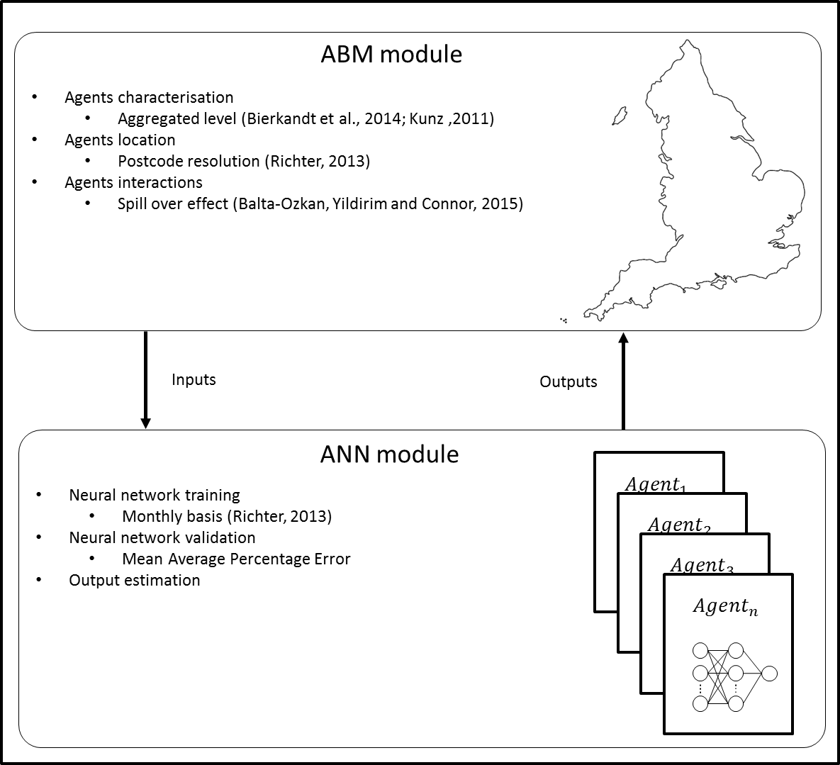
Modelling
Methodology
The model is structured in two modules: AMB and ANN module
The AMB module defines
  Agents’ characteristics
  Agents’ location
  Agents social-network
The ANN module defines
  The decision-making process
Methodological framework and information flow between the layers.
Notes:
Our model is structured in two modules, the ABM module and the ANN module.
The ABM module defines the models spatial layout where the agents location, characteristics and social network are defined.
Then, the ANN module defines the agents decision-making process. This module is embedded into the AMB module, and there are as many neural networks as agents in the population.

Slide 9
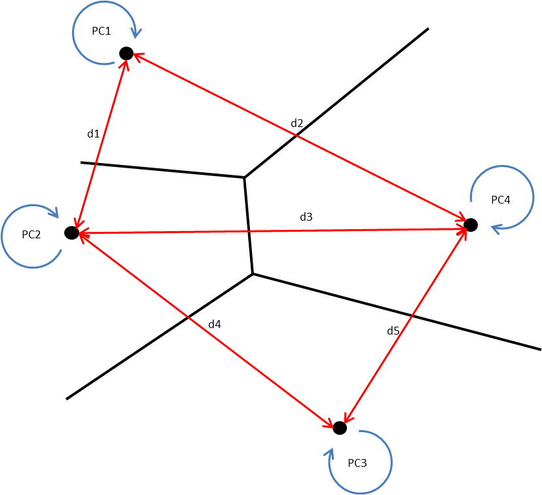
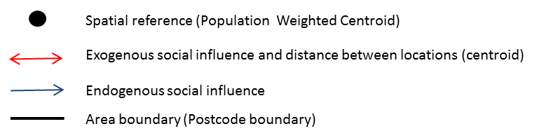
Modelling
ABM module
Agents are characterised as geographical areas
  Providing spatial accurate locations
Agents have socioeconomic data sets
  Providing an explicit temporal dimension
Social effects are characterised based on the number of PVs at each location, and these influences decrease with the distance
Characterisation of social effects and information flows.
Notes:
Agents characterisation follows the aggregate definition
Agents are geographical areas
Agents characteristics are the average socioeconomic statistics and the total number of PV at each location
The social effects are calculated based on the total number of PVs in each area at each point in time.
Socioeconomic data was retrieve from the Office of National Statistics, and the PV data from The Office of Gas and Electricity Markets.

Slide 10
Modelling
ABM module
The 49 postcodes districts of the City of Birmingham
Agents socioeconomic characteristics changes over time, and only influences its own agent’s decision-making
The peer-effect (blue line) is an endogenous influence
The the spill over effect (red line) is an exogenous
Characterisation of social effects and information flows.
Notes:
We focused on capturing the actual agents’ spatial layout. So, we characterise the 49 postcodes districts from the city of Birmingham; socioeconomic and PV data set are specific at each location.
We characterise both social effects, the spill over effect and the peer-effect. The spill over effect as the exogenous influence between adjacent locations. And the peer-effect as the endogenous influence within each area.

Slide 11
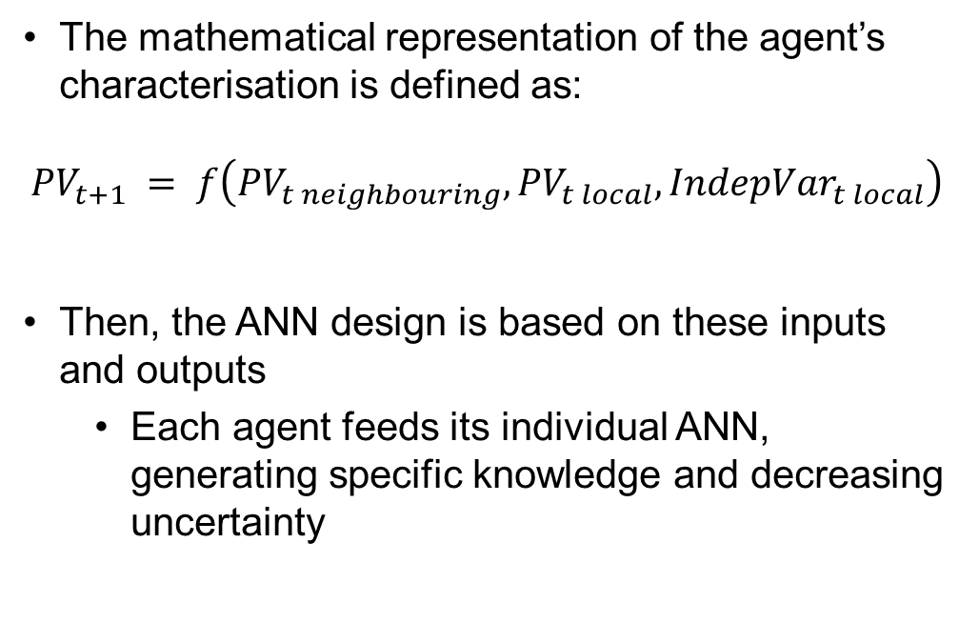
Modelling
ANN module
The mathematical representation of the agent’s characterisation is defined as:
$${PV}_{t+1} = f\left({{PV}_{t neighbouring}, PV}_{t local},{IndepVar}_{t local}\right)$$
Then, the ANN design is based on these inputs and outputs
  Each agent feeds its individual ANN, generating specific knowledge and decreasing uncertainty
Example of a three-layer artificial neural network.
Notes:
A really brief introduction to the ANN model, where we have processing units known as neurons, connected by synaptic weights, and organised in layers.
Each agents owns its individual ANN, generating specific knowledge for its decision-making.
Which is defined following the spatial regression model:
*Describe,
Then, this definition translate into our definition, where the decisions define the total number of PV at a given point in time.
Then, the ANNs are fed with this definition of inputs and outputs., where the inputs are the socio-economic variables and social effects, then the output is the total number of PVs.

Slide 12
Modelling
ANN module
Variable | Spatial resolution | Temporal resolution | Data points
PV installations | PC | Monthly | 2011-15
Income | MSOA | Weekly | 2013, 2015
Pop. Density | PC | Census | 2001,2011
% Owned household | PC | Census | 2001,2011
% Detached household | PC | Census | 2001,2011
Electricity consumption | LSOA | Annual | 2010-15
Education level | PC | Census | 2001,2011
House household size | PC | Census | 2001,2011
CO2 emissions | LSOA | Annual | 2010,2015
Initial list of variables follows the spatial econometric literature as shown next:
Final variable’s selection is alike the econometric stepwise method
Data was aggregated or disaggregated as required to reach PC and monthly basis resolution
Notes:
Now, lets talk about the agents socioeconomic characterisation
The use of spatially explicit data set allows to characterise the temporal dimension of the adoption process, by having explicit changes over the time.
Yet, available data may not be in the required spatial and temporal resolution, then the data was aggregated or disaggregated, to meet the model requirements.

Slide 13
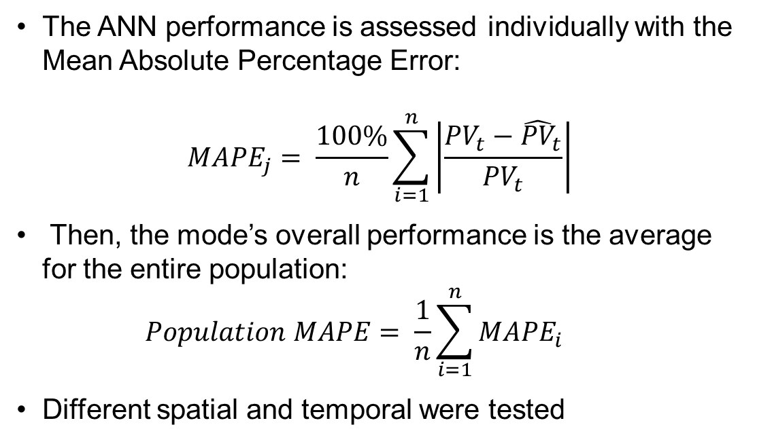
Modelling
Model validation
Iterate
Validation
The ANN performance is assessed individually with the Mean Absolute Percentage Error:
$${MAPE}_{j}= \frac{100\%}{n}\sum_{i=1}^{n}{\left|\frac{{PV}_{t}−{\hat{PV}}_{t}}{{PV}_{t}}\right|}$$
Then, the mode’s overall performance is the average for the entire population:
  $$Population MAPE= \frac{1}{n}\sum_{i=1}^{n}{{MAPE}_{i}}$$
Different spatial and temporal were tested
Notes:
Training process

Slide 14
Emerging results
Temporal validation
Estimation errors show a decreasing tendency
  Although these converge at the end of the fitting, these present some disturbance in the last quarter of 2011
The model yielded the best results, 95% of accuracy, from:
  Income
  Electricity consumption
  Average household size
Average Mean Absolute Percentage Error for the entire population over the time
Notes:
The first result to show is the temporal validation, which summarises the overall fitness of the model:
From the original list of independent variables the best results were yield from the combinations of income, electricity consumption and average household size.
**Describe graph
As we can see, errors exhibit a negative trend, and errors converge at the end of the data set

Slide 15
Emerging results
Temporal validation
Further analysis to the residual revels a strong temporal behaviour
Largest estimation errors accumulate at the last quarter of 2011
  Corresponding to the highest Feed-in Tariff rate and preceding to the latter decrease of it
Proportion of largest estimation errors by area
Notes:
Looking in detail at the residuals, we found a interesting highlight
The graph shows, for each agent, the largest of the estimation errors
About 40% of the population present a shift in its behaviour in the same point in time.
This suggest that not all the agents react to the FiT increase or decrease at the same rate and pace.
Supporting the idea of localised financial incentives.

Slide 16
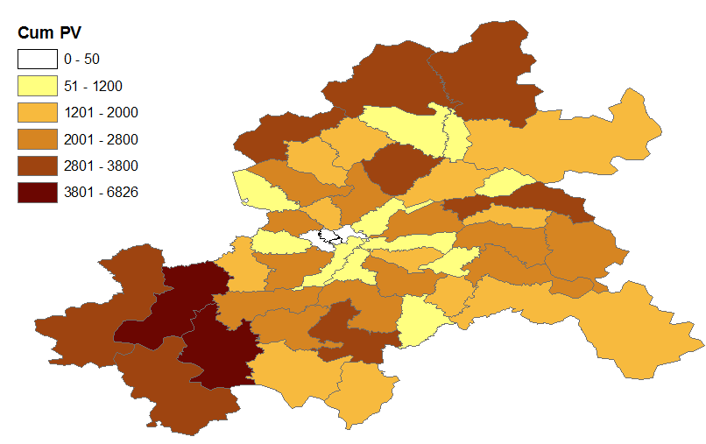
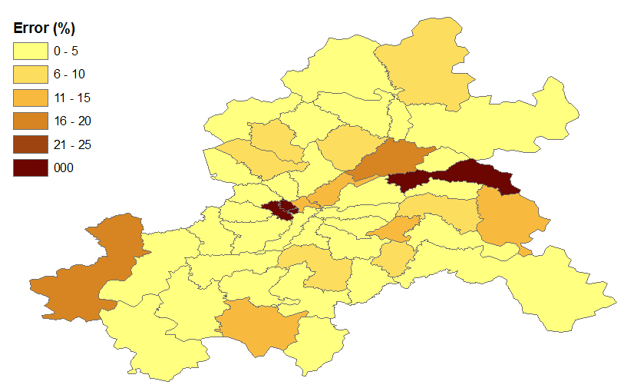
Emerging results
Spatial validation
Most of the areas present a fitness level above 90%
Largest estimation errors are present in the areas with less than five PV installations
  MAPE calculation is sensitive to any minor change in small numbers
Birmingham’s PV spatial distribution by Sept. 2015.
0 – 5
6 - 10
11 – 15
16 -20
21- 25
+25
+25%
Spatial distribution of the model’s estimation errors.
Notes:
The next result validate spatially our model, and allows the examination of the agents individual errors.
On top we have the actual spatial PV distribution 30 September 2015
Disregarding the areas with a minimum number of PVs, as we see in the central postcodes districts, the errors does not show a strong spatial patterns.
As we can see, most of the areas have a fitness greater than 90%, and lets bear in mind that the MAPE calculation is sensitive for the small numbers.

Slide 17
Emerging results
Predictive accuracy
Average MAPE accumulates, and quickly doubles by the fifth forecast
  Model performance is still at 90%
As agents decision-making considers others agents decisions, the errors accumulate not only over time but also in space
Forecasts’ Average Mean Absolute Percentage Error for the entire
Notes:
After the empirical validation, we moved to the prediction of future values of PVs.
Contrary to the fitting error, the forecasting error diverge and by the fifth forecast it doubles, yet, the average error still under 10%
It is important to note that as the agents decision-making considers other agents decision then the error accumulation occurs not only in time but in space.

Slide 18
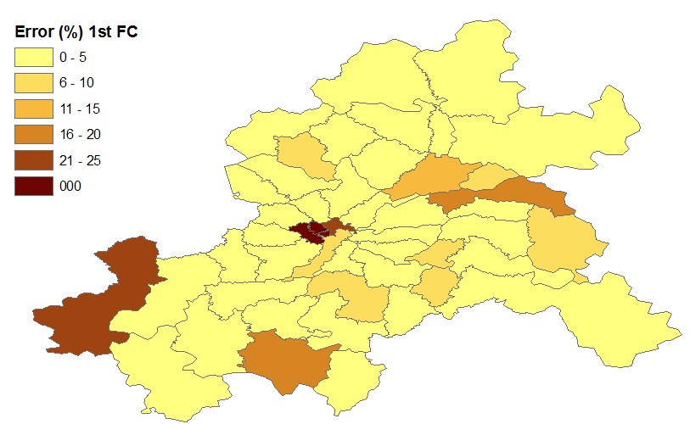
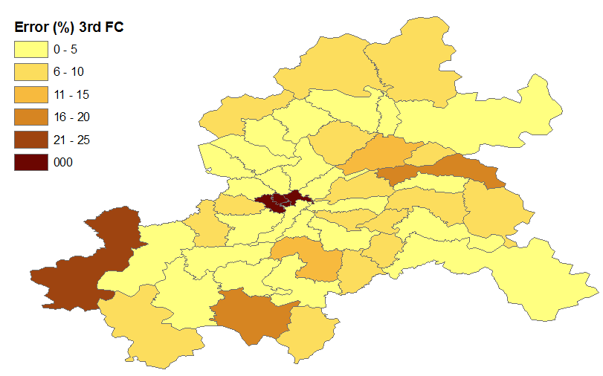
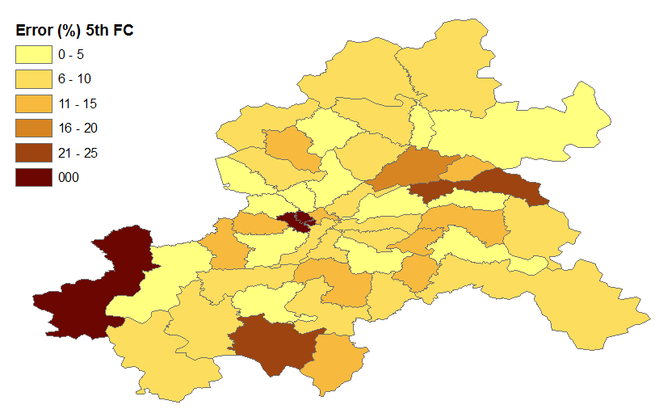
Emerging results
Predictive accuracy
The estimation errors does not follow an strong spatial pattern
During the first forecast period most of the areas have an error below 10%.
  Yet, the fifth forecast almost 30% of the agents present errors greater than 10%
0 – 5
6 - 10
11 – 15
16 -20
21- 25
+25
0 – 5
6 - 10
11 – 15
16 -20
21- 25
+25
0 – 5
6 - 10
11 – 15
16 -20
21- 25
+25
+25%
+25%
Errors spatial distribution for the first, third and fifth forecast
Notes:
Stills, as we can see there is no a strong spatial pattern for the error distribution.
However, as we reach the fifth forecast more than 30% of the areas present error of more than 10%

Slide 19

Conclusions
& Future work
Conclusions
Our work is a novel approach, which empirically characterise the PV adoption process at a high temporal and spatial resolution.
The model reduces the exhaustive data requirements that the individual level approaches require while increasing the certainty of the results
The spatial characterisation increases the degree of certainty on the agent’s location
This approach can be adopted in any ABM – not only PV ABM

Slide 20
Conclusions
& Future work
Future work
Extending the study’s scope to bigger areas or other cities
Extending the time frame by longer statistics but also high-resolution socio-economic data.
Include the FiT variable as an independent variable and confirm its impact on the errors’ perturbances shown in this study.
Produce insights for network operators and policy makers, which recognise the variation of the spatio-temporal nature of the PV adoption process

Slide 21
Thank you!

Slide 22
Any questions?
Ali Alderete Peralta
BIEE 12th Research Conference 2018 - Consumers at the Heart of the Energy System?

